Slide 1
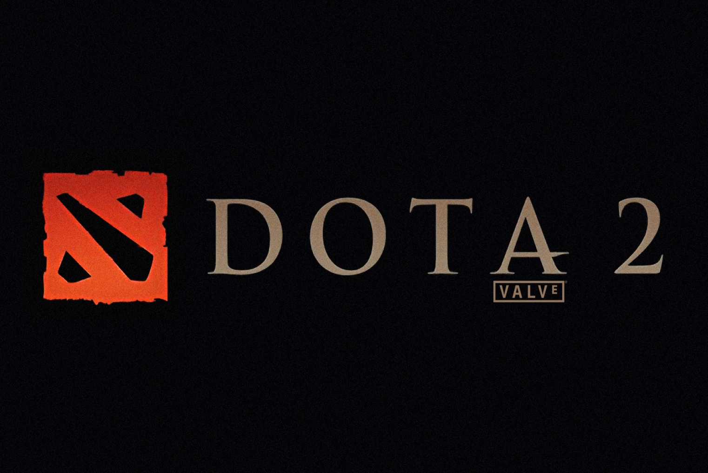
Review by: Joseph Chandler
CIS 487

Slide 2
Basic Information
DotA2
Valve Corporation
Multiplayer Online Battle Arena (MOBA)
Free to play
Microsoft Windows, Mac OS X

Slide 3
Basic Information (Minimum Hardware)
Windows XP, Vista, 7
CPU: Intel Pentium 4 (3GHz)
RAM: 1 GB RAM
HD: 4 GB free HDD space
Video Card: NVIDIA GeForce 6600 128 MB
Ati Radeon x800 128 MB
DirectX compatible Sound

Slide 4
Basic Information (Recommended Hardware)
Windows XP, Vista, 7
CPU: Intel Pentium Core 2 Duo (2.4GHz)
RAM: 2 GB RAM
HD: 4 GB free HDD space
Video Card: NVIDIA GeForce 7600 256 MB
Ati Radeon x1600 256 MB
DirectX compatible Sound

Slide 5
Game Summary
Installation
DotA2 requires Valve Corporations distribution platform (STEAM)
You really can’t get any easier, find the game in the store and download it (when it’s out of beta)
The Steam application allows you to choose where to store the game, and does the rest.
It even lets you know when it’s ready to be played!

Slide 6
Game Summary
Overview
In DotA2, the story is completely stripped away as this game is purely based on 5 vs. 5 competitions.
Players assume the role of 1 hero out of about 108 total heroes and battle the opposing team on 1 carefully designed map.
Each hero has unique abilities (4-12 abilities) which benefit the player in various ways, and require experience during the match to level up in order to “rank” up abilities.
Each player must acquire gold from killing enemy players and/or creeps in order to acquire items which give various benefits.
Players must select heroes carefully, as to fully synergize with other heroes on their team in order to beat the opposing team.

Slide 7
Game Summary
Overview (Should also mention)
DotA2 is the second installment of Defense of the Ancients, a Warcraft 3 mod.
The lead game designer (artwork) is IceFrog. The guy is a legend.. Was the orginal person working on the Warcraft 3 mod, and now employed by Valve for DotA2.
DotA2 is now a standalone game after a little dispute over the name with ActiBlizzard.
Tim Larkin and Jason Hayes are the composers. Larkin has worked on MYST, which if you’ve played it.. You know the music is godlike. Little information has been released about Hayes.
The game is entirely done in the Source engine.

Slide 8
Game Summary (More on gameplay)
One large map is divided into 3 “lanes”
Each “lane” has 3 allied towers, and 3 enemy towers.
The end of each lane is the enemy base.
Each “lane” has NPC waves of “creeps” which continue to spawn and head towards the enemy base.
The goal is to infiltrate the enemy base, and destroy their main base building in the center.
The player must continue to level his hero, equip the hero with strong items, and outsmart his/her opponent in order to gain the advantage to push towards the enemy base. All of this must be coordinated with the 4 other players.

Slide 9
Game Summary The Map

Slide 10
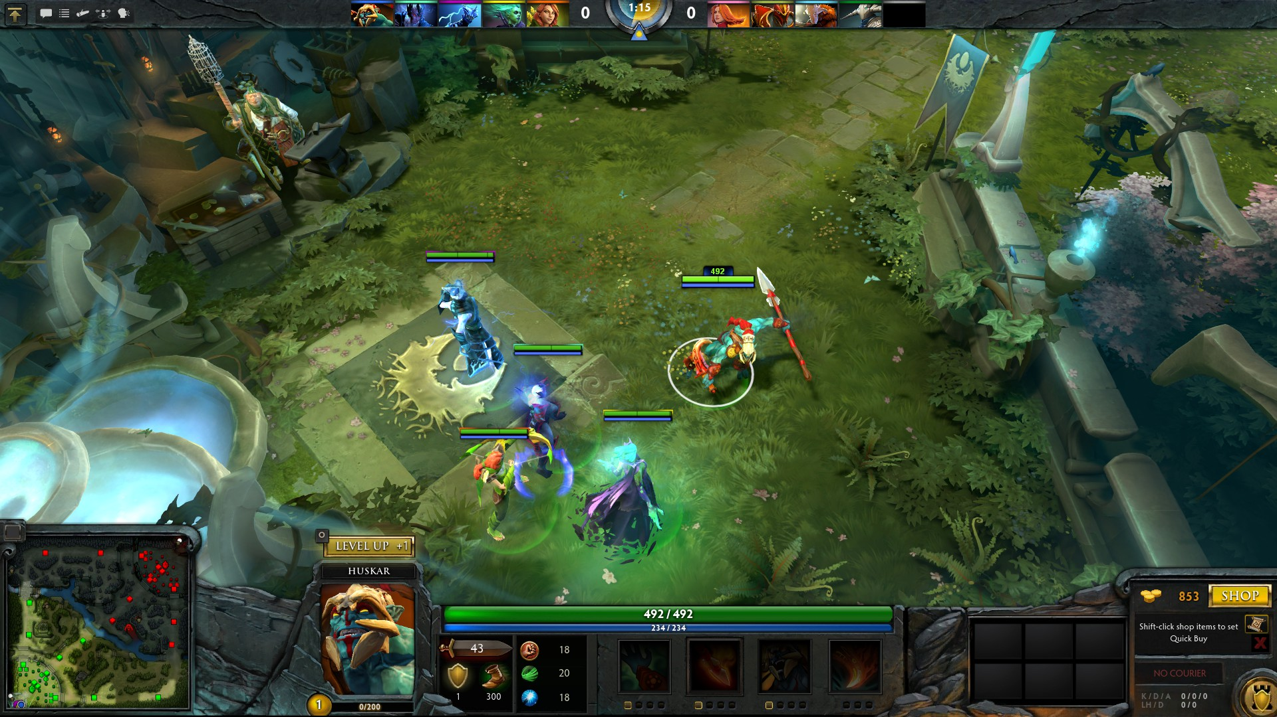
Game Summary
User Interface

Slide 11
Game Summary
In-Game item store.

Slide 12
Game Summary
Mostly everything in the game is customizable for keybindings/mousebindings.
The game has a learn tab as you’ll see on the next slide. This allows for the player to study each hero, view their abilities, and review the in game items.

Slide 13
Game Summary “Manual”

Slide 14
Game Summary (Special Features)
The game is meant to be competitive. Valve has provided the game with an amazing interface witch allows you to spectate live games.
This special feature could be talked about for hours so I’ll highlight some amazing features.
Live broadcasters in multiple languages for tournament matches.
The option to allow the broadcasters to control the camera, so you can see the action they are commentating on.
Live, on the fly, in game statistics about various components of the game.
Allows for full interaction with the client while watching.
Saved game replays.

Slide 15
Game Summary (Special Features)

Slide 16
Game Review
The Good?
The game has been in beta for so long that it is absolutely ironed out. Balancing issues are non-existent with team compositions and hero drafting which allows for banning of heroes before the start of each match.
The game is absolutely free to play, where their revenue comes from community based art derived enhancements to the heroes. (Even the people get a cut of the money who make the new items.)
Every hero released is free to everyone, and no items are anything more than cosmetic. This ensures the game does not turn into a pay-to-win scheme.
Hours can be spent just watching some of the highly skilled matches, this drives the entire community to get better.
The controls are very crisp and customizable.

Slide 17
Game Review
The Good? More?
The artwork and sound effects help keep the player really into the action.
The level design has been play tested millions of times, and there are absolutely no advantages to starting up top or at the bottom.
The game is a very tight functioning framework, which allows players to develop the game experience on the fly.
The game is purely skill/knowledge based(Fair).
Players are allowed to create their own lobbies and play against bots in order to learn.
The depth of this game is so large, that it makes mastering it feel like a true accomplishment. Plus the ultimate reward is real money, up to 1.5 million USD.

Slide 18
Game Review
The Bad. ☹
With all of the good comes an insanely steep learning curve.
New players will feel overwhelmed.
The camera angle, click to move style of play is hard to get accustomed to, as well as it does not feel intuitive if you’re not familiar with Real Time Strategy games.
A vast base of knowledge is required in order to play with the community.
Mistakes are punished, hard. Very unforgiving. Which can lead into team mates becoming angry at new players.
As with most competitive games, many in the community hate losing, yet one team will always lose each match. For some, an emotional burden of losing, as well as screwing it up for the team can be too heavy to bear and limit the “fun factor.”
Each game takes around an hour in order to complete. Leaving early is frowned upon in the community as losing a player almost always means a loss for the team. This game requires a concrete amount of time dedicated to it.

Slide 19
Game Review
Similar Games?
League of Legends vs. DotA2 (LoL essentially copied off of DotA)
LoL is the industry standard right now, due to the fact that DotA2 is still not widely available.
LoL’s competitive interface is nowhere near as nice or nurturing as Valve’s.
The artwork feels a little too cartooney to some.
The controls are not nearly as customizable, nor as fluid feeling as DotA2.
The character responsiveness is much slower than DotA2, which is huge in competitive gaming.
LoL feels like a cash cow, each “Champion” costs money, and with every new champion there are major balancing issues, as well as some champions becoming obsolete(which people pay money for).
LoL has a rune system, which to many, feels like pay-to-win. These give slight advantages to the account holder as they gain account experience.

Slide 20
Game Review
Similar Games?
SMITE vs. DotA2
This isn’t really a fair comparison, as SMITE puts the player into the third/first person mode into the mix.
It shares the same style of tactics, as in a 3 lane map, but on a smaller scale, and the player chooses Gods which all have unique abilities that require leveling up.
SMITE uses familiar First Person Shooter controls to control the God.
SMITE has a lot to do in order to foster the competitive attitude that many enjoy from this MOBA genre.
SMITE is much more newbie friendly, although the community appears to be rejects from the harder games like LoL and DotA2.

Slide 21
Game Review
Appropriate Audience
DotA2 is definitely geared towards hardcore gamers.
People with intense passion to compete, a lot of time to dedicate, and the desire to perform under intense pressure.
People who enjoy being the content, rather than being shoveled new disposable content every month.
Not for people who want something to just waste a few minutes of their time.

Slide 22
Game Review
Design mistakes
I’m in the minority who thinks this, but I feel the camera angle/view is slightly too zoomed in. It would be nice to see more of the action.
While the game uses fog of war in order to limit viewing distance, as well as allows for terrain to limit it, it would be a much more pleasurable experience to see a slight bit more of the battle field.
In the “Learn” tab, you can view youtube clips of each heroes abilities. While the videos are played within the game browser, they still feel separate from the game browser. They should feel more streamlined(I hate that word) into the game application.

Slide 23
Summary
Strengths
A fully functional and concrete framework to allow players to make their own competitive experiences.
Amazing features to foster competitive play.
Outstanding success involving the community by allowing for people to make cosmetic items. If they’re good, and selected to be official, the person makes 50% off of the items sold.
Every detail for the scope of their game, is there.
A business model which does not intrude on the game experience.

Slide 24
Summary
Weaknesses
Must be played online.
Is not newbie friendly.
Requires a large time investment to be competitive.
Requires a static amount of time for each game played in order to not be shunned from the community.

Slide 25
Summary
Is the game worth purchasing?
Well, it’s free when it releases, or, you can buy into beta for $30(Includes various cosmetic items)
So, if you’re the target audience, yes. If you don’t know, download the spectator client and watch some games first. Not only will you get an idea of how the game is played through it’s various stages, but whether or not it looks enjoyable to you.
Or, when the game is released, download it, and create a bot match lobby and try it out for a few hours.

Slide 26
Summary
Improvements
Unfortunately with how narrow of a scope they have to have for this game in order to keep the community backing, the best improvement is to not continuously improve it. While Valve is amazing at being god like, nobody wants to be a Blizzard and screw up a game as bad as they did with Diablo 3.
While I’d be happy with a slight zoom out on the character perspective, 95%(fake statistic) of the community would be angered by it.

