Slide 1
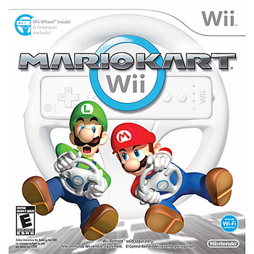
Mario Kart Wii by Nintendo
Game evaluation by:
Anthony Walker

Slide 2
Basic Information
Company Name: Nintendo
Author: Nintendo Entertainment Analysis and Development
Type of game: Racing
Price: $49.99 (includes steering wheel)
Minimum H/W requirements: Wii console, Wii Remote
Actual H/W requirements: Wii console, Wii Remote w/ Nunchuk or Wii Remote or Wii Remote w/ Wii Wheel or Classic controller or Nintendo GameCube controller

Slide 3
Game Summary
There are four game modes to choose from to race in: Grand Prix, Time Trial, Versus and Battle
All modes are playable by a single player with the Versus and Battle modes being the only multiplayer modes
The role of the player(s) is to win each race they drive (progressing through the game unlocks more characters, vehicles and courses
The artwork, sound and music in the game are good (not boring or annoying at all)
The user interface is simple (you can change the settings to make it more challenging for more advanced players)
Copy and paste the following link to a browser to view the trailer: http://www.nintendo.com/games/detail/O8zz_eN8oGRK9ApOgJ86zbE6zRv3pdB2

Slide 4
Scoring
Grand Prix and Versus modes (12 racers total)
1st place: 15 points, 2nd place: 12 points, 3rd place: 10 points, 4th place through 12th place: 8 points to 0 points respectively
Time Trial mode (1 racer)
Race through a course to break the existing time record
Battle mode
The person (single player) or team (multiplayer) with the most points wins

Slide 5
Game Review
What’s fun about it
Various courses and levels of difficulty
Being able to use your Mii (character you created) as the driver
Why it’s fun
Additional levels are unlocked based on how successful you are on the courses that are available
Pretty cool to be able to use the character you created instead of using one of the Mario characters

Slide 6
Game Review (cont.)
What’s not fun about it
Having objects thrown at you with no way to defend against it
Falling off the course
Why it’s not fun
When you’re in the lead it often knocks you back a few places (this is only fun when you’re not in the lead)
Frustrating when you’re not familiar with the course, forget about the sharp turn or get confused on which direction you should be going in

Slide 7
Game Review (cont.)
Comparison to similar games
I feel it’s better than other games because there are opportunities to throw off the people in front of you if you’re not in the lead which gives you the chance to compete for position by means other than just hoping to catch up
Target Audience
Anyone ages 6 and up
No design mistakes noticed

Slide 8
Summary
Mario Kart is a game worth purchasing (especially with the inclusion of the Wii Wheel)
Overall Strengths
1 to 4 players
The ability to throw objects at the leader to give you a chance to come from behind
Courses reflect those from other Mario games
Overall Weaknesses
Having objects thrown at you when you’re in the lead without a way to defend yourself
Areas for improvement
Allow a way to defend yourself when items are thrown at you

