Slide 1
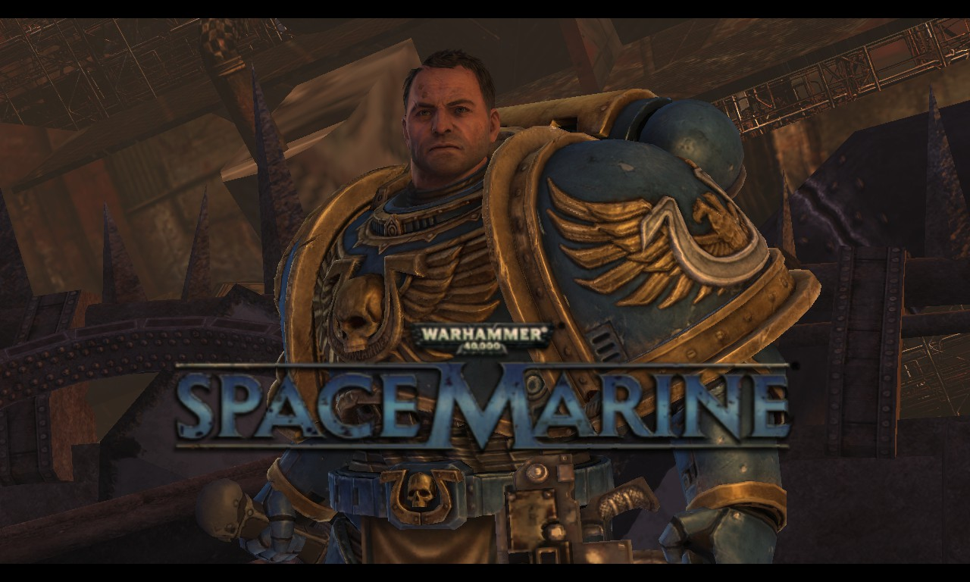
Reviewed by:
Damian Strong

Slide 2
Basic Information
Game title- Warhammer 40k: Space Marine
Company & Author: THQ
Type of game: Third Person Shooter
Price: $49.99 (on Steam)
Genre: Action
Release Date: September 6, 2011

Slide 3
Hardware Requirements
Stated:
OS: Windows XP SP3, Windows Vista SP1, Windows 7
Processor: 2.0Ghz Dual core CPU (any Core 2 Duo or AMD X2 or better)
Memory: 1GB (XP), 2GB (Vista), 2GB (Windows 7)
Graphics: 256MB Video Card using Shader Model 3 (Nvidia GeForce 8800GT, AMD Radeon 3850 and above)
DirectX®: 9.0c
Hard Drive: 20 GB space free (10 GB free after install)
Sound: Laptop and Notebook users will need to download the newest Nvidia 280.26 or AMD Catalyst 11.8 drivers.
OS: Windows 7
Processor: Any Quad-core Intel or AMD Processor
Memory: 1GB (XP), 2GB (Vista), 2GB (Windows 7)
Graphics: 512MB Video Card using Shader Model 3 (Performance equivalent to an AMD Radeon 5750 or better)
DirectX®: 9.0c
Hard Drive: 20 GB space free (10 GB free after install)
Sound: Laptop and Notebook users will need to download the newest Nvidia 280.26 or AMD Catalyst 11.8 drivers.

Slide 4
Game Summary
Story line –You are a Super human Soldier in the 41st millennium entrusted in stopping an alien invasion of a planet important to humanities continued survival.
Player's role- Elite super Human Soldier, Savior of mankind
Installation- install steam from steampowered.com, purchase game from steam, click install on steam, wait for game to download and update, click play.
Game Play- Fast paced third person shooter, high levels of gore and Death, recover health by performing special executions on stunned enemies in close combat.
Scoring- Multiplayer only, earn exp for kills and achieving objectives
Sound and Music- Gothic styled rock music. The sounds of death and combat.
Special features- Switch seamlessly from close combat to shooting, competitive online multiplayer for up to 16 people, achievements, voice chat, heal by performing executions.
No Manual

Slide 5
User Interface
Health Bar along top with points earned below.
Top right shows recent kills, who killed whom, and with what weapon
Bottom right shows current weapon, ammo, and war gear remaining
Bottom left shows nodes controlled, and current teams scores.
Reticule in center to show current accuracy and where the player is aiming
On screen indicators show current status of objectives and location.
Skulls indicate friendly players death

Slide 6
Bugs
Enemies fall through geometry or get stuck in walls.
Execution button does not react to some stunned enemies.
Player can get stuck in geometry after performing a ground slam with jetpack.
Player floats in air while performing execution on an enemy near a cliff edge.

Slide 7
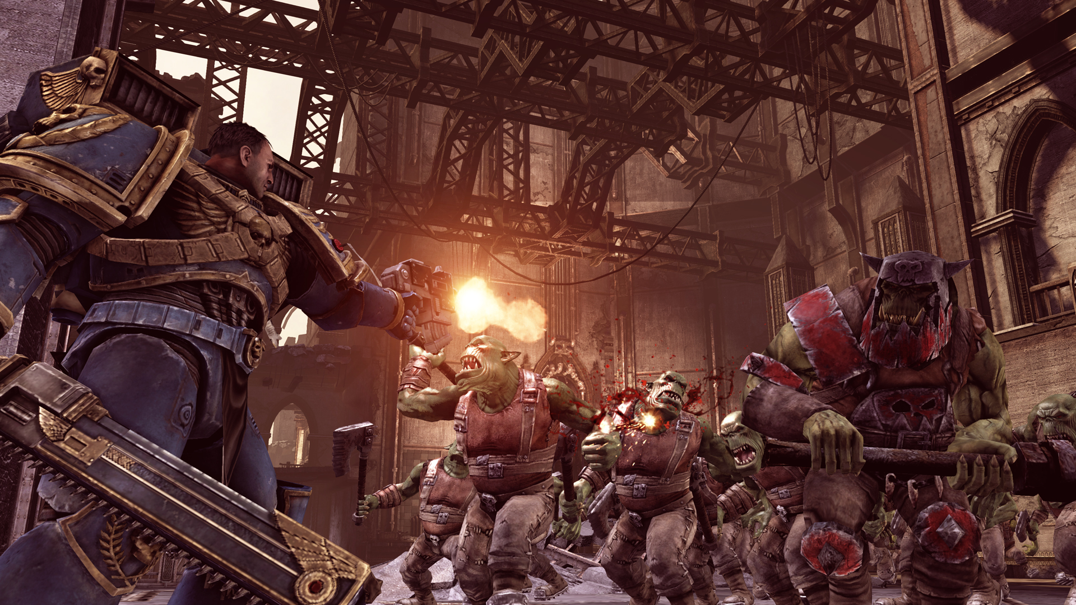
Game Review
Good:
Game is true to the 40k universe it’s based on.
Game gives both a good feel of the sheer weight and power of protagonist
Allies never over shadow the player
Space marine shines in the genre alongside gears of war without being a clone. It does not rely on cover but the sheer raw power and skill of the player to overcome amazingly one sided odds.
Audience: Fans of Warhammer 40k, Fans of third person shooters and any FPS
Bad
Only 2 Multiplayer game modes
No option for Co-Op play.
Fury system seems unnecessary
Still take damage while performing executions.
Noticeable static in audio
No mute button for voice chat.

Slide 8
Summary
Could be improved with additional multiplayer modes, addition of Co-op online, addition of a survival multiplayer mode, addition of orks as playable characters in multiplayer.
Definitely a must have for fans of both the 40k series and 3rd person shooters.
Strengths: Face paced gory action to sate anyone's blood lust.
Online multiplayer
Excellent single player storyline and with achievements make it worth playing again and again.
Character customization for multiplayer is fun and gives a player an individual identity among the masses
Weaknesses: Requires a fairly decent computer to run smoothly.
Lack of additional multiplayer modes.
No mute button means players get to listen to what is on someone else's TV at home.

