Slide 1
SpaceChem
A Game Review

Slide 2
SpaceChem
Developer: Zachtronics Industries
Genre: Puzzle
Price: $14.99
Hardware Requirement
OS: Windows XP SP3 / Vista / 7 (As Reviewed)
Processor: 2.0 GHz Processor
Memory: 1GB RAM
Hard Disk Space: 300MB
Video Card: frame buffer support recommended

Slide 3
Overview
Given chemical inputs, generate the required compounds.
Design a machine using various commands to accomplish this.

Slide 4
Story
Minimal story told through vignettes after beating certain stages.
You are a new reaction engineer and strange things are happening.
Giant Pyramids, Squids, and people going insane?
Fishcakes.

Slide 5
Player Role
Designs reactions given input compounds and required outputs
Player takes on the role of a new reaction engineer of the SpaceChem corporation.

Slide 6
Installation
Installed through Steam.
Also available on the Ubuntu store and directly from Zachtronics Industries.
Coming soon to iOS.

Slide 7
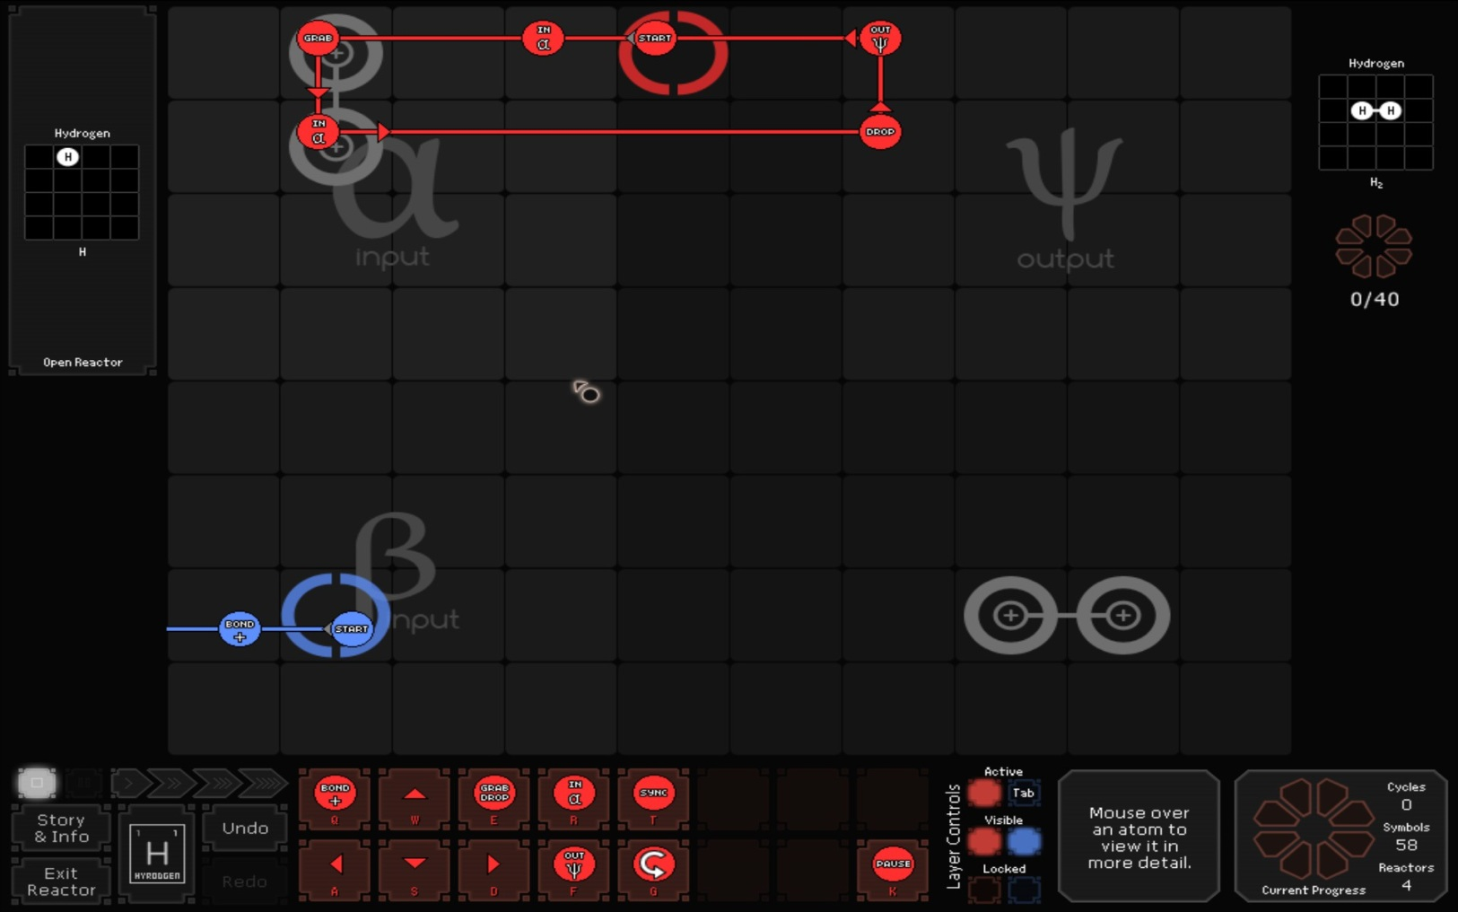
Interface - Reactor

Slide 8
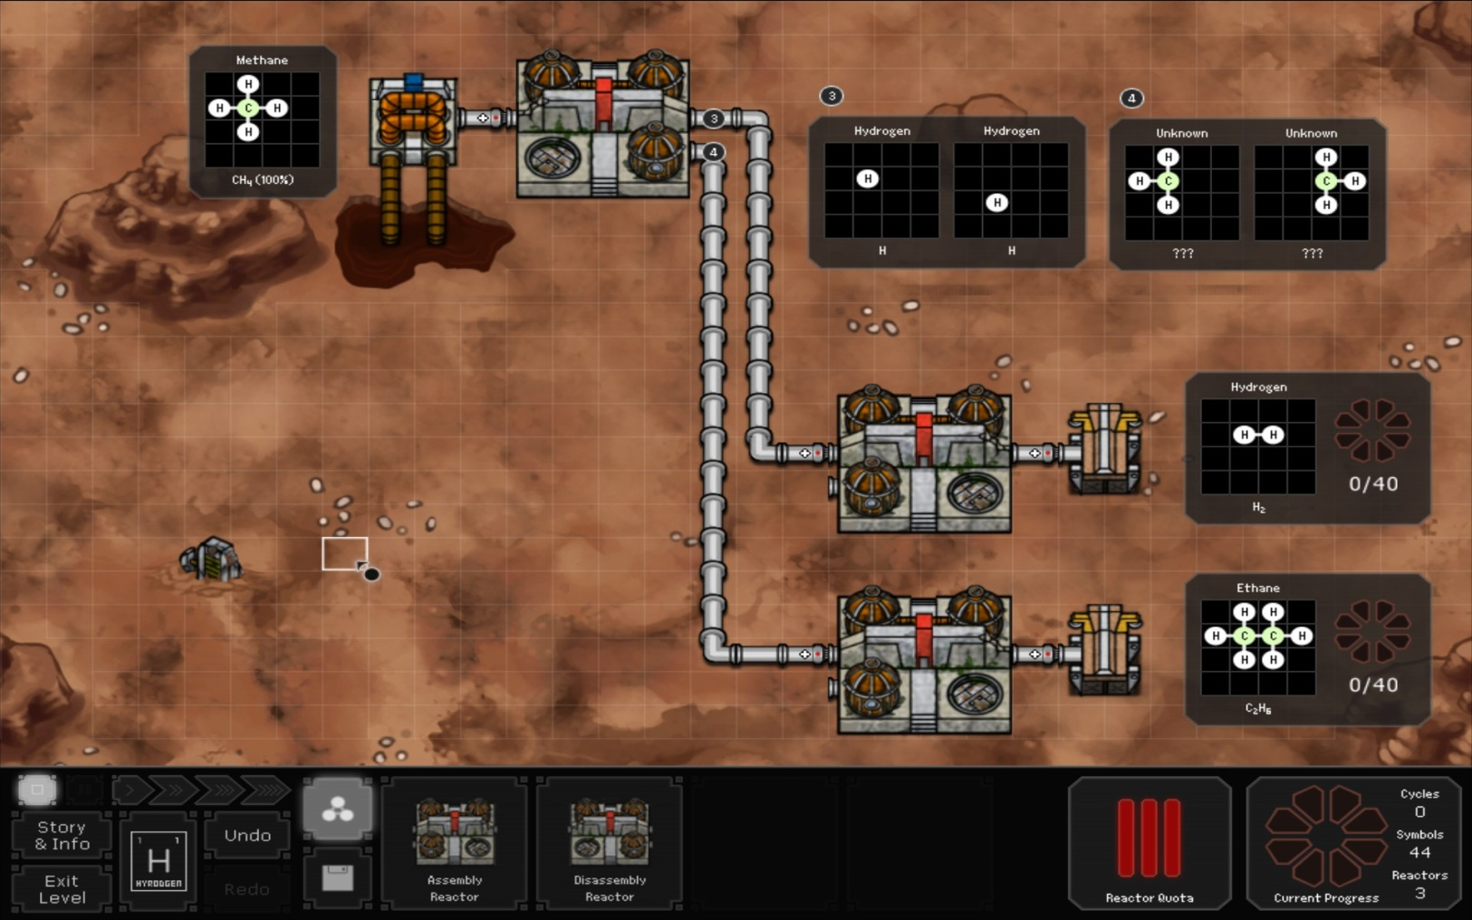
Interface - Production

Slide 9
Gameplay
Easy
Medium
Hard
OMG, My Brain Just Melted

Slide 10
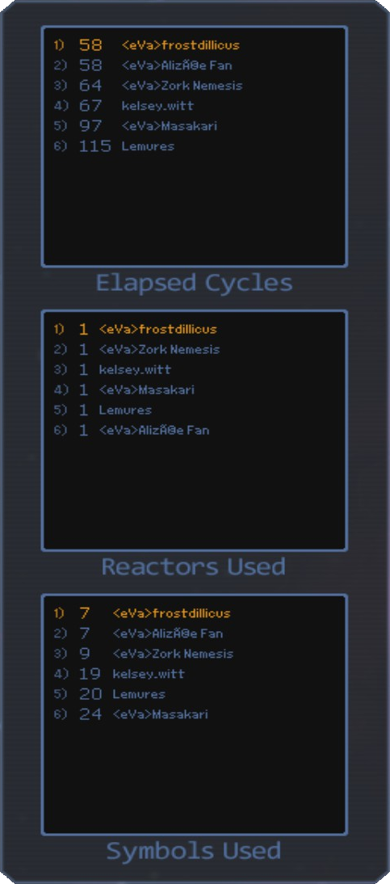
Scoring

Slide 11
Artwork
Very simple artwork even for production levels.
Animation is quite fun to watch.
Good use of color to differentiate what is going on during a reaction.

Slide 12
Sound and Music
Music is very catchy, yet laid back enough to not get on your nerves.
Sound is well designed and appropriate for the conditions.

Slide 13
Special Features
Research Net provides the Journal of Reaction Engineering. Regularly released new Puzzles.
Ability to create your own puzzles and share them with friends.

Slide 14
Game Review
My Thoughts

Slide 15
The Good. Why is it fun?
Very unique puzzle game.
Challenging puzzle progression.
Keeps you thinking about puzzles long after you shut down the game.
Built in YouTube solution recording.
Combination of Chemistry and Space!

Slide 16
The Bad. What is not fun?
Debugging complex reactions can be tedious.
No way to rewind a reaction to see what the state was before it crashed.
Sometimes you get very few research tasks to prepare you for complex production tasks.

Slide 17
SpaceChem outside the Vacuum.
Puzzle genre is very popular. Why SpaceChem?
SpaceChem is a unique blend of science and puzzle.
No “right” solution to any problem.

Slide 18
Audience
Game is Rated E.
Very reliant on critical thinking and logic.
Difficulty scales to a point where it might be too difficult for children.

Slide 19
Design Mistakes
Debugging complex reactions can be quite difficult.
No rewind function for reactions.
When a reaction crashes, you can not look at the other reactors during production.

Slide 20
Summary
SpaceChem! Waldos! Fishcake!

Slide 21
The Good. The Bad.
Weaknesses
Strengths
Debugging complex reactions is very difficult.
Production can stall and you have no idea why.
Innovate puzzles.
Addictive gameplay.
Extensible through Research Net.

Slide 22
Should you buy SpaceChem?
Well, should you punk?

Slide 23
YES

Slide 24
Robin Walker even thinks so.
“Pretty much the greatest game ever made.” – Robin Walker

Slide 25
Improvements?
Add a rewind feature after a reaction has crashed.
Allow players to step through reactions much like a Debugger does.

Slide 26
SpaceChem!
Any Questions?
Comments?
Desire to eat Fishcake?

