Slide 1
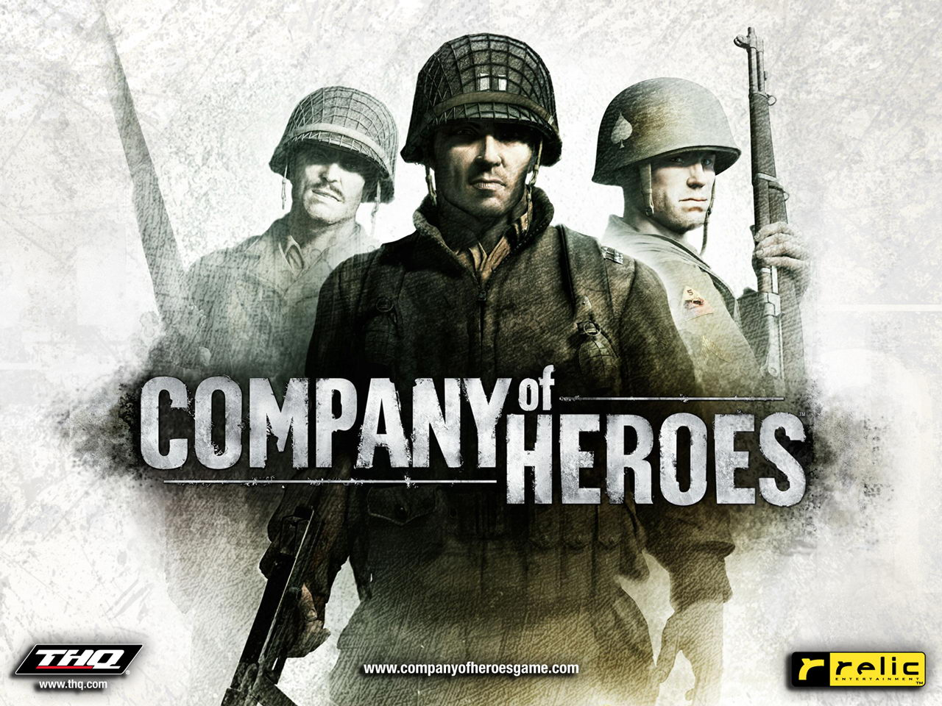

Slide 2
Company of Heroes
Developer: Relic
Publisher: THQ
Type: Real Time Strategy
Platform: Windows
Price: Around $10
Free Version: Company of Heroes Online (Game play is slightly different)

Slide 3
Hardware Requirements
Minimum System Requirements
System: 2 .0 GHz Intel Pentium IV or equivalent
RAM: 512 MB
Video Memory: 64 MB
Hard Drive Space: 6500 MB
Recommended System Requirements
System: 3.0 GHz Intel Pentium or equivalent
RAM: 1024 MB
Video Memory: 256 MB
Hard Drive Space: 6500 MB

Slide 4
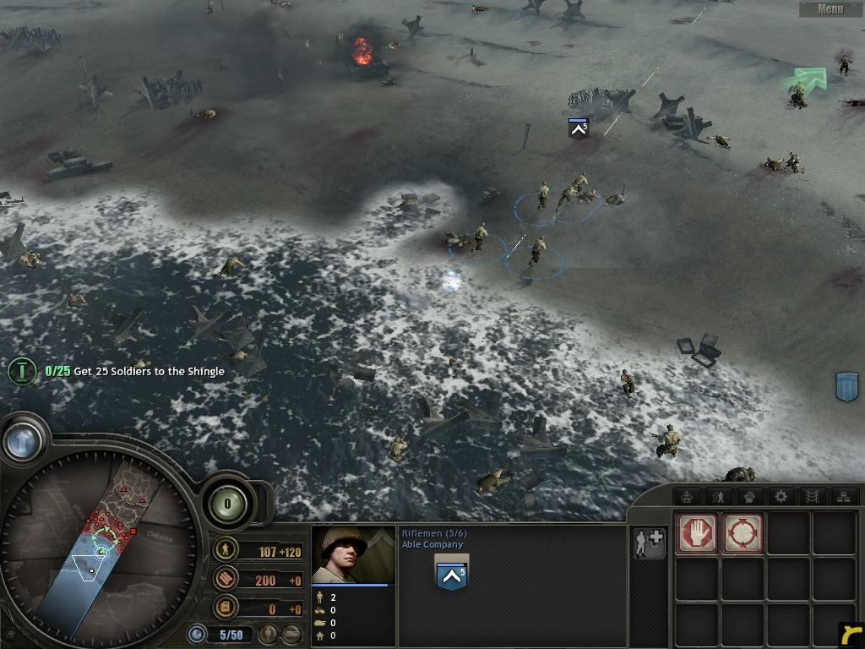
Quick Overview
World War II, D-Day Invasion
Factions
American
British
German
Panzer Elite
Single Player Campaign
Multiplayer
Expansions
Opposing Fronts
Tales of Valor

Slide 5
Story
D-Day Invasion
Able Company’s assault on Omaha Beach
Battle of Carentan
Fox Company’s capture and defense of Carentan
Battle of Cherbourg
Able and Fox Company’s advance to the deep water port
Operation Cobra
Able Company’s attack on Saint-Lö
Operation Lüttich
Able Company’s defense at Mortain
Falaise Pocket
Destruction of the German Seventh Army

Slide 6
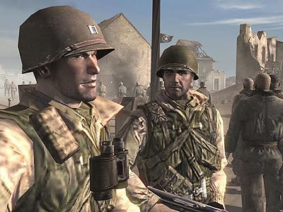
Characters
Captain John MacKay
Command of Able Company
Sergeant Joe Conti
Game Narrator
Second-in-Command of Able Company
Hauptmann Joseph Gunter Schultz
Tiger Ace Tank Captain

Slide 7
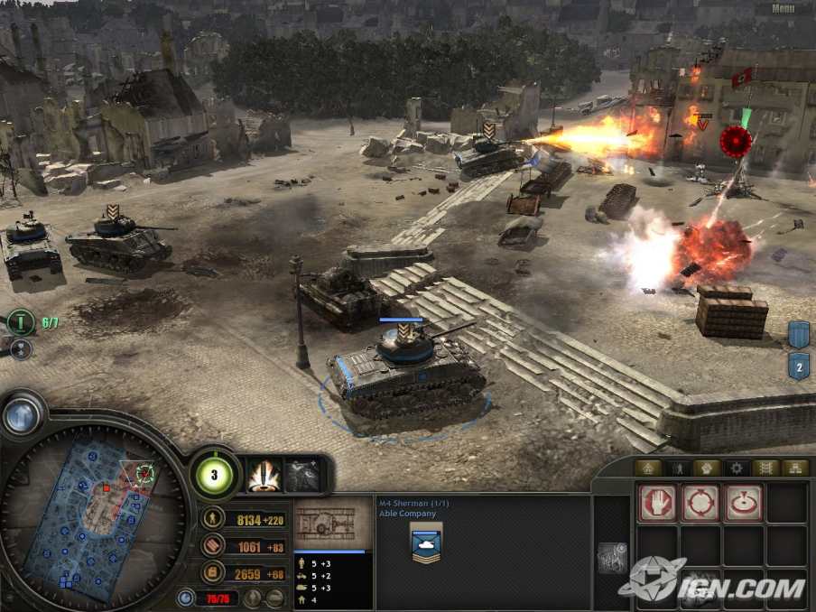
Player’s Role
Single player
Control two U.S. Military Units
Battle of Normandy
Allied Capture of France
Able Company (Infantry)
Fox Company (Airborne)
Multiplayer
Axis vs. Ally (Two Game Modes)

Slide 8
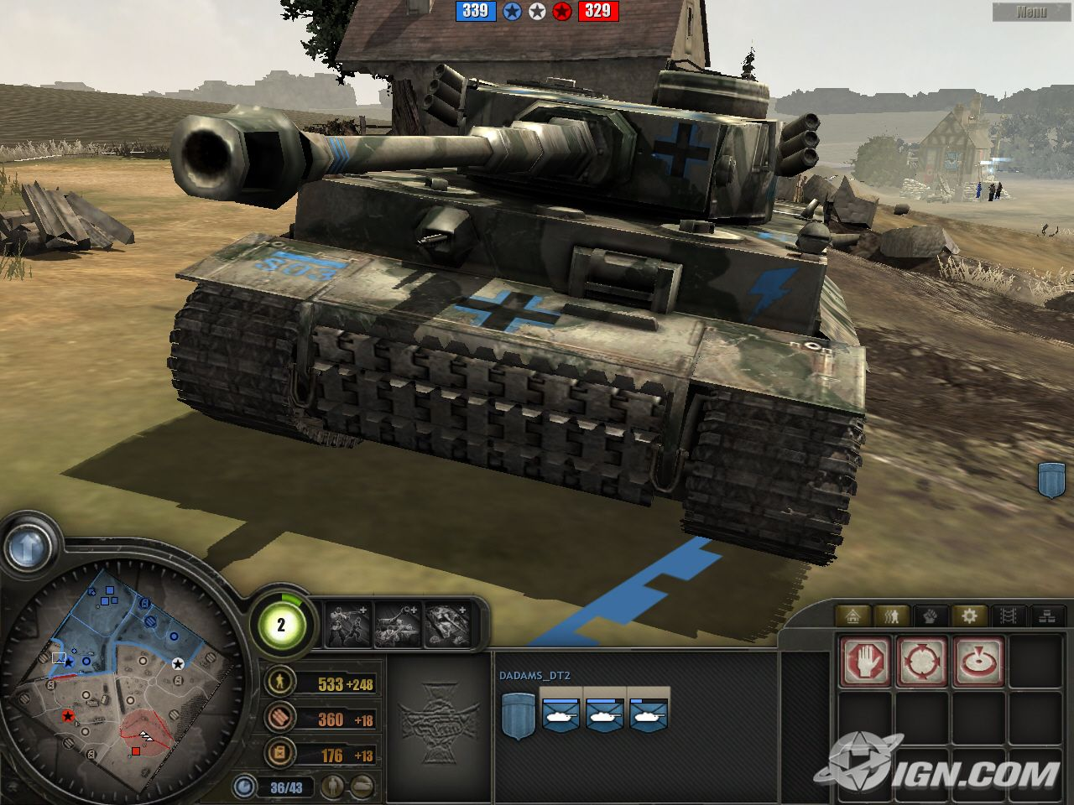
User Interface

Slide 9
Game Play
Resources
Man Power- necessary to produce all units
Munitions- upgrade squads or vehicles and use abilities
Fuel- purchase tanks and other vehicles
Buildings
Units can garrison in city or town buildings and convert it into field barracks.
Americans- barracks, weapons support center, motor pool, tank depot, triage center, supply yard, etc.
Germans- Wehrmacht quarters, Krieg barracks, Sturm armory, Panzer command, Kampkraft centre
Units
Infantry
Support
Vehicles

Slide 10
Game Play… Continued
Combat
Activated support actions
Units have different fighting abilities
Vehicles have target weak spots
Micromanagement of troops such as reinforcing, taking cover, salvaging wrecks, picking up weapons, rigging bridges, etc.
Combat outcome is a result of tactical deployment and battlefield terrain rather than mere unit composition and volume.
Strategic Points
Marked points on map (Man Power, Munitions, Fuel)
When captured, you generate the marked resource
Able to upgrade to produce 40% more resources and increase defense
Since winning the game comes down to controlling these points, both sides are forced to constantly expand which creates constant battle.

Slide 11
Scoring
Victory Point Control
These games focus on controlling several victory points around the middle of the map. These victory points can be captured similarly to strategic points. The point function in Company of Heroes works much like the ticket feature in the Battlefield series.
Annihilation
To win, the player needs to destroy all enemy buildings excluding observation posts on points.

Slide 12
Sound
Composer: Jeremy Soule
Guild Wars
Guild Wars 2
Unreal 2
The Elder Scrolls 3: Morrowind
The Elder Scrolls 4: Oblivion
Star Wars: Knights of the Old republic
Warhammer 40,00: Dawn of War

Slide 13
Special Features
2 Expansions
Opposing Fronts
Added dynamic environmental effects system
Added British 2nd Army and Panzer Elite
British 2nd Army campaign: Battle of Caen
Panzer Elite campaign: Operation Market Garden
Tales of Valor
New units
“Direct Fire” feature- can target specific units in a squad

Slide 14
Other Info
Standard installation through Steam or Windows Installer
Manual found online at http://www.scribd.com/doc/2358213/COH-user-manual
Bugs and fixes found online at http://forums.relicnews.com/forumdisplay.php?f=183

Slide 15
Review
Audience: Hardcore strategy gamers
In my opinion, Company of Heroes offers one of the best tactical experiences a player could ask for. I believe this because the game is more than just massing the right units like most RTS games. With Company of Heroes’ approach to tactics, the player must not only create a strategy, but they must also enforce their strategy through use of specific tactical planning. No one unit is guaranteed to win the battle. This special attention to tactical planning provides a superb game play experience and gives a whole new meaning to real time strategy games.
Problems
Some multiplayer maps require 3 or more players to play
AI sucks like usual, predetermined builds
Needs more game modes

Slide 16
Demo
http://www.youtube.com/watch?v=-spdu2UZ9P8

