Slide 1
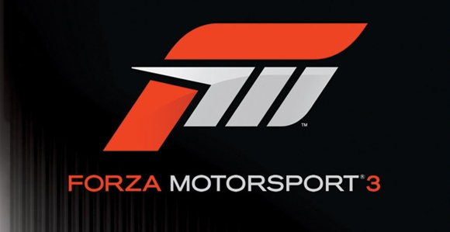
Forza Motorsport
A Game Evaluation

Slide 2
Intro

Slide 3
Overview
Creator: | Turn 10 Studios
Genre: | Racing Simulator
Price: | $60
Hardware Required: | Microsoft Xbox 360 Network access for multiplayer Steering Wheel Recommended

Slide 4
Gameplay
2 game modes:
Arcade: casual racing
Career: in-depth simulation
Player’s goal: win races!

Slide 5
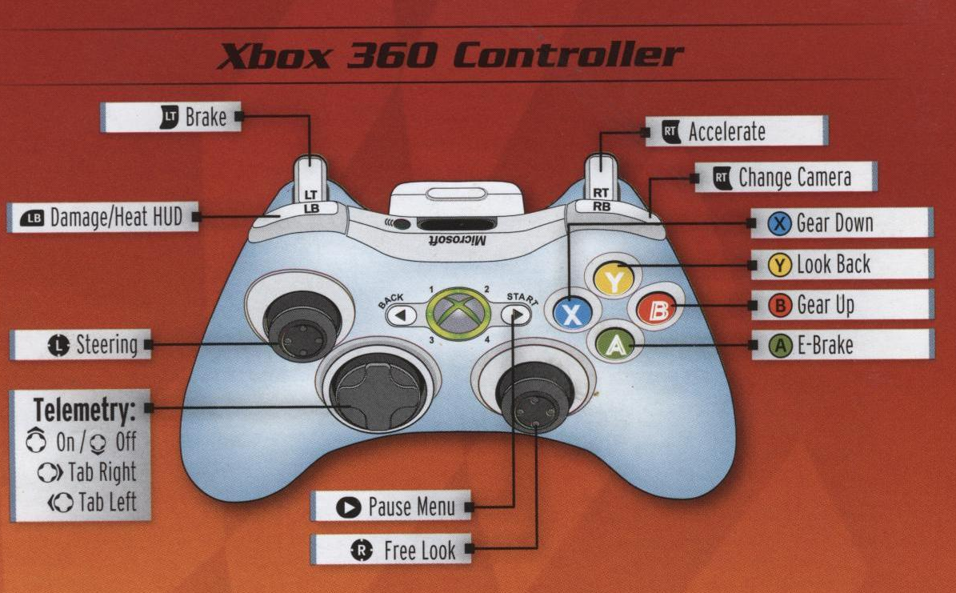
Gameplay
Players control their vehicle using the Xbox 360 controller or steering wheel

Slide 6
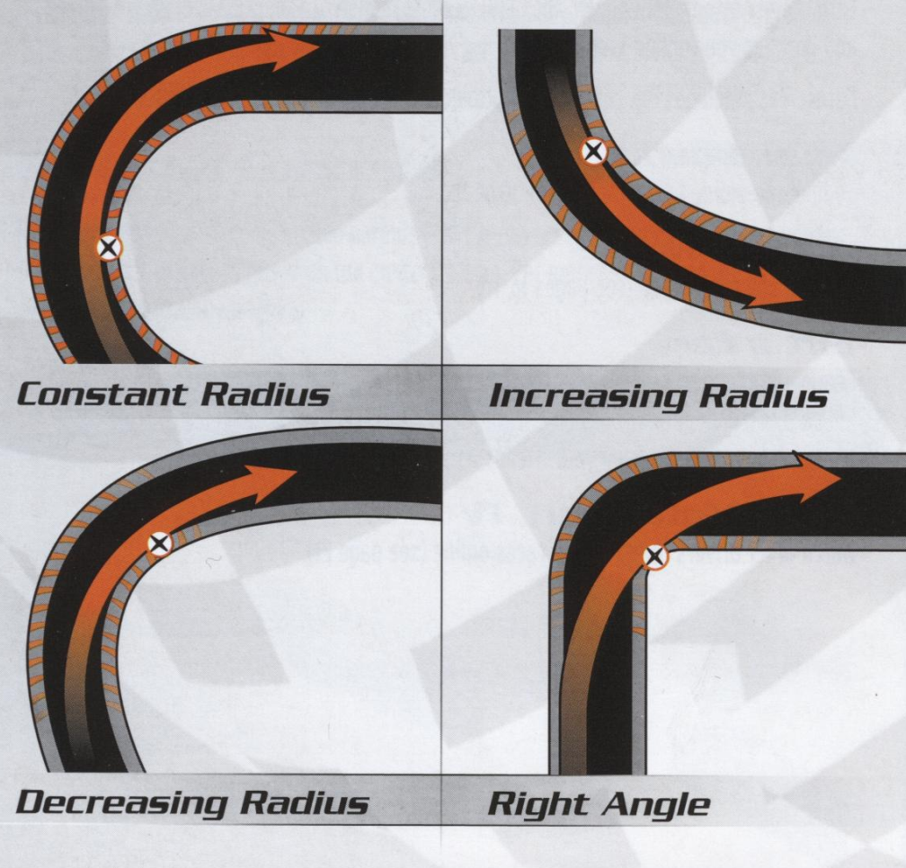
Gameplay: Driving
Vehicle physics are tuned to be as realistic as possible
Player skills:
Braking points
Apex clipping
Skid control
Weight transfer

Slide 7
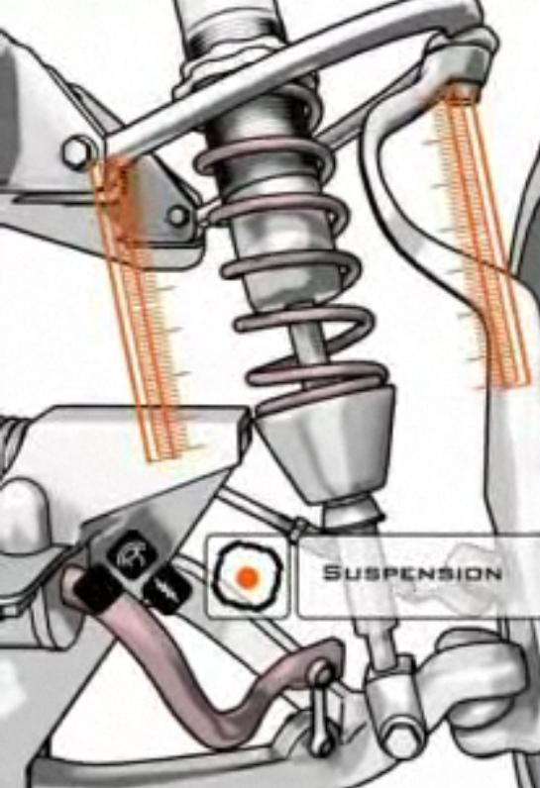
Gameplay: Tuning
Players can customize vehicle parts and settings
Player skills:
Gear ratio optimization
Suspension settings
Horsepower/torque curves
Aerodynamic aids
Tire size, type, pressure

Slide 8
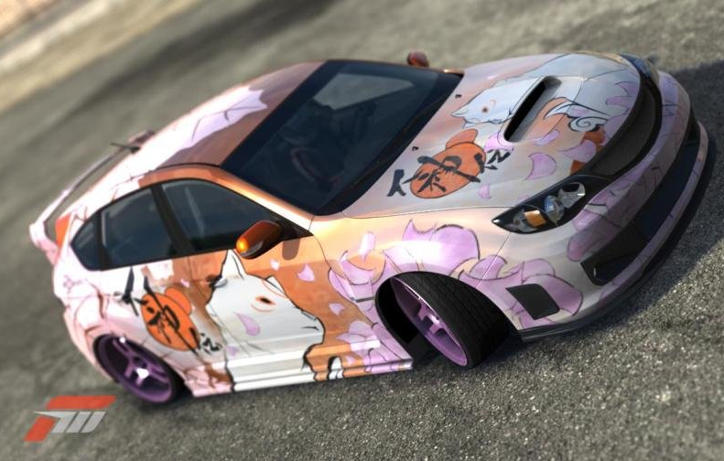
Gameplay: Designing
Car paint jobs can be customized in the paint shop
Player skills:
Design composition
Color choice
Decal placement
Layering

Slide 9
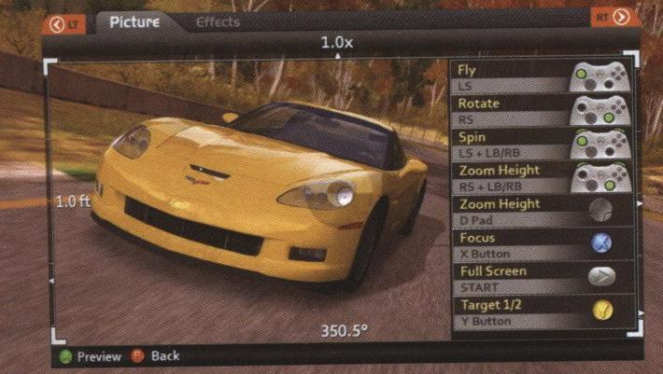
Gameplay: Photomode
Players can review a replay and take photos of their car
Players choices:
Aperture size
Shutter speed
Focus
Lens filters

Slide 10
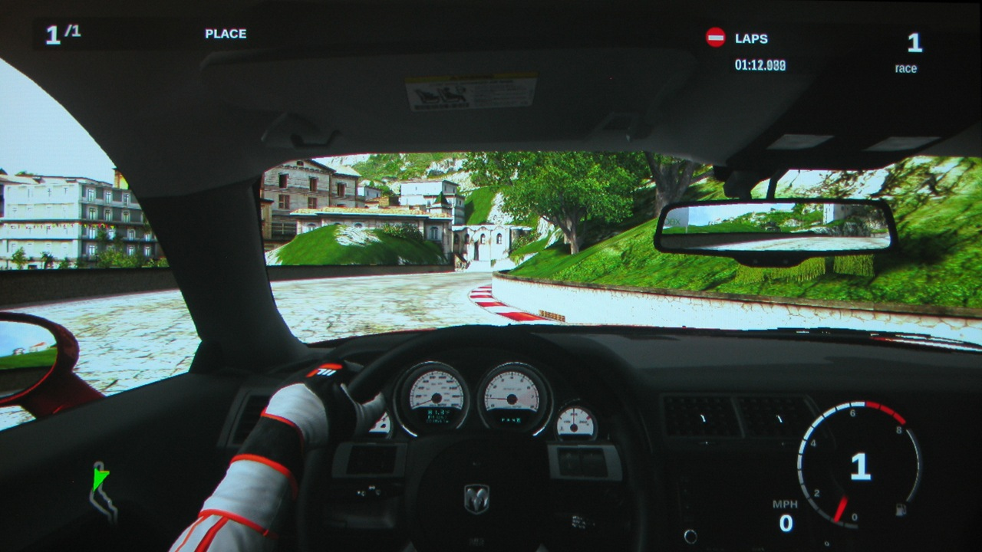
User Interface: Driving

Slide 11
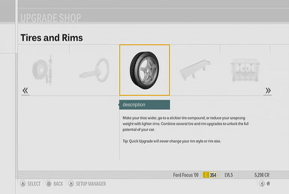
User Interface: Tuning

Slide 12
User Interface: Tuning

Slide 13
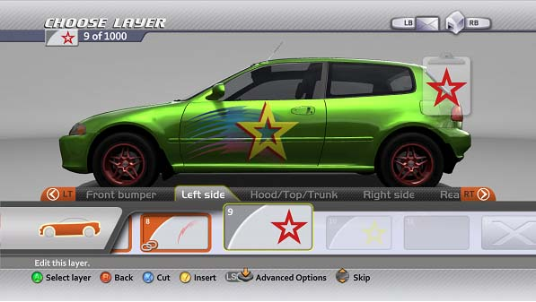
User Interface: Paint Shop

Slide 14
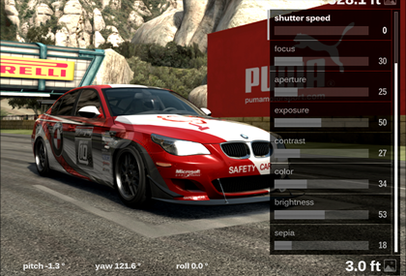
User Interface: Photomode

Slide 15
Artwork
Realism is the primary goal of the artwork
Game textures were created through photographs of the cars and tracks
Even tracks without real-world counterparts are designed to look and feel realistic

Slide 16
Sound and Music
Real-world vehicles were tested and recorded on dynamometers to develop vehicle sounds
Real-world vehicles were also wrecked to obtain collision sounds
Game music is generic techno/rock, set up to be replaced by music from the player’s own library

Slide 17
Game Review: The Good
Game captures the feeling of real-world road racing
Player assists make the game competitive and fun for players of all skill and interest levels
Innovative “experience” system rewards consistent players
Multiplayer allows players to create their own race types
Paint shop and photo mode give an avenue of fun and customization to what is often a very stale genre

Slide 18
Game Review: The Bad
Despite efforts to broaden the user base, this is still a niche game
Gameplay is the same throughout the game; some players will get bored
Takes too long to build up enough in-game credits to purchase/unlock cars and races

Slide 19
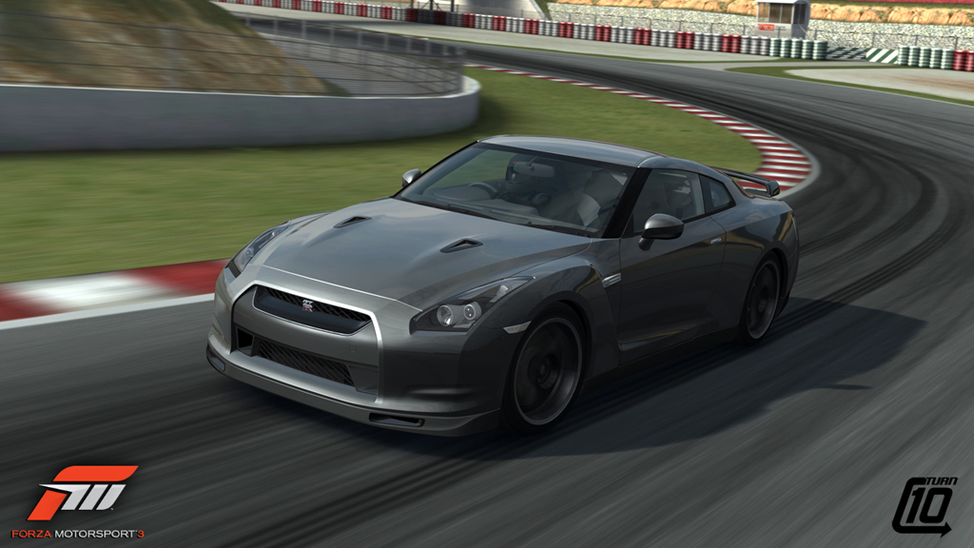
Game Review: Competition

Slide 20
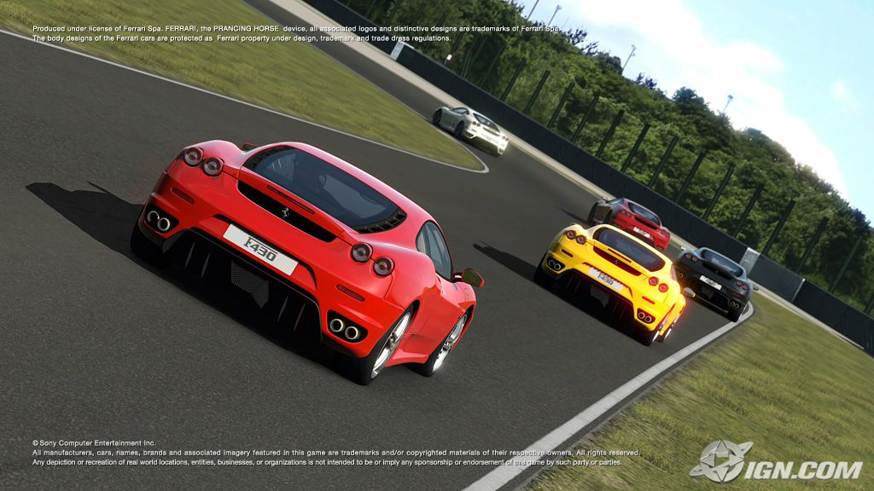
Game Review: Competition

Slide 21
Game Review: Competition
Comparative strengths:
Accessibility to casual players
Car customization
A.I. opponents
Damage modeling
Comparative weaknesses:
Graphics
Quantity of vehicles

Slide 22
Game Review: Audience
Targeted audience: car enthusiasts and casual racing players
Actual audience: car enthusiasts
Casual racers will have a hard time staying with the game due to the nature of its gameplay

Slide 23
Summary
Strengths:
Vehicle dynamics
Customization
Accessibility
Weaknesses:
Long-term interest

Slide 24
Summary
Worth buying?
Hardcore enthusiast: Yes!
Casual player: Rent first
Improvements:
Allow players to select their gameplay style up front, and tailor rewards accordingly
Graphics, especially race replays

