Slide 1
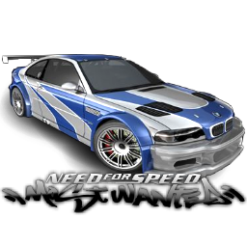
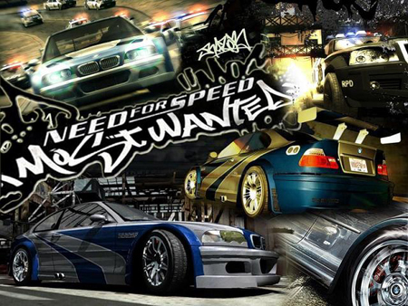
Need for Speed: Most Wanted
Publisher: Electronic Arts
Author: Paul Linford
9th Game in the Need for Speed Series
Release Date: November 11, 2005
Genere: Racing
Price: $50
ESRB Rating: Teen +
Review By: Sreekanth Gogineni
CIS 487 Fall 2010

Slide 2
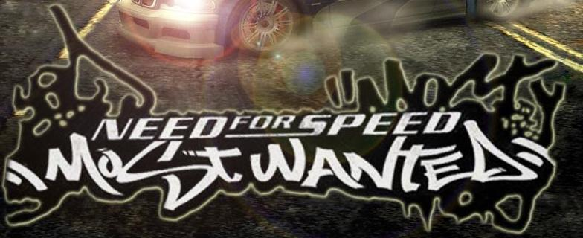
System Requirements:
Minimum:
Recommended:
OS: Windows XP or 2000 CPU: 1.4 GHz or faster RAM: 256 MB or more Disc Drive: 8x or faster CD/DVD drive Hard Drive: 3 GB or more free space Video: DirectX 9.0c compatible (see right) Sound: DirectX 9.0c compatible Input: Keyboard, mouse, or USB Steering Wheel/Gamepad Video card with 32 MB or more memory is required Multiplayer requires 1 set of discs per PC and a broadband (Cable, DSL, or faster) connection. Internet or LAN (2-4 players)
OS: Windows XP CPU: 3 Ghz or faster RAM: Atleast 1 GB Disc Drive: DVD reader Hard Drive: 3 GB or more free space Video: DirectX 9.0c compatible Sound: DirectX 9.0c compatible Input: Keyboard, Mouse or Steering Wheel/Gamepad Video Card: Atleast an NVidia 5900 or ATi 9800 with 256mb of video memory Multiplayer requires 1 set of discs per PC and a broadband (Cable, DSL or faster) connection. Internet or LAN (2-4 players)

Slide 3
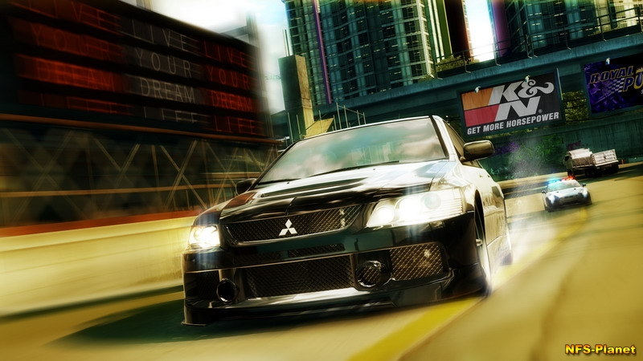

Slide 4
Quick Overview of the Game:
Story Line:
You start off as a newcomer into the metropolis of Rockport. You start with the game’s title car, the mighty BMW M3.
Soon afterwards, you are auto enrolled in a race with Razor, the main antagonist of the game. Razor plays dirty, and sabotages your car in order to win the race, your car, AND sending you to jail…what a start!

Slide 5
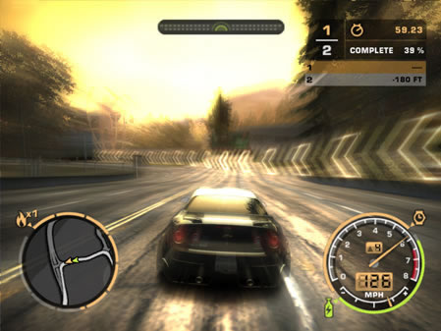

Slide 6
Player Role:
The game continues with you getting out of jail and learning from Mia(your new friend of sorts in Rockport) that Razor used to ride to win him self to the top of blacklist.
Blacklist 15 – You main goal of this game is to get to the top of the blacklist. The blacklist is a list of the 15 best racers the metropolis of Rockport, and they each control certain sections of the city.

Slide 7
Player Role:
The player has to race and gain notary in the city in order to challenge blacklist racers, and your goal is to take down Blacklist #1 Razor, so it means you must race our way up the blacklist starting with #15.
In order to challenge a blacklist member, you have to meet certain qualification such as number of race wins, and milestones.

Slide 8
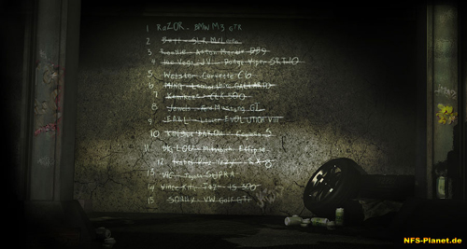
Blacklist 15:

Slide 9
Types of Races:
There are 6 types of races:
Circuit – Single or Multi Lap
Circuit with last man knocked out every lap
Sprints – Plain Race form start to finish.
Drag Racing – Where you control lane and shifts.
Speed Trap - Clock fast speeds at these traps and rack up more total speed than the others to win.
Toll booths – Race from booth to booth in the amount of time specified.

Slide 10
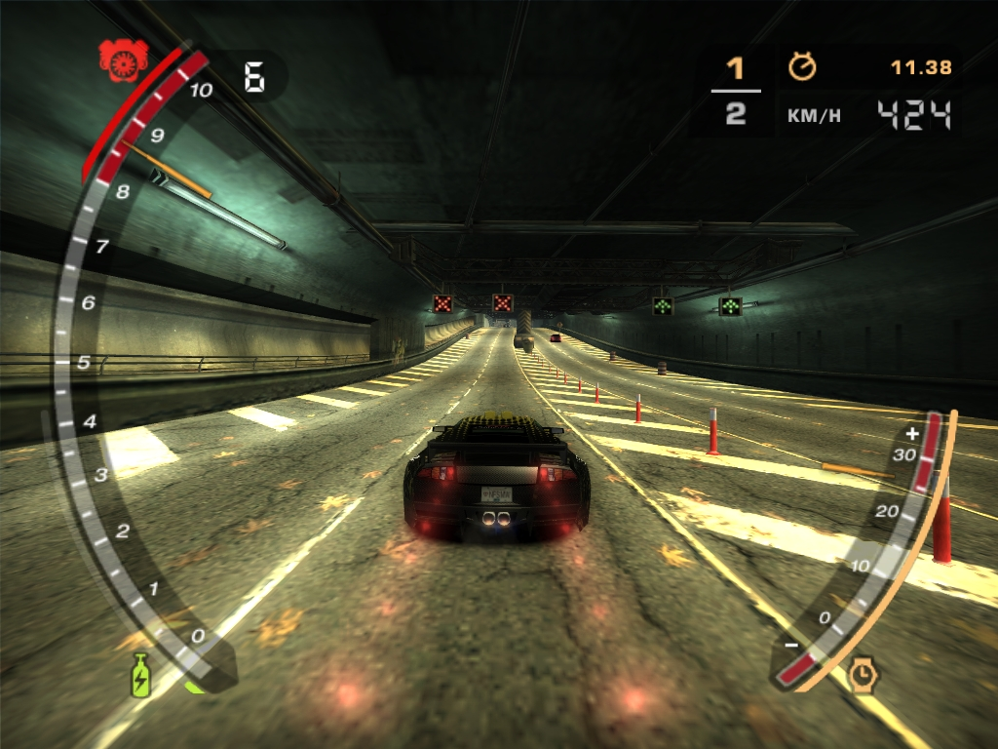

Slide 11
Milestones:
In order to challenge a blacklist member, you need to meet certain milestones such as Bounty, number of police chases and other tasks such as number of police cars destroyed, property damage attained..etc.
Another difference with this game is that the police can start going after you in between a race and making you life harder.
The police AI in this game I feel is perfect, easy in the beginning, and they get progressively harder, basically helping you get better at the game.

Slide 12
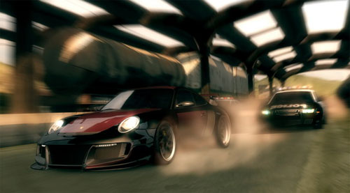

Slide 13
Installation and Setup:
Installation of this game was easy and straight foreword, but the setup it self felt very outdated. It used a simple setup screen with 10 preselected images that it would cycle through while the installation was completed, and no music or story line explained.
The game does not support play without DVD in drive natively.

Slide 14
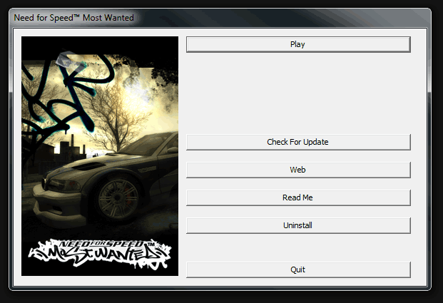

Slide 15
User Interface And Game play
The user interface was very easy to navigate through and well organized
Ample In-Game Keyboard shortcuts were provided making game play less menu selection oriented.
Game play overall was smooth, but gets choppy during high speeds if the computer cannot handle the shadows.

Slide 16
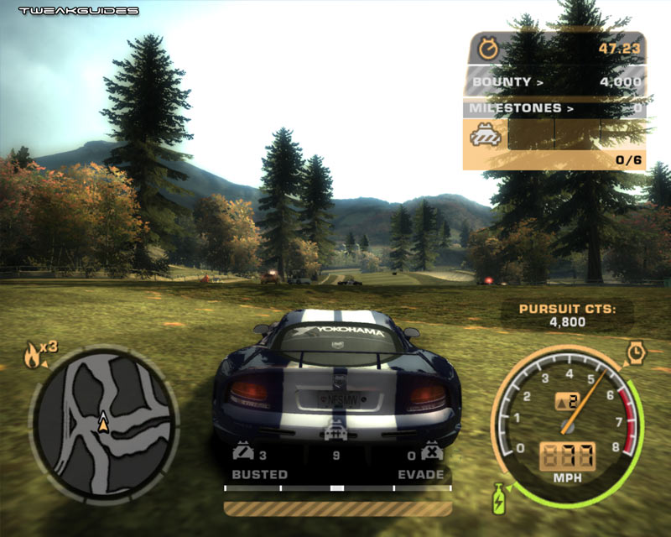

Slide 17
Artwork:
Artwork: I believe the game for the release time had some of the best Art Work in the market.
Each Car has 5+ Custom after market body Kits available, 100’s of other aftermarket parts like hood scoops, wings, tail pipes, etc.
Maps seemed very well designed, and attention was paid to every detail of the surroundings from the lamp posts to speed signs.

Slide 18
Sound and Music:
The engine sounds in the game are absolutely superb, and every car sounds unique.
What I would like to see improved is a variations of turbo/supercharger spool sounds as they all sound identical.
Music in the game seemed carefully picked, and fast beats make them amazing to listen to while driving fast.
The sound of the police chatter on the radio scanner is something that has been vastly improved and is not very important to pay careful attention to as it helps out a lot in the game.

Slide 19
Special Features & Manuel
Special Features: As always, this version of Need For Speed also has bullet time, where upon activating the ability, time seems to slow down and the player is able to make split second maneuvers at break neck speeds, but watch out as the ability has a time limit, and recharges slowly over time.
The game also allows the player to Tune the car’s handling.(next picture)
A Manuel is included with the game, and it helps new players understand the user controls and general game play. It is also very well organized and was easy to understand.

Slide 20
Bugs:
I have not really discovered any bugs, as I believe over the years they have released patches that fixed almost all of them.
But something they do need to include in a new patch is the ability to support resolutions higher than 1024x768 as it does not natively support it.

Slide 21
What is good (fun) about the game? Why?
The fun aspect of this games comes from the manner that it makes you feel like a kid in a candy store. While in the free roam feature, the player can do what every they choose, just roam around, speed excessively through busy city intersections, go for a highway blast, find shortcuts for upcoming races, but watch out! As the police will soon be on your tail if you wander in one place too long.
The game gives you the freedom to go through the game at your own pace.

Slide 22
What is bad (not fun) about the game? Why?
Some of the Milestones and Achievements that are required for the player to achieve to move foreword in the game seems a little too high, especially for new players.
Also, I would like the drive engine in the game to be better developed so hand brake turning is much easier than it currently is.

Slide 23
How does it compare to similar games in the same genre?
This game is in a category almost of it’s own even in the racing genre.
Its street racer game persona is very well suited with free roam, and police chases that help the player get the feeling of being a real street racer.
This game is not a straight up racing game with emphasis on making the best and smoothest turns, its about using your street wits while racing to gain every advantage and coming first at the end. There’s a plethora of racing shortcuts in the game, and the player is urged to use them in order to win.

Slide 24
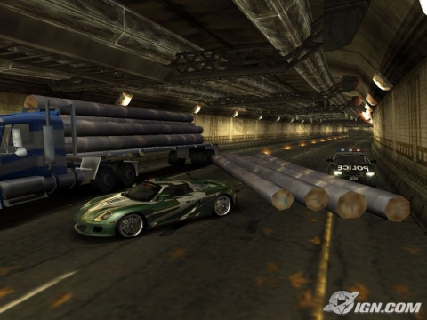
Why is it better or worse than similar games?
I think it is a superb game, but can it can use some refinement still,
The use of real life actors, and merging them highly detailed animated characters of them helps to really bring the game to life.
Additions such as log carrying truck pursuit breakers really make the game interesting.

Slide 25
What is the appropriate audience for this game?
The appropriate audience for this game is anyone that enjoys driving…fast.
While the game can be enjoyed by almost anyone, teens seems to be main target audience for this game, as the cars included in the game are considered high profile cars that are popular with teens, and especially with an emphasis on street customization.

Slide 26
Are any design mistakes present? Summary
Nope, as this game is not the first in the series, I think the developers have addressed design issues they have had in the past, and took time and care to avoid them this time around.

Slide 27
Overall strengths and weaknesses.
Overall strengths of this game include, exceptional game play, well designed levels, fast cars with beautifully designed customizations that have life like weight distribution while driving really helps the player fall in love with the game.
No weakness as far as I could tell.

Slide 28
How could it be improved?
Some issues that can be improved up on for this game include further enhanced car handling and a mode selector to make the game easier for beginners/casual gamers.
The designers should really put some more effort into redesigning how the car handles in reverse as in the game, while going in reverse one does not really have control of the car, and if the player tries to turn the car in either direction while backing up there’s a high chance of the car just veering out of control.
Also, while reversing it would be nice if the game made it easy to do a 180 and face the other direction, it rather just veers into one direction, and you have to fight for control.

Slide 29
Is the game worth purchasing?
Absolutely, form its initial price point of $50 when it came out in 2005, it was an exceptional buy. Its hardware requirements were not too demanding even in 2005.
But in today’s point, I’ve seen the game selling for $20 at best buy, and I think its an amazing buy, and a must buy for any street racing fanatic.
The game has a exceptionally high replay value which makes it a great add to many collections.

Slide 30
