Slide 1
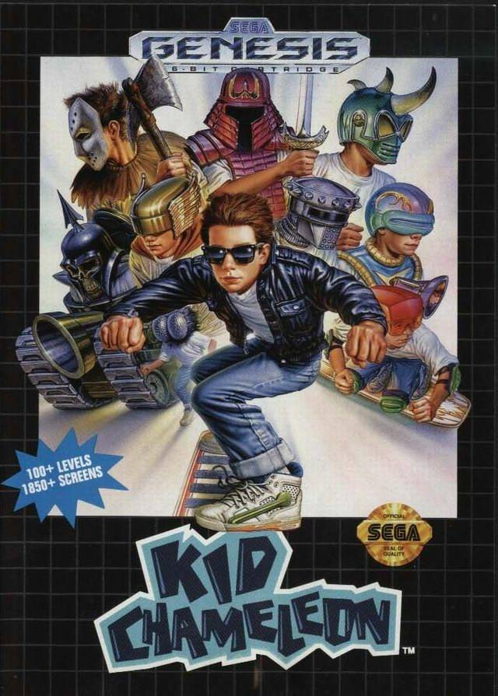
Kid Chameleon

Slide 2
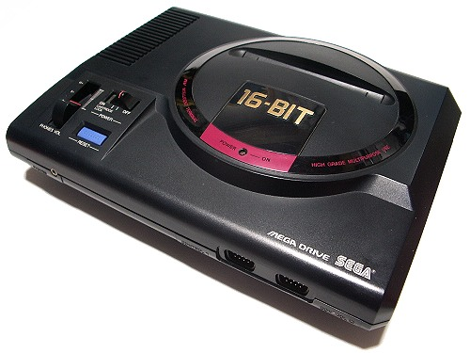
Development
Released in 1992 at standard game rate: $50
I got my copy for $30. SCORE!
Age Recommended: 4+
Type: Side Scrolling Platformer
Hardware needed:

Slide 3
Overview
Crazy VR arcade ingests people
One awesome gamer goes into the machine
Helmets(different forms follow)
Ram EyeClops Tank Knight Fly Skycutter Cyclone
Red Stealth (Ninja) Maniaxe (Jason rip, coolest)

Slide 4
Monsters
Multiple monster types across the maps
No monster is specific to a certain map type
Only 3 types of monsters in a given map
Example: Lion God
Shoots semi-homing spheres from scepter
Runs left to right, usually towards the player by using the screen as bounds
Scary fast in later adaptations (recolors in later levels)

Slide 5
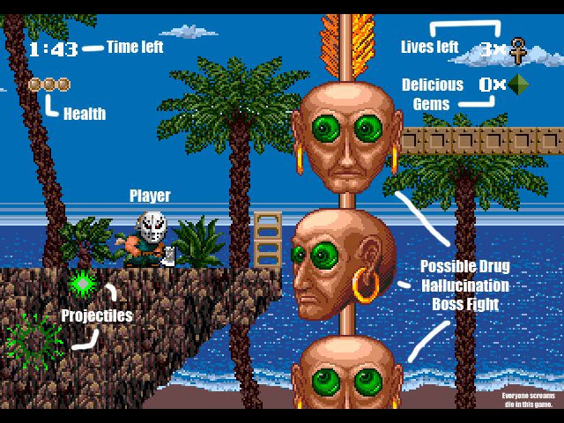
User Interface

Slide 6
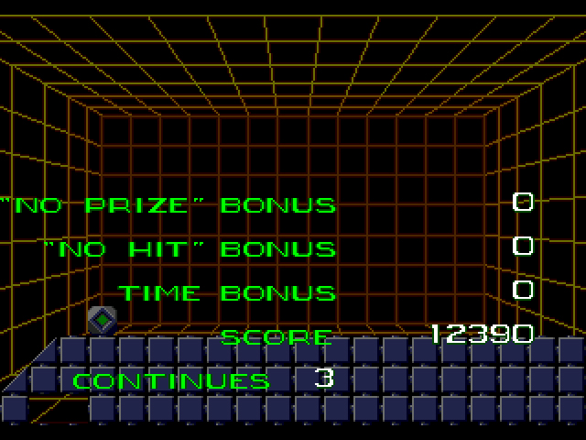
Scoring

Slide 7
Game Comparison
THEN:
KC < SM series wrt puzzles, level depth
KC > Sonic wrt non-linear gameplay
NOW:
KC < Most platformers out there wrt graphics
KC > Most platformers out there wrt difficulty

Slide 8
Improvements?
Level Checkpoints
More Levels – K-E Level Editor
More ways to use delicious gems

