Slide 1
Vampire the Masquerade: Bloodlines
Game Review by
Craig Crowder
For CIS-587
September 28, 2009

Slide 2
Vampire the Masquerade: Bloodlines (VTMB)
Released: November 16, 2004
Developer: Troika Games
Publisher: Activision
Platforms: Windows (PC)
Designers:
Jason Anderson (creative director)
Leonard Boyarsky (executive producer)
Tim Cain (design)
Brian Mitsoda (lead writing, design)

Slide 3
Price
Type, Genre, and Rating
VTMB can be purchased from Direct2Drive.com for $19.95
Amazon.com has the following options available as of 9/27/2009
New : from $89.95
Used: from $48.45
Collectable: $65.99
First or Third person Fantasy Role Playing (FRP) game.
Based on the Vampire the Masquerade role playing game.
The Mature (17+) rating reflects content containing blood, gore, intense violence, sexual themes, and strong Language.

Slide 4
Hardware and Media
Hardware
Media and Game Modes
1.2 GHz Athalon or 1.2 GHz Pentium III, or higher
384 MB of RAM
Quad-Speed CD-ROM
3.3 GB uncompressed hard disk space and 1.4 GB for Windows swap file
100% DirectX 9.0c compatible video card
16-bit sound card and drivers
Media Choices:
3 CD-Rom
1 DVD
Available for Download
Modes:
Single Player
Multiplayer (unofficial)

Slide 5
Specification of Test Configuration:
Hardware
Software
Dell StudioXPS 1640
4 Gig Ram
Intel Core Duo CPU T9550 @ 2.66Hz
ATI Mobility Radeon HD 4670
Bluetooth
Headphones
Mouse
Keyboard
Windows Vista Ultimate 64 Bit OS, Service Pack 1
DirectX version 10
Official Game Patch version 1.2
Unofficial Game Patch version 6.5, released by the user community September 21st, 2009

Slide 6
Overview:
VTMB is a Fantasy Role Playing game that can be played from the first or third person perspective. Game play is advanced through a combination of player choices and character abilities. The game topography is designed to flow through four major quests that depend on dozens of smaller quests and that can be augmented by dozens of side quests of varying difficulty. The story line begins with the birth (death?) of the player character (PC) and runs through the PCs “Un-Life,” culminating in the PC making the final choice that determines the outcome of the vampire “End of Days” scenario.

Slide 7
Story Line:
Character creation marks the beginning of the story in all cases. You are a fledgling, a freshly sired vampire, in Los Angeles, California. A turf war between vampire organizations is underway in Los Angeles and you are caught in the middle. Struggling to find your way, locked in a struggle between chaos and order, you must decide who to follow – who to trust. Will you follow the leaders of the various sects and/or clans, or will you trust only yourself? Your situation is further complicated by necessity to follow the rules of “The Masquerade.” You must hide the existence of vampires from the human inhabitants of the world, just as “The Kind” have done since the days for the first vampire (The Curse of Cain). And you must hide the truth from yourself. For, while you struggle to maintain your humanity, “The Beast” lies just below the surface. To lose control of the beast is to forever lose yourself and to descend into madness.

Slide 8
The Player's Role
The various factions within the vampire community of Los Angeles are in conflict over an ancient artifact – the Ankaran Sarcophagus. Each faction tries to use you (the PC) to foil the other’s attempts to gain control over it. The Ankaran Sarcophagus is believed to contain the sleeping body of an ancient vampire. Through the choices the player makes, the player ultimately decides who will win, the fate of Los Angeles, and the outcome of “The End of Days.”

Slide 9
Installation:
There were no outstanding issues involved in installation. My version of the game came with three CD-ROMs. The first CDs AutoRun executes a “Launch.exe” file, shown on the right. Prior to installation, the first option is “Install.” Installation requires 3.3 Gig of uncompressed disk space and DirectX 9.0C (included)

Slide 10
The default user interface is tied to the keyboard and Mouse.

Slide 11
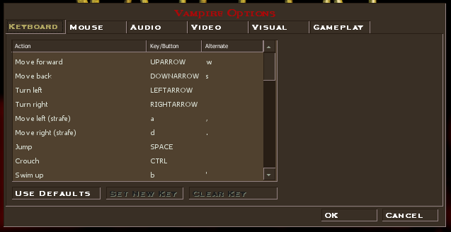
However, the user interface may be customized.

Slide 12
Character Interfaces:
The Character Sheet:
The Inventory:

Slide 13
Quest Log:
Character Info

Slide 14
Game Play:
The cross hair is the focus of the character’s attention.
Focusing on a person or object that may be interacted with, changes the icon to indicate what’s possible.

Slide 15
Player / Non Player Character Vocal Interactions
When vocal interactions occur, the non player characters (NPC) speak through the sound card.
The PC dialogue choices are enumerated. Alternate colors are used to convey choices that use magical ability or special skills, such as seduction or persuasion.

Slide 16
Game Play:
Items of interest or people may be interacted with.
Focus attention on the item or person then press ‘E’
Items that may be taken are added to an inventory sheet.
Items that may be manipulated, such as doors or locks, will react with a pass (e.g. a door will open) or fail (e.g. “Door Locked”) message.
Speaking to people invokes an animated sequence interspersed with dialogue choices.
Players move from scene to scene through doors, elevators, and man hole covers (through sewers).
Major location changes are facilitated by taxi cab.

Slide 17
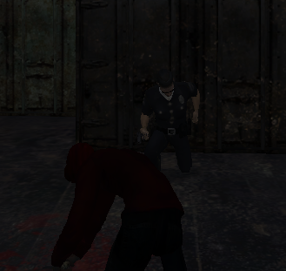
Game Play: Combat Combat may take place in first or third person.
Ranged weapons are in first person perspective.
Hand to hand combat is in third person perspective.

Slide 18
Combat Sequences:

Slide 19
Scoring:
The player character is awarded experience points for successfully completing each quest. Experience points may be “spent” enhancing the characters abilities.

Slide 20
Music and Sound
Custom music sequences for each type of scene:
Combat
Neutral situation
Nightclub
Bar
Haunted Mansion
Etc.
Sounds and Vocals:
Each person has a unique voice.
Background noises, such as cell phones, passing cars, and footsteps, are very realistic.

Slide 21
Special Features:
The sound track to the game was released as a pre-order incentive through Best Buy.
Manual:
The manual is delivered in both hard copy and soft copy for the retail boxed version. Softcopy is delivered with the downloaded version. Softcopy is in Adobe Portable Document Format.
Bugs:
While version 1.0 (the released boxed version of the game) had several significant defects, none were deemed serious enough to prevent it’s overdue release. Versions 1.1 and 1.2, released within six weeks of the boxed version addressed those defects.

Slide 22
What's Good?
VTMB is incredibly complex. The story line, NPC interactions, and ending are dependant upon multiple factors including player choices, PC attributes and abilities, and clan/sect ties. This increases the opportunity for repeat game play.
It uses Valve’s Source engine. It was actually released a week prior to Half Life 2, making it the first game to use it.
The game requires thinking and some role playing in order to complete it successfully.

Slide 23
What's bad?
VTMB is incredibly complex. In the end, the complexity delayed development, the subsequent game release, and resulted in the company’s demise.

Slide 24
How does it compare?
If compared to other first person shooter games, VTMB can be slow (too little action) and overly cerebral.
If compared to other FRPs, VTMB is a great piece of work. The balance between role playing and combat is wonderfully tuned. The puzzles and quests are challenging but not daunting. Further, the story line and the concept of the Masquerade is beautifully executed.

Slide 25
Appropriate Audience?
VTMB is rated M for Mature (17+) and the rating is appropriate. In addition to the blood, gore, and intense violence (there’s no shortage of violence) the game presents strong language (frequently) and sexual themes. The sexual content is not limited to innuendo and double-entendre. At one point the Player Character and a Non Player Character have sex. This encounter is not shown on screen, but the audio content is extremely explicit and continues for some time.

Slide 26
Design Mistakes
Though no mistakes are apparent, in game play, the game is approximately five years past it’s initial release. VTMB enjoys a strong cult following and the user community continues to release updates, fixes, and expansions to the games core capability. The latest such release was September 2009.
Further research, however, shows that the initial release of the game used Troika’s home grown AI engine, which was not very well received. Subsequent releases of the game used Valve’s Source AI engine.

Slide 27
Strengths:
Weaknesses:
Lot’s of paths through the story
Well conceived story line
Strong support from the user community
The inability to change the level of gore, blood, and strong language. That inability makes VTMB inappropriate for younger audiences and, therefore, misses a large portion of the market share.

Slide 28
Is the game worth purchasing?
How could the game be improved?
VTMB has a high entertainment to cost ratio. There’s a lot to do in the game for the price. Being that it’s several years past it’s release date, the cost has dropped making it a great opportunity.
I like the game as is.

Slide 29
Thank You!

