Slide 1
Burning Skies
2d Game by Nick Rebain

Slide 2
Story overview
In the distant future you are in a world where war is just around the corner. Your country has decided that a preemptive strike is needed to help ensure victory.
You play a fighter pilot whose mission is to cut through enemy forces and take out defenses like enemy planes and turrets to pave the way for bombing runs.

Slide 3
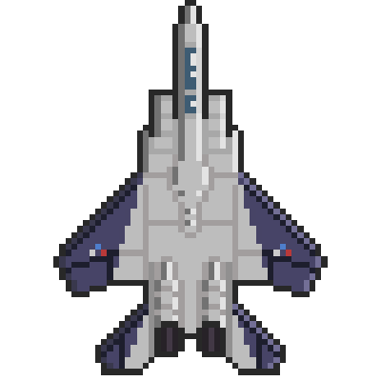
Appearance
2d scrolling game where the level scrolls downwards automatically while your ship flies up.
Graphics will be 2d with minimal detail. Probably pixelated, as I am a very bad artist
UI will be as minimal as possible. It will show health and any special abilities you may have collected along with your score for the level

Slide 4
Player Roles and actions
While the ship will fly up automatically, the player will have control of moving up, down, left, and right within the area they have at any given time.
The players goal is to destroy as many enemies and defenses as possible until the end of the level.
The player will be able to control when to shoot and when to use other special abilities.

Slide 5
Strategies
The main strategy will be to kill as many enemy units as possible while taking as little damage as possible.
While you might be able to get through the stage by not destroying enemies, this would be unwise as your scores on each level help you unlock powerups and later levels.

Slide 6
Level summary / progression
The game will consist of multiple levels that unlock once you get past a certain score on the previous level.
Enemies will get tougher and rewards will get better the as you go through the levels. Enemies will take more hits to destroy and will deal more damage to the player.
Landscapes will start out more in the ocean as you move further into land in later levels.

Slide 7
Hardware/software
Game will be relatively simple and should run on even weak hardware and should port easily to mobile devices.
Game will be made in Unity 5.4.1

