Slide 1
2D Game Pitch Cave Explorer (FINAL)
Aaron GARNETT & Luis Gonzalez-Prendes

Slide 2
Table of Contents
Abstract of Game Story: Slides 3-5
Appearance: Slides 6-7
What You Do: Slide 8
Gameplay Look & Feel: Slides 9-10
Enemies: Slide 11
Strategies & Motivations: Slides 12-13
Level/Story Progression: Slides 14-15
Hardware: Slide 17
Software: Slide 18
Algorithm Style: 19
Revisions: Slide 20

Slide 3
Abstract of Game Story
You are an explorer that finds yourself traveling the world
During your travels you come across an ancient cave that you must visit
Once inside the cave, the entrance collapses and you find yourself trapped inside

Slide 4
Abstract of Game Story
The only way out of the cave is to go through the cave and come out on the other side
However you are not the only person in the cave, so exiting the cave will not be easy
Enemies are coming out at random and you must destroy them to safely exit the cave

Slide 5
Abstract of Game Story
While the cave may be unsafe, it also has its share of treasure that you would like to collect
A successful mission ends with defeating as many enemies as you can and collecting as much treasure as you can

Slide 6
Appearance
Platformer
The setting of the game will have a cave theme background
Score is located in upper left hand corner
Lives located in lower left hand corner
Menu: Start Game, Options (sound settings), & Quit Game

Slide 7
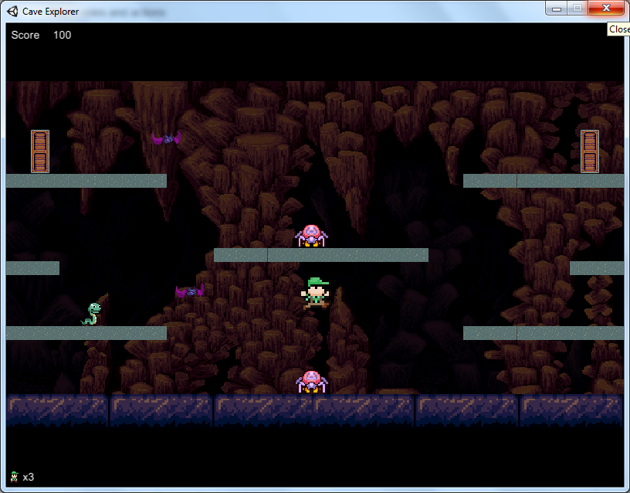
Appearance: Level
Screenshot of Level

Slide 8
What You Do
The user will move across platforms and may jump on higher ones to move about the game screen.
The user will be able to jump on enemies to destroy them and add points to their score. If the user takes enough damage, they will die.
The user may also collect coins that will contribute towards their score

Slide 9
Player Roles & Actions
The main goal is to complete the level without losing all your lives (you are given 3 lives)
During your time in the cave you are tasked with two objectives to work on
Defeat as many enemies as you can (without taking damage) during the level
Collect as many coins as you can during the same level

Slide 10
Player Roles & Actions
Controls
Right and Left Arrow on keypad to move left and right
Spacebar to jump
P to pause game
Jump on enemies to destroy them (1 enemy defeated = 100 pts)
Run through coins to collect them (1 coin = 200 pts)

Slide 11
Player Roles & Actions: Enemies
Snakes: Basic Enemy
Spiders: These enemies are a faster version of snakes
Bats: These enemies bounce across the screen
Each enemy will have two different spawn points
Defeat each enemy by jumping and landing on them for 100 points
Enemies will despawn if no interaction with them occurs

Slide 12
Strategies & Motivations
The user would like to prevent the enemies from damaging him and exit the cave safely
The user may also choose to destroy the enemies
The user would also like to collect as many coins as he can
Currently this is a single level game

Slide 13
Strategies & Motivations
The user may you use different platforms to hide under to dodge enemies
The user may also jump from platform to platform to make contact enemies and destroy them as well as collect coins
Continually moving around will be the quickest way for the user to complete the level

Slide 14
Level Summary/Story Progression
Initially only enemies will spawn when the game begins
Shortly after coins will begin so you can start accumulating more points
As the game progresses, the enemies will spawn more frequently

Slide 15
Level Summary/Story Progression
To ensure we had all other functions in the game, the game currently only has a single level
Future levels would include
New Enemies
Enemies that require more than one leap to destroy
Coins worth more in later rounds (i.e. bonus round)
Game ends with “Game Over” screen with ability to retry

Slide 16
Development Specification
Hardware
Software
Algorithm Style

Slide 17
Hardware
Game is developed to function on:
PC
Mac
Linux

Slide 18
Software
Game is developed in Unity
Game uses MonoDevelop for Coding

Slide 19
Algorithm Style
Detections of collision for enemies and coins
Algorithm for coin value
Algorithm for increasing difficulty
More Health
More Spawns of enemies

Slide 20
Revisions since Pitch
One Level Game
Multiple Types of Enemies
Menu Added
Spawn Points Adjusted

