Slide 1
Village in Peril RPG Pitch
By: Abdullah El-Haik

Slide 2
Executive Summary
This game design document describes outlines the details for a PC action rpg. The main premise of this game are to defeat the evil characters plaguing the in game village and complete a series of quests. Once the quests are completed the game will end.
Magic, monsters, and medieval level technology will dominate the world. All the visual and audio assets in the game will share a theme to help immerse the player in the world. This is meant to be a lighthearted rpg experience.
The core mechanics of this Action RPG are stat progression, health system, potion inventory, basic attack and movement, quests, and dialogue.

Slide 3
Characters and Roles
Julius - Players will control Julius, the main character in this game. Julius is a wandering mercenary passing through the small village of Dore. He has been on his journey for years and is relatively experienced. His role is to defeat the enemies and save the town.
Justice is the local mage in the village of Dore. He has spent most of this life in this isolated village in deep research.
Hamilton - The local blacksmith in the village of Dore. His wares were stolen by the invading orcs. Except for his prized golden armor.
Mayor Westley - The mayor of Dore. He is frustrated and exasperated from the constant bandit harassment. Mayor Westley is hoping the Julius would be able to help the free the town from Captain Crook’s tyranny.
Orcs - Just a bunch of guys up to no good that decided to make some trouble in the neighborhood.

Slide 4
Story/ Story Progression
The peaceful village of Dore is a village close to the outskirts of the Empire. Few people decide to live so far from the glitz and glamour of the core cities. Those that do prefer a simple honest life away from the hustle and bustle of civilization. However, being on the edge of the Empire’s borders makes Dore a prime target for bandits. The orcs decides to extort the townspeople for “protection money”.
Julius is on his way to his next job in the Border Lands. He has been on the road for weeks and has been dreaming about sleeping in a warm bed. It is with relief that he sees the signpost pointing towards Dore. He proceeds down the path to the town, unaware of the role he will play events to come.
Julius will arrive in time to see some orcs harassing the town. After dispatching the enemies, the residents will bring the player up to speed on their current predicament. After a short intro to the various game mechanics control will be given to the player to travel wherever they would like. As the player progresses towards the enemy hideout they will encounter enemies and various small quests along the way.

Slide 5
Gameplay Mechanics and Goals
A quick summary of the game is that you control a character in an action rpg. You can move anywhere on the map, talk to npcs, and fight enemies. Each enemy you defeat will give you experience points that you can you to level up and increase stats.
The game will have a simple health system, currency, and consumables.
Overall (long term) Goal: Defeat the orcs and save the village.
Gameplay (short term): Defeat the enemies, explore the world, help the villagers.

Slide 6
Gameplay Controls & Consumables
Movement controls:
Up – up arrow, W
Down - down arrow, S
Left – left arrow, A
Right – right arrow, D
Attack – Left mouse
Talk - spacebar
Items – 1,
The player has access to some health potions at the beginning of the game. Each health potion can refill the player’s health to max.

Slide 7
Progression/challenge/Loss & Victory States
As the player gets closer to the main hideout they will encounter more enemies.
The player must level up along the way by defeating enemies and collecting experience points.
With each level up the player’s stats will increase.
The player loses the game anytime their health drops to 0.
The player wins the game when all the quests are completed.

Slide 8
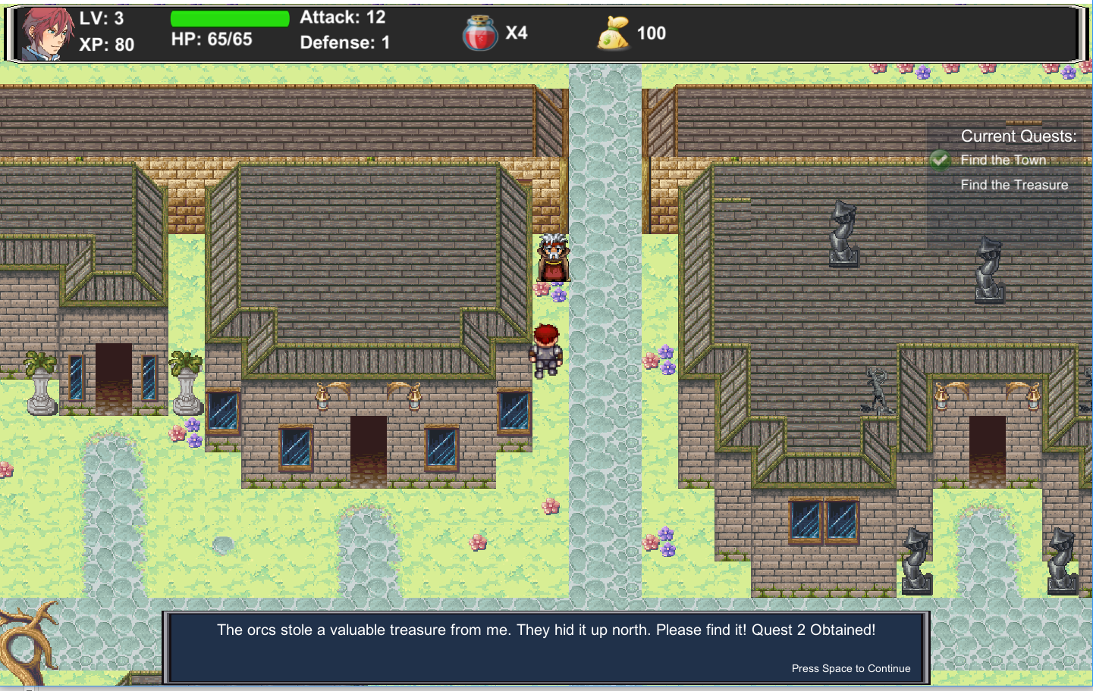
Art Style & Music
This game is a 2D action RPG.
The game uses low fidelity sprites with animations ranging from 3-6 frames depending on assets.
Art assets were obtained from opengameart.org.
Tiled was used to generate maps and import them to Unity.
The soundtrack is composed of a single track titled “Overworld” found online.
Sound affects were added for actions suck as attacks, enemies receiving damage, and player death.
Sample screenshot & dialogue from the game

Slide 9
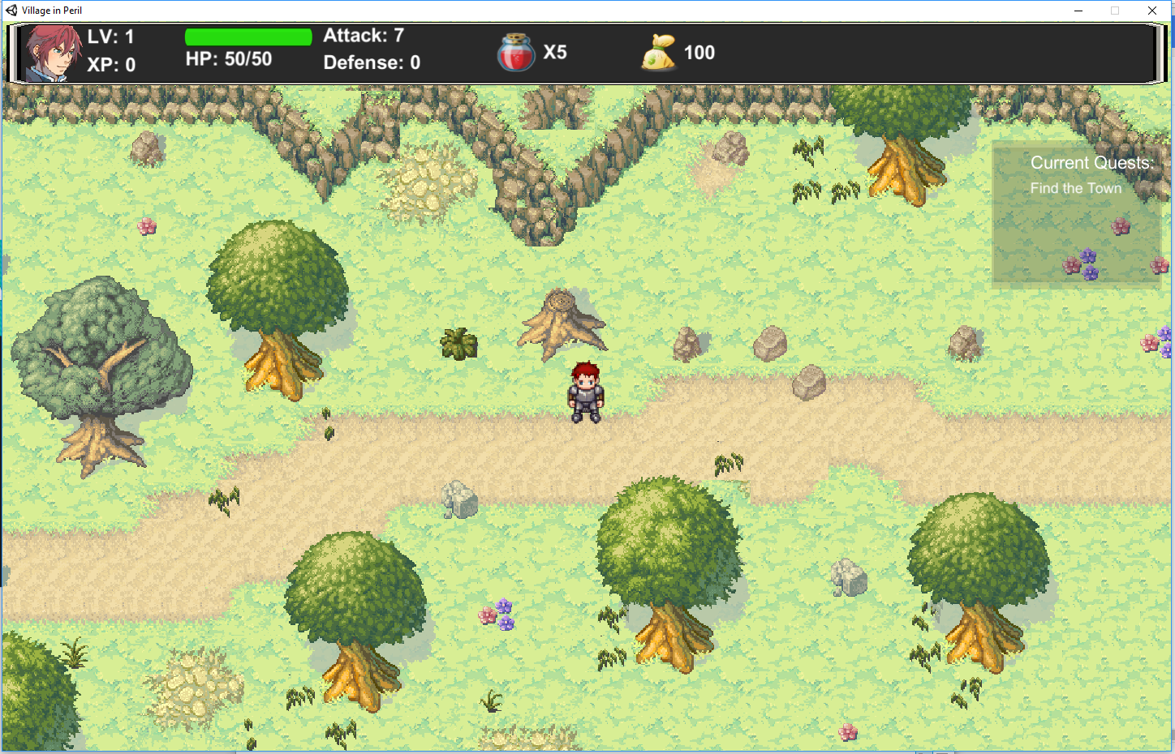
Gameplay Look & UI Elements
Player Portrait
Level
Experience
Player Health
Player
Stats
Health Potion Consumables
Player
Quest Log
Player

Slide 10
Development Specification & Algorithms
This game will be a PC release. The game will not be very resource intensive and should be able to run on any computer made in the last 15 years. The game will be developed using the Unity 3d 5.4 game engine.
It is intended for everyone
Only available in English
The enemy AI will randomly move in a direction every couple seconds. There is also a 25% chance that they will not move.
Once the enemy receives damage or the player character is in range, they will head towards the player and attack.

