Slide 1
Escape the Haunted Mansion
By Margaret Nazelli and Kevin Learned

Slide 2
Executive Summary
Type of Game: Point and click puzzle game
Abstract of Game Story: The player wakes up to find themselves in an unknown bedroom in a haunted mansion. The ghost of a little girl talks to the player and seemingly tries to help them escape the mansion. The player must find the keys to 3 rooms and along the way they will uncover the truth behind the deaths of the family members that once lived in the mansion.

Slide 3
Game Play, Look and Feel
Appearance: Images used in the game will be obtained from free online databases. The source information is at the end of this presentation.
UI: To start the game, the player can click anywhere. This is also true for scenes where the ghost girl is talking. Important items in the level will highlight when the mouse moves over it. Items are added to the inventory when the users clicks its location but, only for the first click.

Slide 4
Game Play, Look and Feel
Player roles and actions: The player’s role is to escape the mansion, 3 rooms, by helping the ghost girl.
The main action of the player is clicking objects in the game to obtain items that will help them complete tasks. The items are stored in an inventory in the lower left corner.

Slide 5
Game Play, Look and Feel
Strategies and motivations: The main strategies to finish the game is to read everything the ghost girl says to you and spot items in the room that could help move to the next room
Story Progression: The player first talks with a ghost who appears to be a child. As the story progresses, the player comes to learn that there is more to the mansion than just playing a game with a ghost. In the end, the player must make a life or death choice based on the discoveries found in the mansion

Slide 6
Development Specifications
Software
Made with Unity 5
C# scripts
Free source PNG images from online databases
Images created with GIMP 2
Hardware
Since it is made with Unity, there are several hardware setups that the application can be run on
PC
Android devices
For the final product we built it to run on Windows PCs only. More testing would have needed to be done to create games that ran on other machines such as the ones listed above
iOS mobiles devices
Window Phone

Slide 7
Development Specifications
Algorithm Style
Level x(){
for (int numOfItems=0; numOfItems<neededItems; numOfItems++){
case 1: Item 1 clicked
case x: Item y clicked
} while(All Items not Clicked);
}while(All Doors not opened);

Slide 8
Game Art
Sound: https://drive.google.com/open?id=0B9sAEqZzYFuzUkJJOE1ySUZjaFU

Slide 9
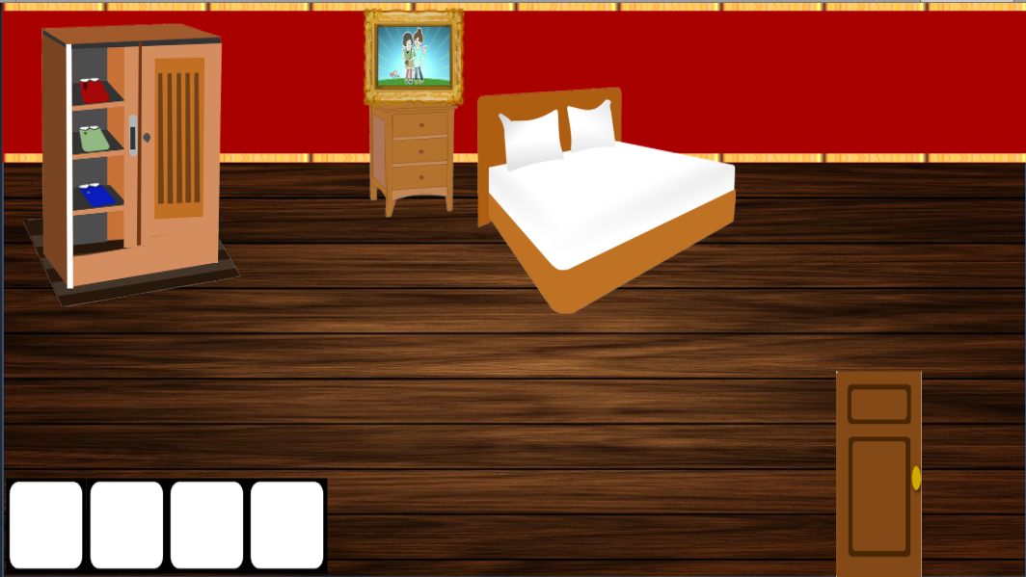
Game Art
Sound: https://drive.google.com/open?id=0BwJetflacO63MkNqMC1xc09ma3M

Slide 10
Game Art
Sound: https://drive.google.com/open?id=0BwJetflacO63cDVrSnNYeHB2RTQ

