Slide 1
When there is no more room in hell,
The dead will walk the earth

Slide 3
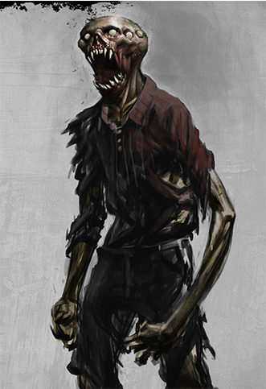
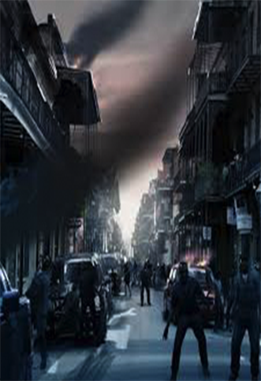

Slide 4
Game Pitch Document
Game: Z-Apocalypse
CIS487
Team 9
Member: Fan Zhang
Zhenjie Hao

Slide 5
Game Storyline
An evil group of scientists are making business with some organizations by selling the bio-weapon.
One day, one of the scientist got infect by a unformed new virus accidentally.
Soon, the virus turned him to a zombie, and it start to attack people. Every person who got bite will also turn to a zombie. The virus and zombie spread out……

Slide 6
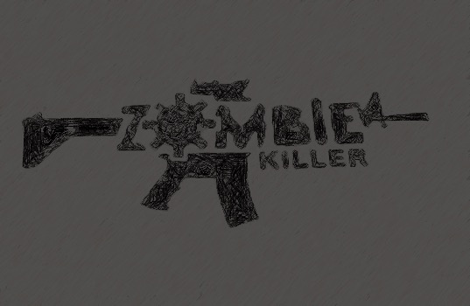
Abstract of Game story
City Z is the city where the outbreak starts, and soon got over by zombies.
CDC send our protagonist, Tony, the special troops to cleaning the city and search information about zombie virus.
Player will take on the role of elite forces soldier with high-tech weapons taking the task of killing zombies in the ruined city, city Z.

Slide 7
Game Play and Appearance
Game type: STG(shooting game)
Main game play will take place in a 2D interface
Single player mode
Keyboard controls

Slide 8
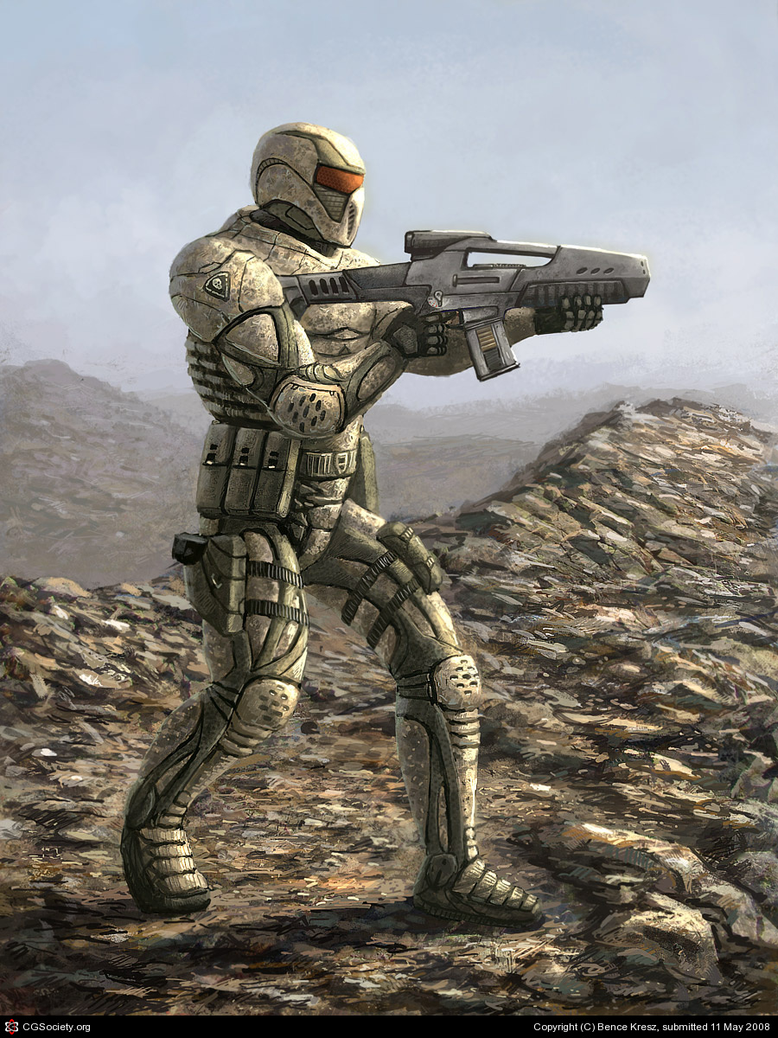
Player Role and Actions
Main objective: kill all the zombies appear in the city
Secondary objective: Searching information about the zombie virus.
Keep alive

Slide 9
Strategies and Motivation
Try to keep the distance with zombies and shoot them before getting close.
Take advantage of stand at some high structures that zombie cannot reach.
Kill zombies to get more points
Collect the hp kit and ammo supply to sustain in a good condition.
You can upgrade your weapon by picking up the weapon supply.

Slide 10
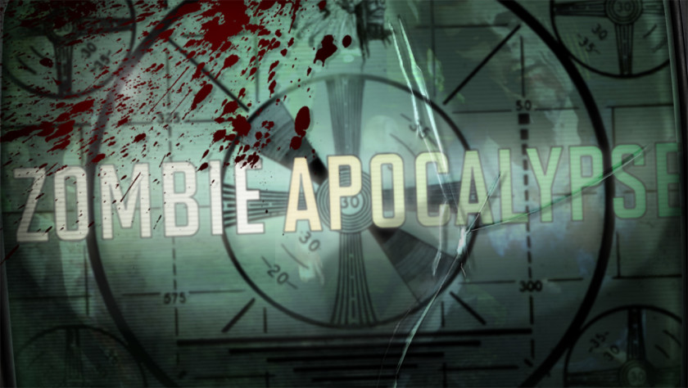
Development Specification
Development Specification
Software:
Microsoft Visual Studio 2013
Unity 5.2
Adobe Photoshop,AfterEffect,Audio
Hardware:
Windows and Mac OS

Slide 11
Algorithm
Basic Shooting: Projectile travels linearly in the horizontal direction pressed; collisions with zombies make damage on them.
Movement: Player moves faster than the usual zombies,
Dash: Player can jump once in a certain height. Player can jump on structures;
Kit Supplies:(1)Place: drop randomly (3)type: HP kit; bomb kit
HP: Player lose Hp when zombies touch him

Slide 12
VISUAL DESIGN
Environmental Design: The game is set in a city that has very recently been subjected to a zombie outbreak. Player entered the city at the dawn of the day, so the color of the background is dark. The game will mostly have asphalt, brick, concrete, and wooden textures, as though in a more industrial or warehouse district.
The camera control is play-oriented, in game play background will be fixed.

Slide 13
SOUND DESIGN
Atmospheric Design: There will also be sounds to provide atmosphere. Environmental noises like the buzz of streetlights and a windy noise in outdoor environments will provide atmosphere to the game. Footsteps and stumbles will have appropriate sound effects as well. The soundtrack will consist of dark, low style. Shooting will make sounds like real gun.

Slide 14
Bugs
Because every blocks are in Box collider 2D so hero may get stuck in the bricks in a rectangular collision.
If the hero escape the enemy without killing them there will be a big trouble and cannot fixed.

Slide 15
Summary
We learned a lot from this game design: Unity skills, understand and application of the C#
After the assignment we learned that it’s important to think as a designer, and put most time in the start to avoid go in a wrong direction.
Thanks to Prof.Maxim sincerely.

