Slide 1
2D Game Pitch: Pacific Crisis
Kyle Hicks & Allison Scherr

Slide 2
Game Story
In the year 20XX, Japan unearths a meteorite with a disturbingly high amount of radiation from the Pacific Ocean. The mineral itself is made up of a newly discovered element that scientist have dubbed as ‘Evolite’ for its unlimited power readings and incredible effects on organic materials ranging from repairing damaged cellular structures to enhancing and building body parts.
However, long exposure to the meteor can change those under its effect into a horrific creature of violent nature bent on killing anything not under the same amount of exposure as the ‘Evolite’.

Slide 3
Game Story (cont’d)
Upon realizing this side effect after months of research, the country realized that there is more of this element out at sea; learning that there is a bigger chunk of the element deep in the Pacific creating demonic creatures bent on the destruction of life. And they are all drawn by the ‘Evolite’ the country is holding, using it as a beacon for where to attack.
The United Nation decided to quarantine the entire country and the surrounding areas of the Pacific in an attempt to not allow the problem to spread across the world. Because of such isolation, Japan incorporates the Evolite into its military and technology in an attempt at protecting its remaining people who survived the first wave and rid the world of this growing threat.
This is the story of the men and women fighting this crisis . . .

Slide 4
Player’s Role and Actions
The player’s role will be to pilot a ship to fight off waves of incoming enemies. The goal is to destroy as many enemies as possible in each level and defeat the boss that is at the end of it.
The ship the player use can move freely across the moving screen fa
Each ship has their own powers and abilities which changes the overall gameplay. The ships are as follow.
Crimson Flame: This ship is the most balance of the three in terms of strength and speed. Its projectile can homes in on certain enemies it comes into contact with.
Turqoise Wave: The fastest yet weakest of the three ships. Its projectile is a short range wave like attack that has a quick fire rate faster then the other ships.
Emerald Quake: Strongest ship in fire power, but poor in speed. Its projectile is a continuous drill missile that takes down all enemies in its line of path. Only covers the enemies on its sides, not center.
Controls:
WASD: Moves the Ship
J: Fires (Projectile is shot.)
K: Bomb (This destroys all the enemies on screen, or depletes the boss health a little.)
L: Combine (The two other ship will come in to help you form a powerful mech. Gameplay completely changes when said mech is form)

Slide 5
Strategies and Motivation
Know the strength and abilities of the ship you are piloting. Each ship has their own special ability and gameplay that differs from one another. For example these include honing devices, shotgun ability, etc.
Enemies patterns and power differ upon their types and color. Knowing what they do help in how to combat them. (Note, not actually going to describe how they function. That will defeat the purpose of
Mech Formation is a special ability that should only be used when necessary. Can only be used when ship has gathered two additional power (Evolite).
Motivation: In order to preserve the survival of the remaining survivors of Japan and preventing a threat that could end all life, you must destroy the invading forces that kill everything and contain the evolite power source that are creating this threat.

Slide 6
Level Progression
Level 1: The player’s character is launched from the commander center on his/her first mission in the newly manufactured [Insert Name] fighter jets. Their mission is to combat the aerial army attacking and destroying the city of Tokyo and save as many survivors as possible.
Level 2: The command center informs you that a wave of enemies above the city have been flying over your radar for a sneak attack on your homebase. You must head for the sky and take out this threat before they succeed in destroying the base.
Level 3: Now it is time to take the fight to the enemy, as you are ordered to destroy the enemy’s base that is sending these waves of enemy. But can you make it through all of the hordes you are about to face out at the Pacific?
Final Level: The base holding these creatures is actually a living mutated orca bent on destroying the entire city. You must kill all the enemies and defeat this kaiju once and for all.

Slide 7
Appearance
The game will be in the style of an arcade shoot-em up similar to Galaga and Ikaruga.
Each ship you pick will have a pilot whose HUD you can see from scoring side of the screen. These pilots will react upon damage taken and health/power receive. Movement is done by change in facial expressions (this includes blinking).
All sprites and background are drawn and animated .

Slide 8
Development Hardware and Software, and Algorithm
Hardware capable of running Windows OS
Software: Unity 2D, C++ Coding
At this time our algorithm will include physics for collision detection, and computation for player and enemy health based on level and hits taken.

Slide 9
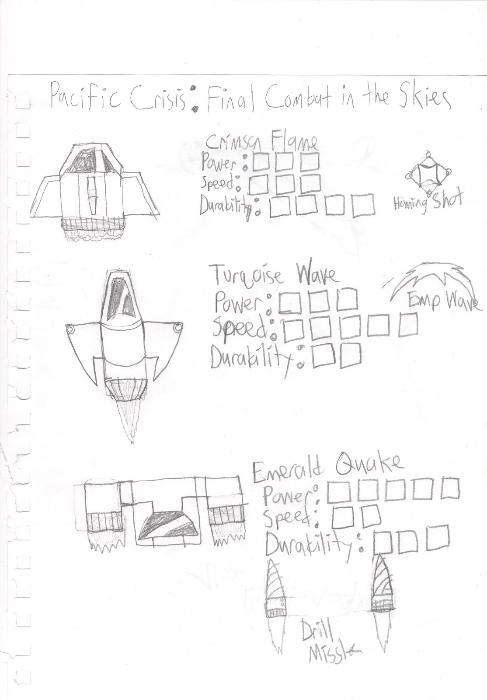
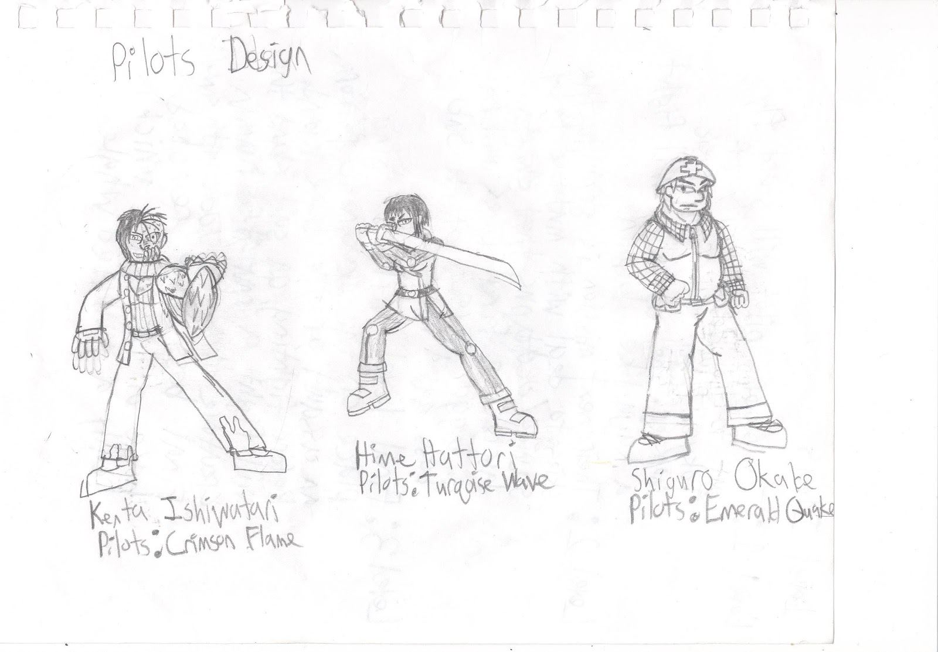
Concept Art: Pilots/Ship

Slide 10
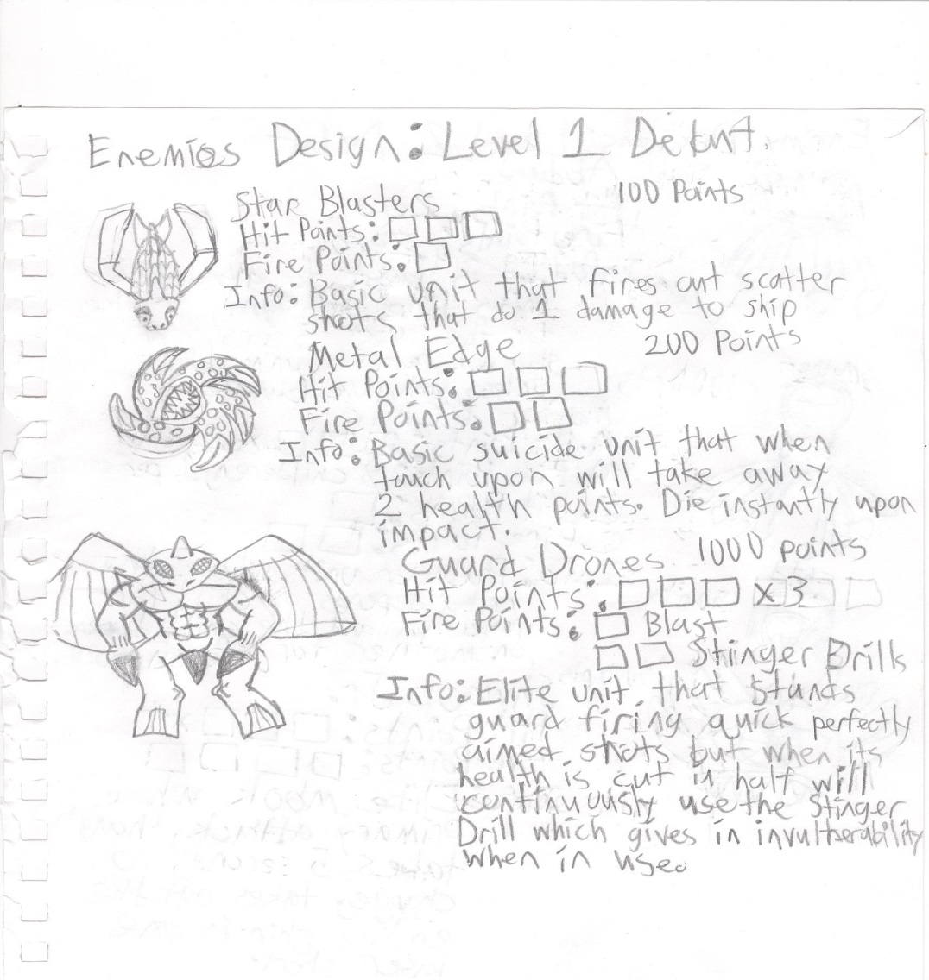
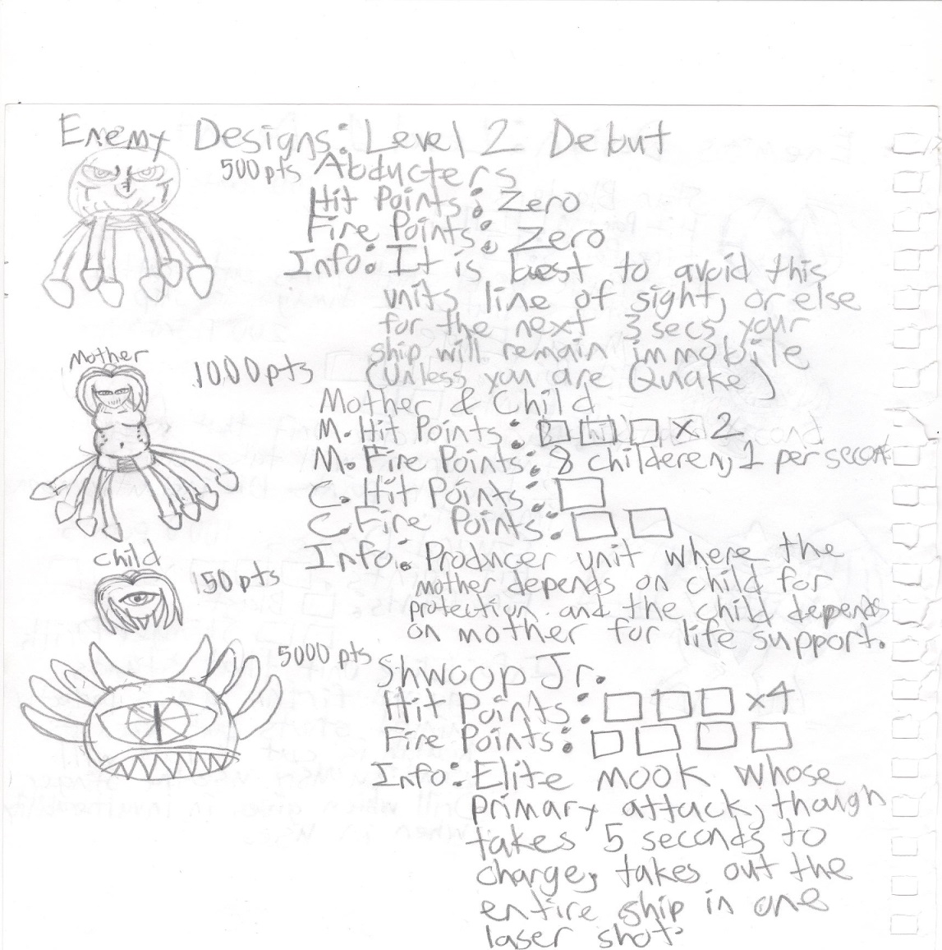
Concept Art: Enemy Targets

Slide 11
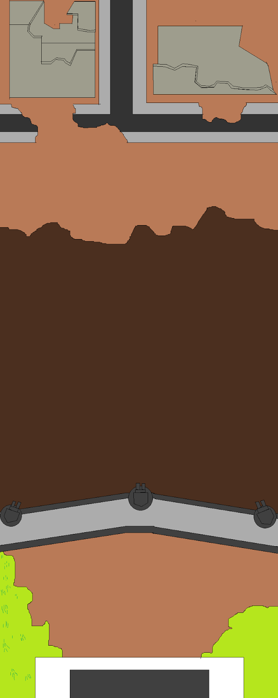
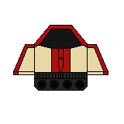
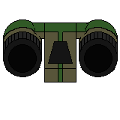
In-Game Sprites (Ships & Stage)

Slide 12
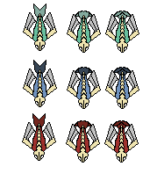
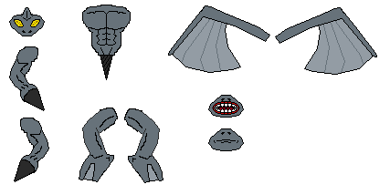
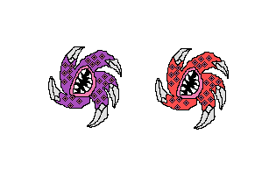
In-Game Sprites (Enemies)

Slide 13
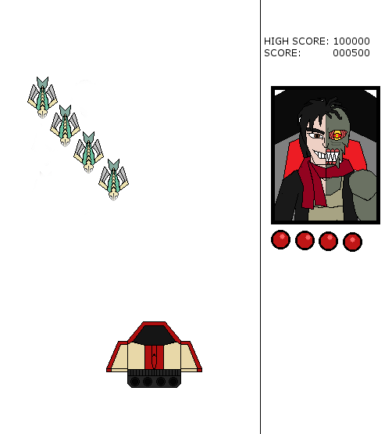
Final Game (Demo UI)

