Slide 1
2D Game Pitch
CIS 487 LeRoy Eberly & Zev Lopez

Slide 2
Abstract
In the game the player takes control of a new nation ruled by a dictator.
As a dictator the player is trying to gain control of all the territories by defeating all of the enemy nations so that the player can rule the world.
The game is a turn based game where each turn a player can move and attack adjacent square, defend one of their own squares.

Slide 3
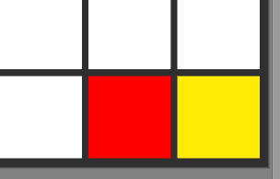
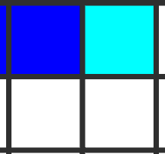
Appearance
The playing field will be a 5 X 5 block board.
Red block will denote enemy squares and adjacent yellow blocks will denote an enemies attack.
Blue blocks will denote player squares and adjacent light blue blocks will denote a players attack.
White blocks will denote neutral territories (squares).
The board will also have a turn counter and a turn log.

Slide 4
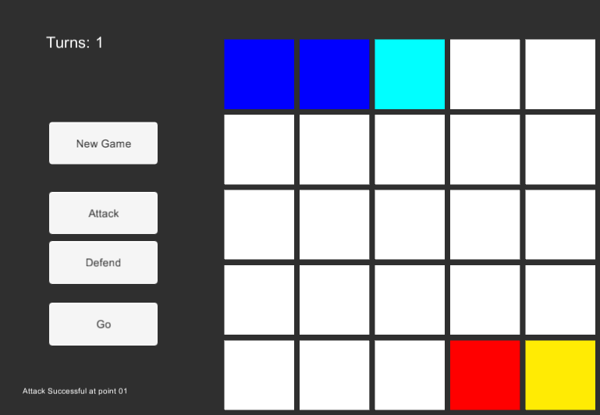
Game Board Layout
Official game board.

Slide 5
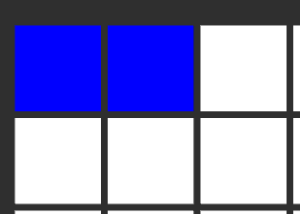
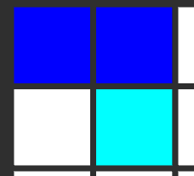
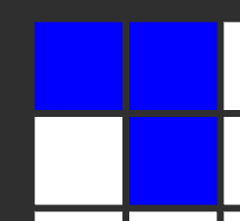
Player Roles and Actions
The game runs on a turn based system, where the player and the computer go back and forth until someone takes over the entire board or the player takes over all enemy territories.
Player’s turn
Player can move from one of his/her squares to an adjacent square in order to take it over. If the square is a neutral square then it is taken over automatically.
Ex. Of a player attack
Before Attack
Selecting Attack
After Attack

Slide 6
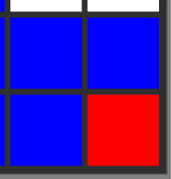
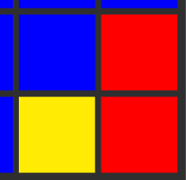
Player Actions continued
The player can defend one of his/her squares and if he does, then the chances of that square being taken over greatly decrease.
Players end their turn by clicking Go
Ex. The enemy goes for an atk on the lower left territory then the user hits defend and click on that yellow block under attack, finally a succesfull defend occurs and the player keeps their territory.
Before defend
Enemy attacks
After defend

Slide 7
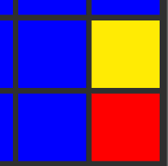
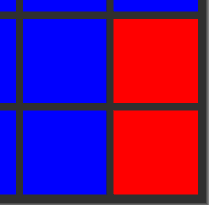
Computer Roles and Actions
Computer’s turn
The computer can perform all of the same actions as the player.
The number of turns the computer takes is based on the difficulty. The number of computer turns will vary to allow the player time to strategize.
Ex. Of enemy attack
Before enemy attack
During enemy attack
After enemy attack

Slide 8
Strategies and Player Motivation
Player Motivation
Player's goal is to take over the game map, by defeating the enemy nation.
Player takes the role of a new nation trying to gain control of the map in order to win.
Strategies
The player's main strategy during his/her turn is to move around the board in order to take control or the enemy territories (squares).
The player will also try defend their territories (squares) from enemy attacks.

Slide 9
Level Summary/Story progression
As you take over more territory you become stronger.
The game is a single level and once you take over the entire map you win.
The player must decide wether to play aggresivly, defensively, or a combination or both.

Slide 10
Hardware and Software
Hardware
The game will be built on a PC running: Win 7 PRo x64 Intel i5 - 4690K NVIDIA 960 GTX 1TB SSHD, and 3TB of HDD
Software
The game will be implemented using Unity 5.2
The scripting will be done with C#

Slide 11
Algorithm Style
Each type of object in the Unity Scene should have its own individual script
There will be a master game controller object that will have all of the information about the game state and relay information between objects
Algorithms themselves should follow Dynamic Programming where applicable
2D graphics and physics
The computer AI will be simplistic: It will first look to see if there is any free spaces (unclaimed) next to the territory that it controls. If there is any available, it takes the first one it finds and attacks it. If there is none, it will then look to see if there is another nation that can be attacked that it has a significant advantage (higher troop count) over. If it does, it attacks.

Slide 12
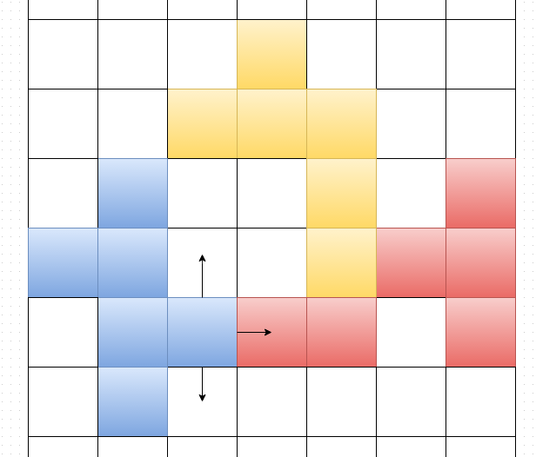
Possible Improvements
Multiplayer
Bigger Maps
More Enemies
Technology Trees
Troop Upgrades

