Slide 1
Team 2: 2D Game Pitch
Alexandra Alioto
Jeffrey Yackley
CIS 487
7 November 2015

Slide 2
Table of Contents
Executive Summary
Game Play Look and Feel: Appearance
Game Play Look and Feel: Floor Layout
Game Play Look and Feel: Ambience
Game Play Look and Feel: Player Roles and Action
Game Play Look and Feel: Characters
Game Play Look and Feel: Strategies
Game Play Look and Feel: Motivations
Game Play Look and Feel: Level Summary/Story Progression
Development Specification

Slide 3
Executive Summary
Type of Game:
2D Isometric Puzzle Game
Abstract of Game Story:
Deep asleep, a young child’s subconscious slips into a nightmare. In order to escape the terrors of their mind, the young dreamer must make their way through their nightmare by collecting items to unlock the doors on their quest to find a portal to escape their nightmare
Return to Table of Contents

Slide 4
Game Play Look and Feel: Appearance
1 Level with 5 Rooms:
Your bedroom (start)
Bathroom
Study
Conservatory
Hallway
Transitional space between rooms
Return to Table of Contents

Slide 5
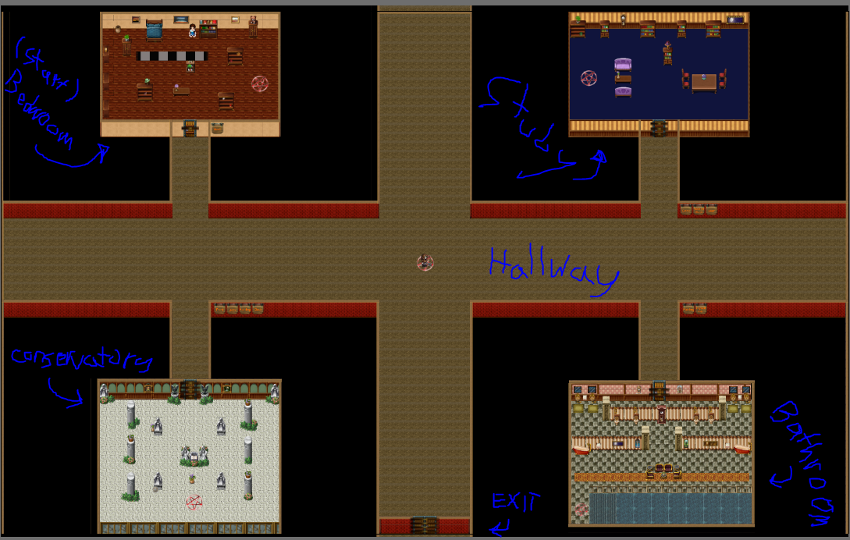
Game Play Look and Feel: Level Layout
Return to Table of Contents

Slide 6
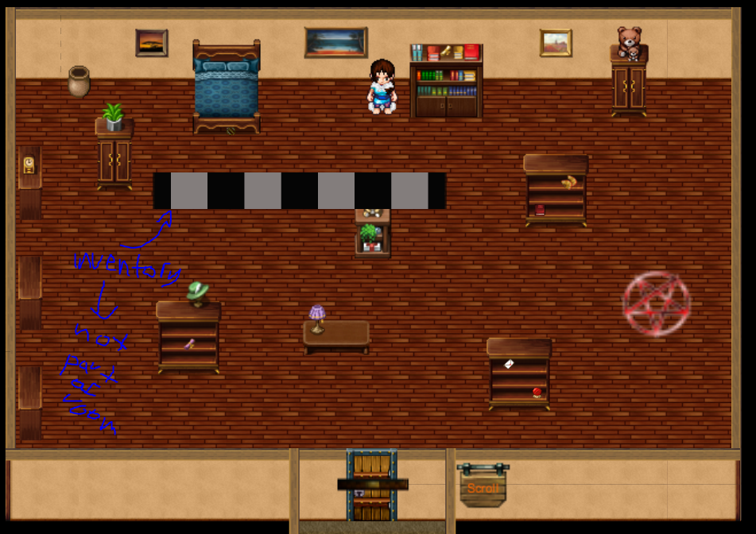
Game Play Look and Feel: Bedroom
Return to Table of Contents

Slide 7
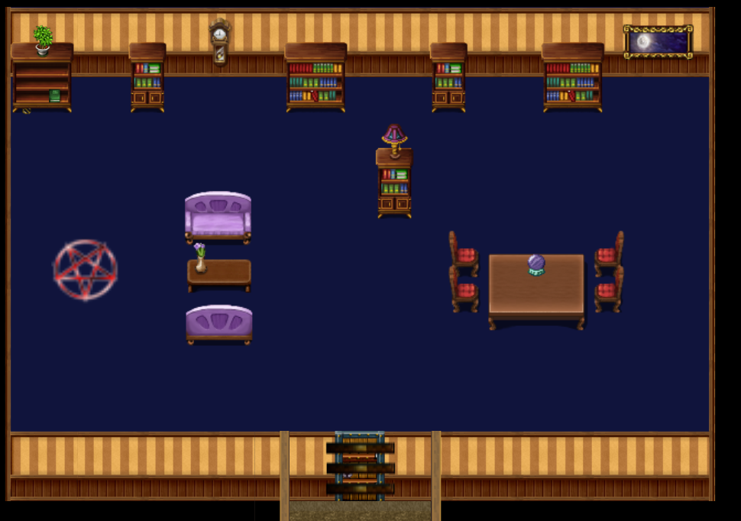
Game Play Look and Feel: Study
Return to Table of Contents

Slide 8
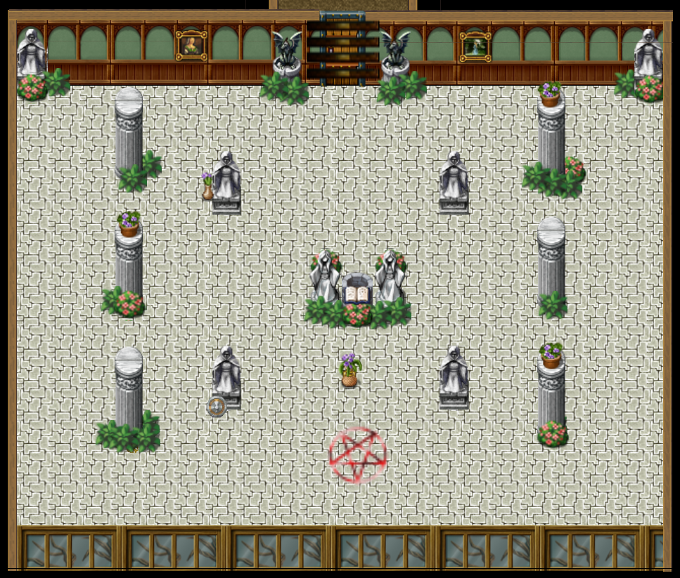
Game Play Look and Feel: Conservatory
Return to Table of Contents

Slide 9
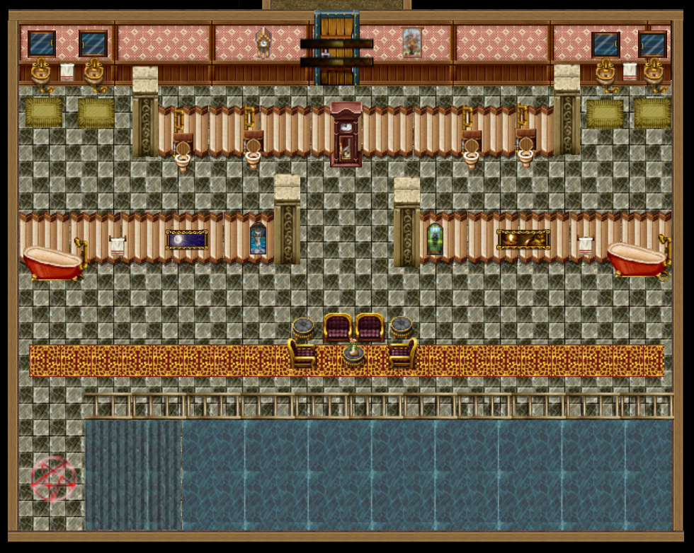
Game Play Look and Feel: Bathroom
Return to Table of Contents

Slide 10
Game Play Look and Feel: Ambience
Sound
Spooky background music to give the player a spooky, horror feeling
Darkest Child by: Kevin Mcleod
Vision
Concept Art
Game level layout (on previous slide)
Example of characters (on forthcoming slide)
Touch
Keyboard and mouse
Return to Table of Contents

Slide 11
Game Play Look and Feel: Player Roles and Action
Main character: Young child
Player Role:
To escape the nightmare by opening the front door of the house by collecting 4 keys items while avoiding the skeleton demon who is the embodiment of all the evil and terror in your nightmare. Other “key” items need to be found to open other rooms which contain the keys to the front door.
Player Actions:
Walk to and around different rooms of the house
Can carry up to four items at once in your backpack
Can remove items from your backpack and place them on the ground, in any room, in order to collect different items
Avoid being caught by the skeleton demon who patrols your nightmare
Return to Table of Contents

Slide 12
Game Play Look and Feel: Player Controls
Player Controls:
Mouse:
Select objects and pick them up with a click
Click and drag items to doors to unlock them
Click and drag items to the floor to drop them
Click buttons to advance through game introductory information
Keyboard
Arrows or (WASD) to move (N/W/S/E)
Shift key to open the backpack
Control key to close the backpack
Return to Table of Contents

Slide 13
Game Play Look and Feel: Characters (Player and Skeleton)
Return to Table of Contents

Slide 14
Game Play Look and Feel: Strategies
To find and collect the keys to the front door (the level exit).
Unlock the front door and travel through it in order to beat the game.
Key items are hidden in the other locked rooms which are unlocked with other items the player will need to find scattered around the house.
There is a limit of 4 to the number of objects you can select and take with you at once
There is a limit of the number of clicks total before players begin to incur a penalty to discourage random clicking to find the items
Based upon total number of items a player will need to find.
Movement speed of skeleton demon increases after click limit reached and increases based on the number of clicks over the limit.
Return to Table of Contents

Slide 15
Game Play Look and Feel: Motivations
Collect items in order to unlock doors
Open all the doors on a level to find the end of level keys to win the game.
Avoid getting caught by your subconscious skeleton demon or you’ll be trapped forever in your nightmare (thus ending the game).
Return to Table of Contents

Slide 16
Game Play Look and Feel: Level Summary/Story Progression
Level Summary:
Only level is a floor plan representing a dream version of the character’s house
Each level has 5 rooms (4 locked rooms plus the hallway that connects the rooms) with various objects in them
“Front” locked door will lead to victory and the end of the game.
Each room has a plaque outside that describes the necessary items needed to open it.
Return to Table of Contents

Slide 17
Development Specification
Hardware:
Computer
Keyboard and mouse
Software:
Construct 2
GIMP / Photoshop
Microsoft Office / Google Docs
Internet browser (Firefox)
Algorithm Style:
2D graphics and animation
Artificial Intelligence
End User Hardware and Software Requirements - Recommended Specs:
Computer w/ modern operating system (Win XP SP2 or later)
Processor: Pentium 4 or better
RAM: 1 GB or more
Hard Disk Space: ~26 MB
Internet browser (Firefox)
Keyboard and mouse
Return to Table of Contents

