Slide 1
Goji’s Adventure
by
Eric Smith
Notes:
Hello, my name is Eric Smith and I will be pitching an idea for a game called Goji’s Adventure.

Slide 2
Story
Goji and her family live on a peaceful tropical island.
Goji’s family is renowned the world over for making the most delicious candies.
Her grandmother says the secret to their candy is the magical soil found only on their island. She has even told Goji stories of magic candies made using secret recipes which let people fly, breath underwater, or talk to animals.
Notes:
The games revolves around a girl named Goji. Goji and her family live on a peaceful tropical island. Goji’s family is renowned the world over for making the most delicious candies. Her grandmother says the secret to their candy is the magical soil found only on their island. She has even told Goji stories of magic candies made using secret recipes which let people fly, breath underwater, or talk to animals.

Slide 3
Story
One day Goji is gathering ingredients when she hears a soft cry coming from the dangerous island jungle. Goji knows she shouldn’t go into the jungle but she has a soft heart and can’t bear the thought of someone in pain. Reluctantly, and carefully, she begins searching for the cry. Soon she discovers a small animal trembling with fear hidden inside a hollowed out log.
Notes:
One day Goji is gathering ingredients when she hears a soft cry coming from the dangerous island jungle. Goji knows she shouldn’t go into the jungle but she has a soft heart and can’t bear the thought of someone in pain. Reluctantly, and carefully, she begins searching for the cry. Soon she discovers a small animal trembling with fear hidden inside a hollowed out log.

Slide 4
Story
Goji uses candy to lure the small animal out. Soon she is petting a tiny elephant. Goji wonders what could have scared the little creature so much.
Remembering what her grandmother told her about magic candies she sets out on a quest to find a special recipe that will let her talk to her new friend.
Notes:
Goji uses candy to lure the small animal out. Soon she is petting a tiny elephant. Goji wonders what could have scared the little creature so much. Remembering what her grandmother told her about magic candies she sets out on a quest to find a special recipe that will let her talk to her new friend.

Slide 5
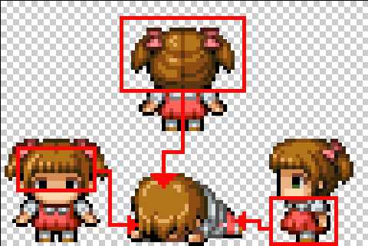
Gameplay look and feel
2D side scrolling platformer
Collect
Craft
Pet helps player
Player and enemies don’t die
Notes:
Goji’s adventure is a two dimensional side scrolling platformer with collecting and crafting aspects. The game has unique gameplay features involving Goji’s pet and player and enemy deaths. In fact neither the player or enemies die. Instead enemies are converted to friends and the player is setback by losing their pets trust. The intent is to keep the game light hearted and fun.

Slide 6
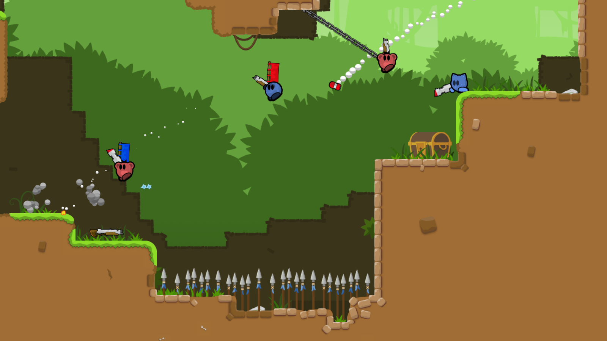
Appearance
Jungle theme
Land, water, trees, caves
Light hearted feel
‘Cute’ graphics
Notes:
The game takes place in a jungle themed environment. This allows level environments to vary considerably. Environment options include land, streams, tree tops, and caves. Overall the game will have a light hearted feel with cute characters and backgrounds.

Slide 7
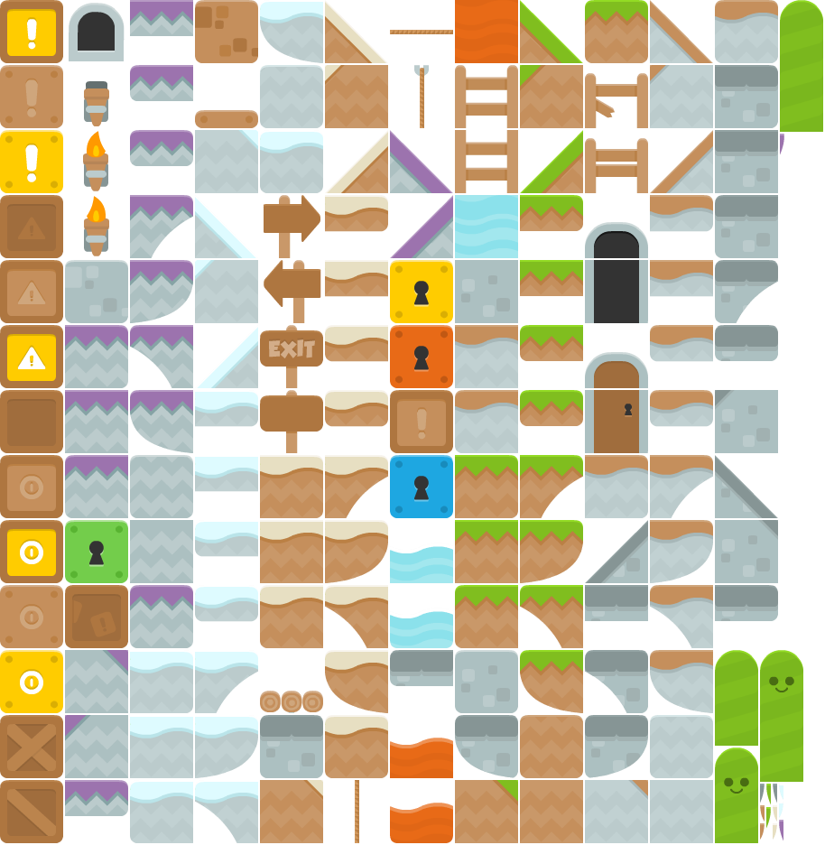
Player roles and actions
Protect pet
Advance through level
Move in 4 directions
Climb, jump, and throw
Command pet
Activate switches
Open locks and doors
Grab hard to reach items
Notes:
The players main role is to protect their pet from enemies as they advance through the level. The player will be able to move left and right, climb ladder structures, and throw candies. The player is also able to command their pet to assist them by standing on switches, opening locks, collecting hard to reach items, or boosting the player over obstacles.

Slide 8
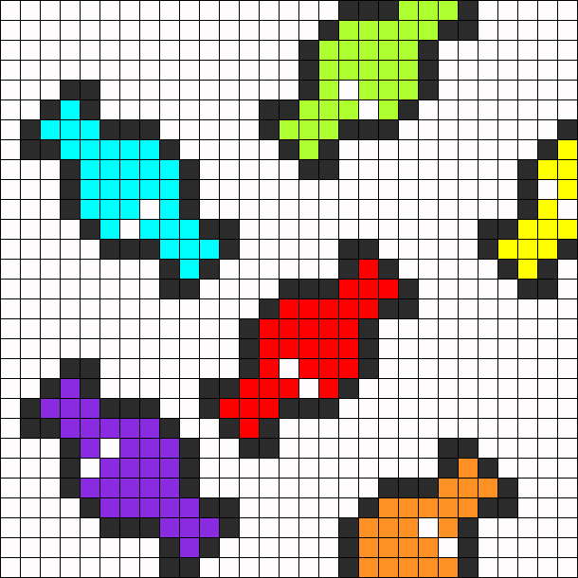
Strategies
Protect pet
Throw candy
Convert enemies to friends
Maintain pet’s trust
Avoid pet abandonment
Notes:
The players immediate goal is to protect their pet. The player does this by throwing candy at enemies, converting them to friends who leave the screen harmlessly. If an enemy reaches the players pet, the pet loses trust in the player. This is represented by the pet moving further away from the player. Once the pets trust is depleted the pet leaves the screen and the player must move backwards through the level to find their pet.

Slide 9
Motivations
Collect ingredients
Defeat bosses to earn recipes
Build pet’s trust to improve ‘health’
Gain special abilities
Craft powerful weapons (candies)
Notes:
The players motivation is to collect ingredients and recipes, and to craft rare candies. Ingredients are collected from strong enemies and recipes are collected from boss enemies. Together ingredients and recipes can be used to craft rare candies which grant the player’s pet special abilities, act as more powerful weapons, or increase the pet’s trust.

Slide 10
Level summary
Jungle themed world includes levels featuring:
2D side scrolling platformer style
Obstacles require assistance from pet
Puzzles to solve
Basic enemies drop candies
Strong enemies drop ingredients
Level boss drops a recipe
Notes:
Levels follow a typical side scrolling 2d platformer format except they include obstacles which require assistance from the player’s pet to pass. Often these obstacles include puzzle aspects that must be resolved. Most enemies within a level are standard enemies that drop common candies. Occasionally, the player will encounter strong enemies. These enemies drop ingredients. At the end of each level the player must defeat a boss enemy. Boss enemies drop recipes, each recipe is unique.

Slide 11
Story progression
As the player progresses they will:
Complete levels
Earn recipes
Collect ingredients
Craft rare candies
Gain new abilities and improved health
Defeat the final boss and talk to your pet!
Notes:
As the player progresses through the levels they gain a number of recipes which allow the player to craft rare candies once the proper ingredients are collected. Rare candies effectively provide the player with new abilities and improved health. The player’s goal is to reach the final boss who holds the last ingredient needed to craft a candy that will allow the pet to talk.

Slide 12
Development Specification
The game will be developed using Construct 2 for use on pc’s running Windows. The game will utilize a gamepad or keyboard for control. The game will adhere to the usual 2d platformer format using sprite animation, collision detection, and physics to implement game features.
Notes:
The game will be developed using Construct 2 for use on pc’s running Windows. The game will utilize a gamepad or keyboard for control. The game will adhere to the usual 2d platformer format using sprite animation, collision detection, and physics to implement game features.

Slide 13
Hardware and Software
Recommended system requirements
Windows 7 or newer
2 GB of RAM
2 GHz Dual Core Processor
nVidia or AMD graphics card with latest drivers
AC’97 sound card
Gamepad
Notes:
Most modern pc’s will be capable of running the game. Recommended hardware includes a video card with integrated graphics, a gamepad, and sound card.

Slide 14
Algorithm Style
Construct 2
Sprite animation
Rope follow for pet mechanics
Enemy AI using path finding
Physics to simulate gravity on thrown objects
RNG to determine enemy drops
Notes:
The game will be built using functions included in construct 2 using 2D sprite animation. It will rely on a rope follow mechanism for basic pet mechanics. Path finding will be used for enemy movement and AI. Physics will be applied to thrown candies to represent the motion of a tossed item. Enemy drops will be determined a random number generator.

Slide 15
Thank you!
Notes:
Thank you for your time, I look forward to your feedback.

