Slide 1
Tenebrae
2D Game Pitch
By: Kelly Katarzis and Brandon Leon

Slide 2
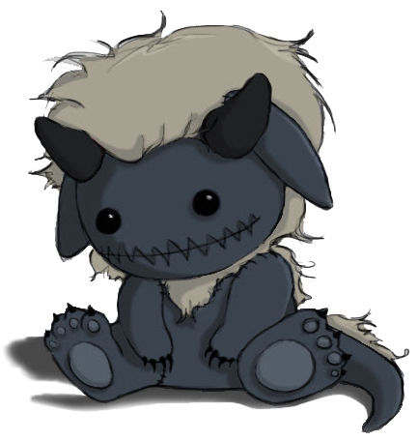
Story
Children have wild imaginations, which can sometimes produce scary dreams. The story begins with a young boy sleepily lying in bed with his favorite stuffed monster toy. The night is eerie, and he falls asleep watching the shadows of the trees dance outside his window.
He next finds himself in a dark forest, costumed as his favorite stuffed toy.

Slide 3
Appearance
2D side scrolling with emphasis on creating an immersive environment
All custom painted graphics
Parallaxing backgrounds to give each level more life
Lighting changes based on player location
Phantom/Ghost-like enemies

Slide 4
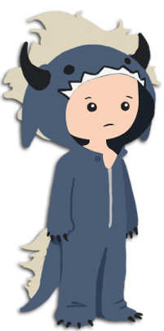
Player Roles and Actions
Player controls the boy in his monster costume
Will be able to move left, right, jump, and perform various skills that will be acquired throughout the level
Puzzle solving

Slide 5
Strategies and Motivations
Adventure puzzle genre, similar to games such as OddWorld: Abe’s Oddysee
No direct attack abilities available to the player
Enemies are defeated through solving puzzles
Defeating enemies will reward players with defensive skills to further progress through the level

Slide 6
Level Summary/Story Progression
The game takes place in the forest
The forest contains enemies and a cave
As the player progresses, the level will become darker
Rather short due to time limitations

Slide 7
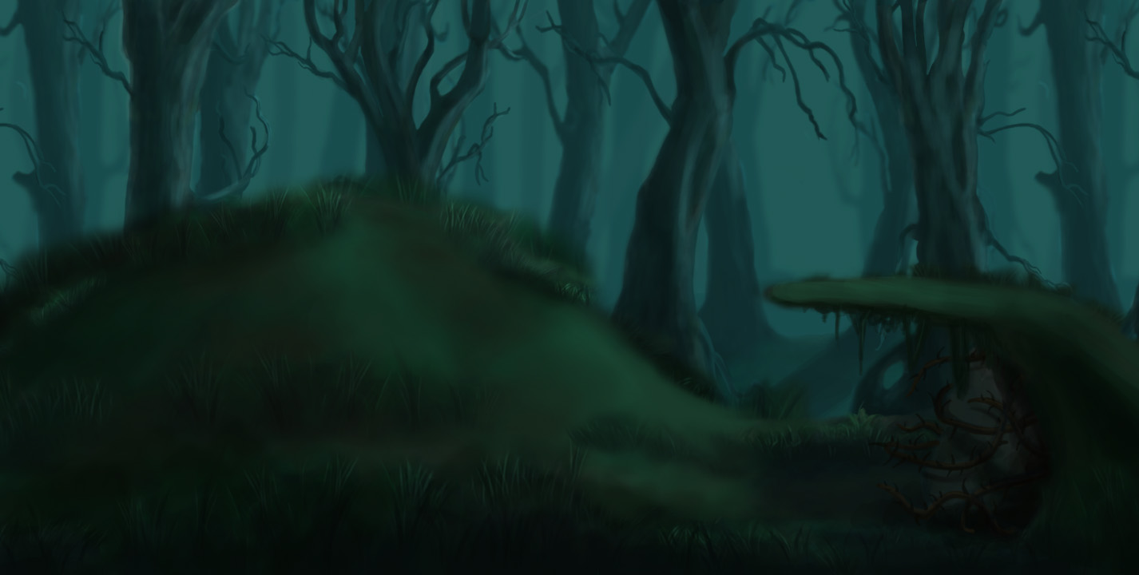
Concept Art - Levels

Slide 8
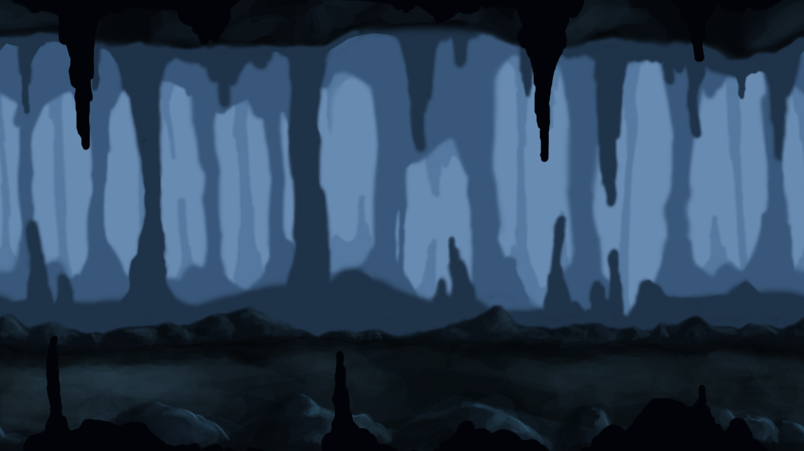
Concept Art – Levels (continued)

Slide 9
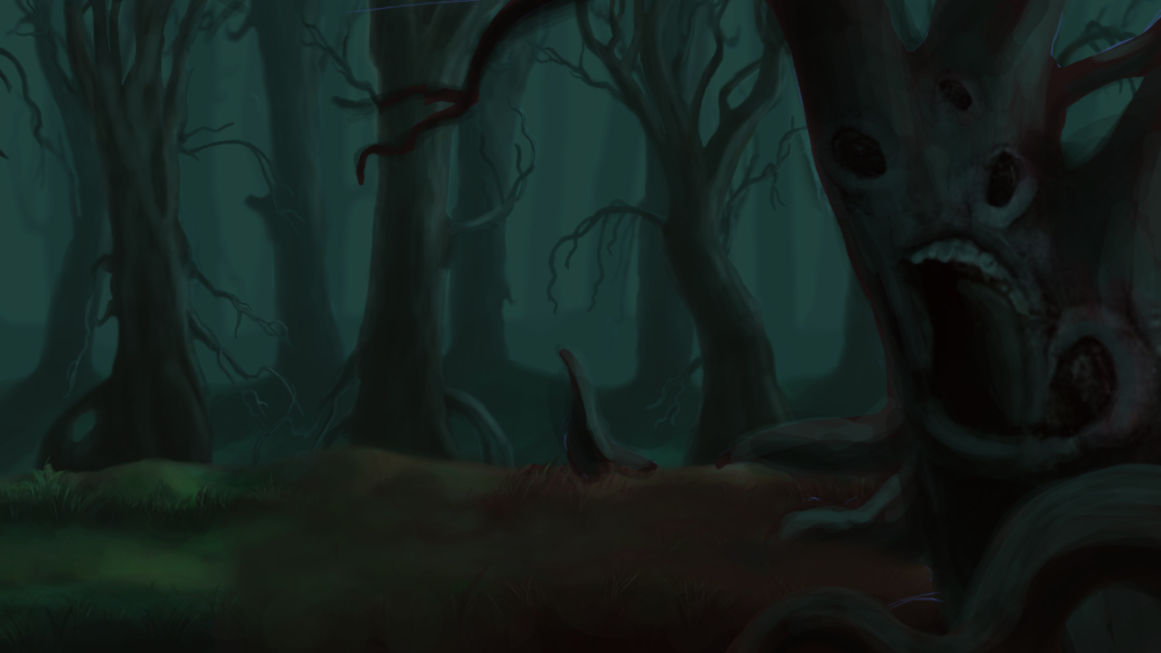
Concept Art – Levels (continued)

Slide 10
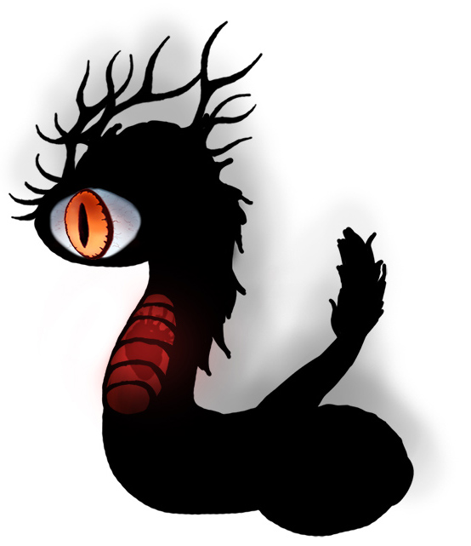
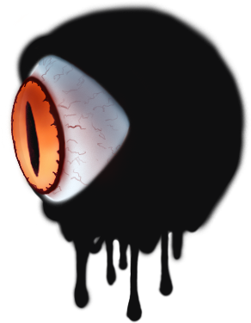
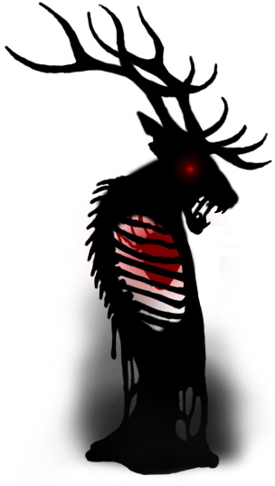
Concept Art – Enemies

Slide 11
Hardware
Will run on desktops and laptops with a web browser
Gameplay will primarily use the keyboard
Mouse features may be implemented
Integrated soundcard and speakers are recommended
Touch capabilities for mobile devices will not be supported

Slide 12
Software
Will run on a web browser that supports HTML5
All development is being done in Construct2 and all art is being created in Photoshop CS6

Slide 13
Algorithm Style - Environment
General platformer physics (moving left, right, and jumping)
Bitmap art is handplaced and repeated throughout the world for efficiency
Collision rectangles placed behind art to simulate solid ground or objects
Invisible checkpoints used to fire off certain events when the player moves over them such as lighting, save points, music, or enemies

Slide 14
Algorithm Style – Enemy AI
Enemies will inherit some physics attributes such as rolling or possibly bouncing
Enemy AI will utilize pathing patterns, line of sight, and player pathfinding

Slide 15
Algorithm Style – Game Progression
Display the title/menu screen
Loop the game until victory is achieved or the player quits
Display the ending scenario and run credits
Return to the title screen

Slide 16
Questions
or
Comments?

