Slide 1
2D Game Pitch
Nicole Farquhar

Slide 2
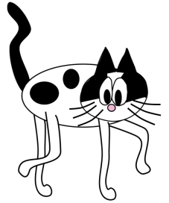
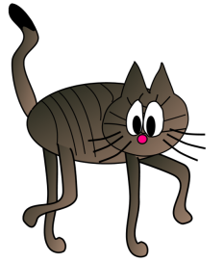
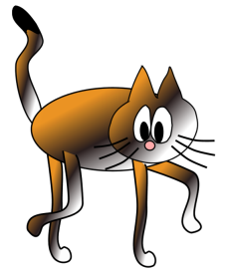
Executive summary
The Earth is being attacked by alien space mice. In order to save the Earth our space cadet cats (the player) must take down these aliens. The cats will travel to outer space in a ship and use missiles to destroy the mice. Through the use of power-ups the cats can gain extra lives giving them more time to destroy aliens. The cats must destroy as many aliens as they can before dying in an attempt to give Earth the best chance at survival.

Slide 3
Game play, look and feel
Appearance
This game will have a very similar feel to Asteroids with a more modern touch.
The background will be a nice outer space image
The alien mice will be green cartoon mice with red eyes carrying meteor chunks.
The Cadet Cats will be in a blue spaceship that can shoot missiles at the mice.
Power ups will be displayed as milk cartons which will spin around.
HUD display will show current number of lives (hits) left and the current score.
SEE NEXT PAGE FOR SCREEN MOCK UP

Slide 4
Menu Layout

Slide 5
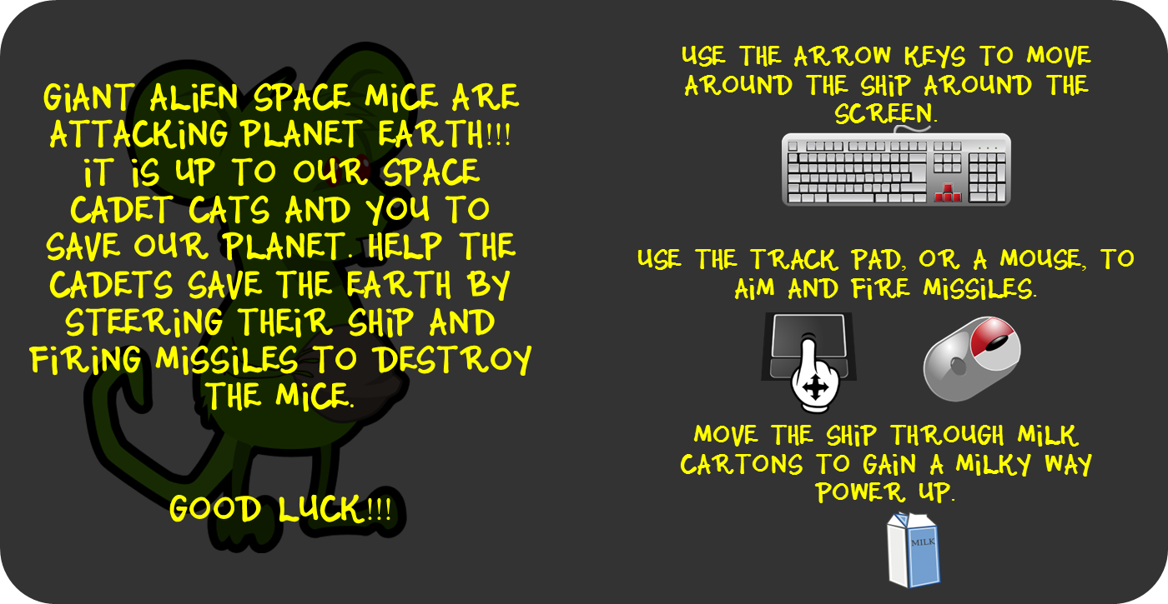
Menu Layout: Information/Instructions

Slide 6
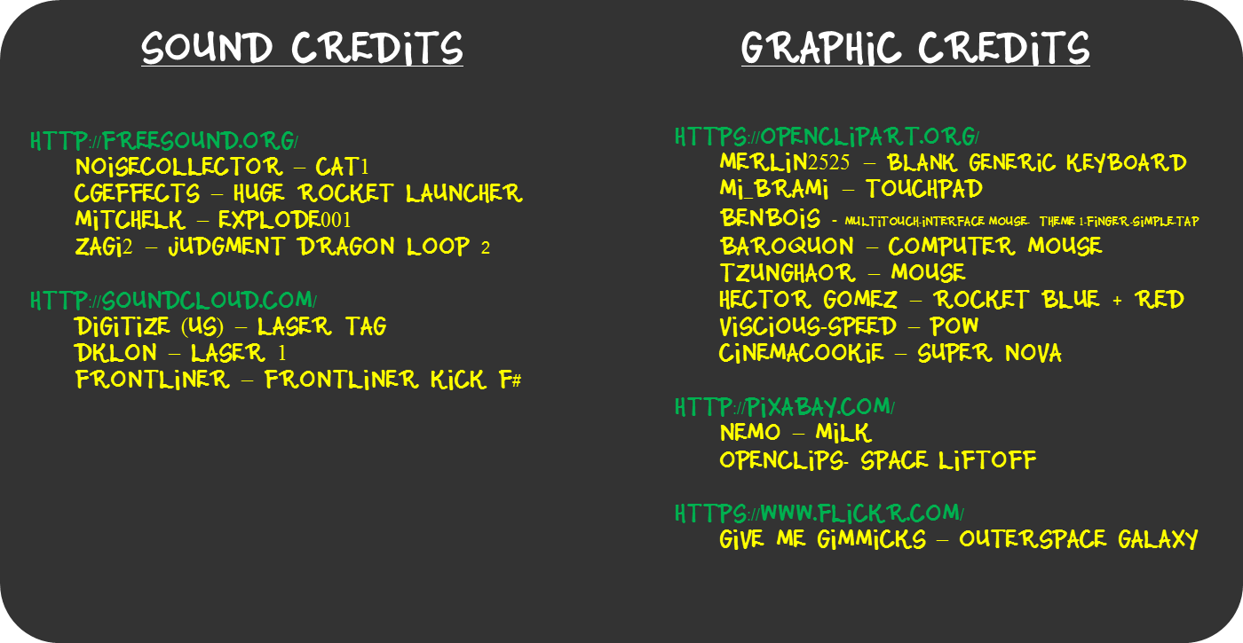
Menu Layout: Credits

Slide 7
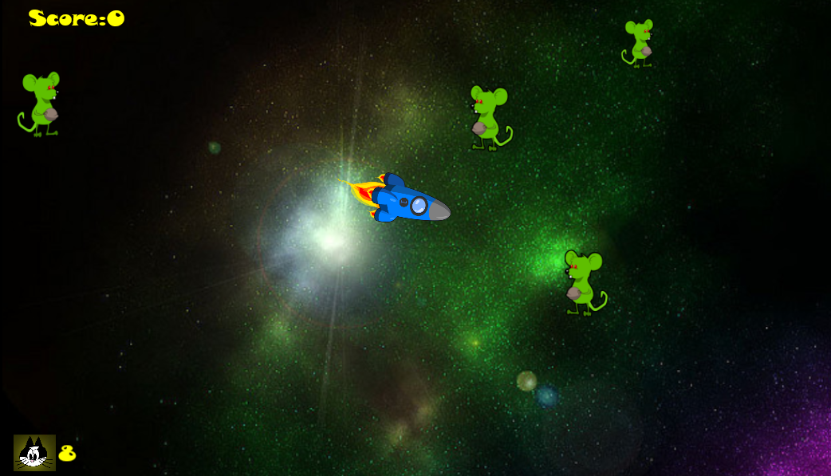
Game Layout

Slide 8
Game play, look and feel
Player roles and actions
The Cadet Cats must use the missiles from their ship to destroy the alien mice.
New alien mice will appear at varying times. The rate of arrival depends on both the level of difficulty chosen (Easy or Hard), as well as, the current time spent in the level.
Alien mice are of varying sizes and will move at varying speeds, each strike from the Cadet Cats will reduce the alien’s health. The mice will shrink as their health decreases. Once they are the smallest and are hit, they will be destroyed. Each strike is worth varying points depending on the current size of the alien mouse.
The Cadet Cats can move their ship around in any direction across the screen.
There are milky way power ups (these are cartons of milk) which will give the Cadet Cats an extra life, allowing them to be hit one additional time. To get this power up the player must move the ship to the milk to collect the carton.
Power ups will only be visible for a short period of time. The Cadet Cats must get to them before they disappear.

Slide 9
Game play, look and feel
Strategies and motivations
This is a high score game. The goal is for the player to stay alive as long as they can to achieve the high score.
In order to stay alive longer the player should work towards getting as many of the milky way power ups.
One strategy might be to work towards destroying the faster moving mice first as they will be coming at you faster.
Another strategy could be to shrink the largest mice to give you more free space to move about the playing field.
This game is intended to be a simple addictive arcade game.
Level summary/story progression
There are two levels of difficulty available for the player to select. In the hard difficulty the mice arrive at a faster rate, take more hits to destroy, and also can move at higher speeds.

Slide 10
Development specification
Hardware
To play this game you will need a laptop capable of running an HTML5 game.
There will be audio in this game, if you would like to hear the audio you should have some kind of speaker or headphone.
Software
Game will be created using Construct2 to produce an HTML5 game.
Algorithm Style
2D sprite creation
Steady camera : no camera movement
Randomized creation of alien mice.
Speed will be chosen at random from a range and will depend on the difficulty level.
Initial size will be chosen at random from a range.
Mice will be created just outside the borders of the screen. The location will be a random X and a random Y value of this border

