Slide 1
Nicole Ebiware
James Polisuk

Slide 2
Executive Summary
In Heroic Age, there are multiple protagonists, and they all have very special reasons for embarking on the journey to defeat the main antagonist, Kiloran. If he is not defeated, he will unleash terror upon the world. The protagonists must defeat him before it is too late.

Slide 3
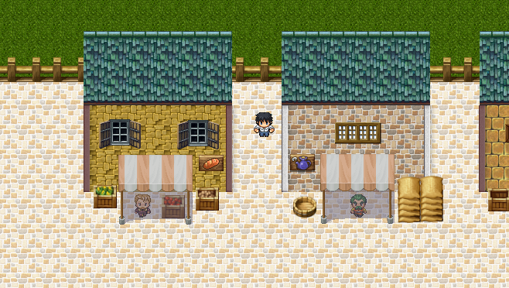
Appearance
2D Turn-based Role-Playing Game.

Slide 4
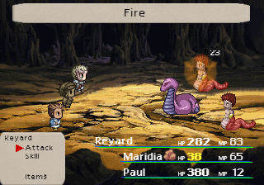
Battle Style

Slide 5
Players Roles and Actions
You play as a group of heroes who are trying to save the world from an evil force threatening its existence. It is an rpg with turn based combat. You have the ability to use attack, skills, magic and items. The magic spells are Fire, Ice, Lightning and Cure. Skill attacks vary depending on the character’s fighting style.

Slide 6
Strategies and Motivations
You want to explore the zone to get as many battle sequences as possible to level up and be strong enough to fight the boss of the zone. Motivation is to get stronger to progress the story and find better weapons, items, and armor.

Slide 7
Level Summary/Story Progression Naire Village
Naire Village is where you grew up. It is a small town, so everybody knows everybody else. The streets are filled with familiar faces, and quaint buildings. One fateful day, the old philosopher of the village tells you that you are the one to defeat the evil being known as Kiloran. You are full of disbelief. He hands you a weapon, and you leave in a hurry to complete your chores which are interrupted by an unexpected encounter with a slime monster. After this battle, you notice the increasing dangers caused by Kiloran, and prepare to depart on your journey.

Slide 8
Lain Forest
Lain Forest is a natural maze. You must travel through the woods in which there are many traps and guardians (monsters) which you must travel past. They are trying to keep you from reaching the cave entrance.

Slide 9
Rosin Cave
You finally reach Rosin Cave, where a powerful monster resides. You see a person trying to defeat the monster, but they are obviously in danger. You join them, and together defeat the monster within the cave. After the battle, the person reluctantly joins you, but they believe it is necessary in order to find and defeat Kiloran. You, then, learn the truth of the darkness in the world and begin your journey to cleanse the world of its taint.

Slide 10
Hardware/Software
PC
Keyboard/Game Controller
512 MB RAM
1 GHz Processor
Windows XP Service pack 3 or newer
HTML5 Compatible Browser
Audio Speakers

Slide 11
Algorithm Style
Random battles
Mathematical battle sequences

