Slide 1
Mila
2D Game Pitch
Kazi Ahmed
Fadi Alnabolsi
CIS 427 - Fall 2014

Slide 2
Executive Summary
Top down 8-bit Zombie Survival
Man wakes up in a hospital, discovers there’s zombies everywhere, searches for family so he can escape with them
More to this zombie infestation than meets the eye

Slide 3
Story
Jimmy Charles mysteriously wakes up in a hospital bedroom, with no memory of how he got there, to discover that it has been overtaken by zombie creatures.
His goal is to escape the hospital, find his wife and daughter, and get to somewhere safe.

Slide 4
Story (In-Depth) (Spoilers?)
Jimmy’s wife actually shot him in the head. Jimmy wakes up in the hospital with amnesia.
His wife is a scientist/researcher. She experimented on herself, losing her mind in the process. (This unknown to Jimmy until he finds her at the end of the game)

Slide 5
Story (In-Depth) (Spoilers?)
One of the early enemies in the game actually turns out to be your daughter (but you don’t know that). It’s discovered at the end when you end up finding your wife.
Turns out Jimmy’s wife infected the entire hospital, and he is given a choice between blowing up the hospital (with him inside of it) or letting the infection spread.

Slide 6
Gameplay
8-Bit Top-Down Shooter.
Pre-determined text dialogues between character and NPCs for story progression.
Use and swap items (guns, medicine)
Start at top of “Savior” hospital and work your way down each level of the hospital. Jimmy’s house is conveniently across the street of the hospital.

Slide 7
Audio/Music
Gunshots audio grabbed from free sources online.
8-Bit adrenaline pumping zombie music.
Eerie music for when you’re sneaking past the zombies.
Example of fight music:
https://www.youtube.com/watch?v=0X3Dbqkmd0o

Slide 8
Player Roles
The player can:
Maneuver the character
Pick up items (ammo, notes, medicine)
Read notes
Use items
Swap and reload weapons
Interact with environment

Slide 9
Strategies
Sneak past the Zombies to the end of the level in order to conserve ammo
Shoot explosive barrels when zombies are near them (can bait zombies into walking towards barrel)
Cycle through weapons to adjust to swarm of zombies

Slide 10
Motivations
Jimmy wants to find his family and escape to safety.
He also wants to know what happened, but that’s second priority to his family and escaping (optional).

Slide 11
Level Summaries
The player starts at the top floor of a hospital full of zombies. He has to get to the bottom, level by level.
He can sneak past the zombies, or he can shoot his way past them.
There will be weapons that can be picked up (along with ammo) the further along you get. Several members of the local police died with their weapons fighting in the hospital.
There will be boss zombies and the levels will get more difficult as you progress.
Final stage is at Jimmie’s home where you face the final boss zombie hybrid.

Slide 12
Story Progression
Little pieces of lore are left in the form of documents on the floors of the hospital. The user can read them, or he can skip them.
As of now, two main pieces of story progression. When you kill your daughter-turned-zombie, and when you face your wife at your house. Your wife explains how that zombie you killed was your daughter, and how she (the wife) is the mastermind behind everything.

Slide 13
Hardware
PC
CPU: Intel Pentium 4 or better
GPU: Radeon HD 4800 or better

Slide 14
Software
Game Engine: Construct 2
Windows 7 OS

Slide 15
Algorithm Style
Simplicity is key.
Instead of a traditional leveling system, upgrades are unlocked as you progress through the game. (Simple boolean stating if weapon has been unlocked or not) If weapon is unlocked ammo pickups for that weapon will start appearing
Zombies have a simple forward-facing detection system (Triangle). If the player makes a noise in a certain radius of the zombie, it will attack.

Slide 16
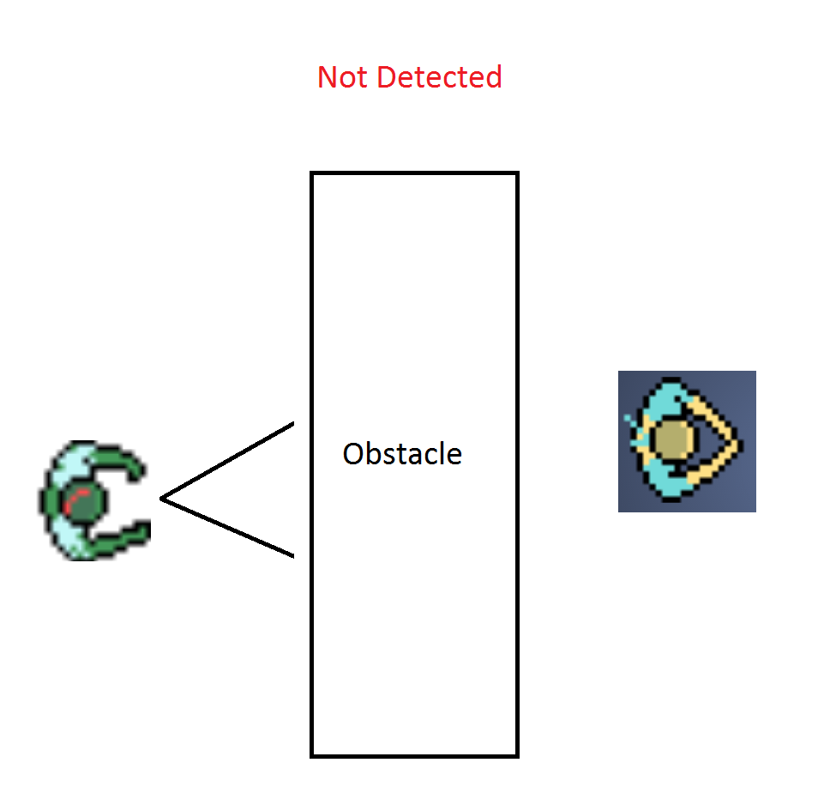
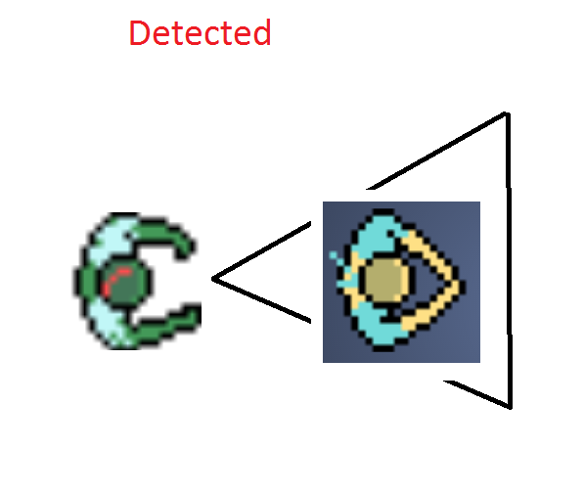
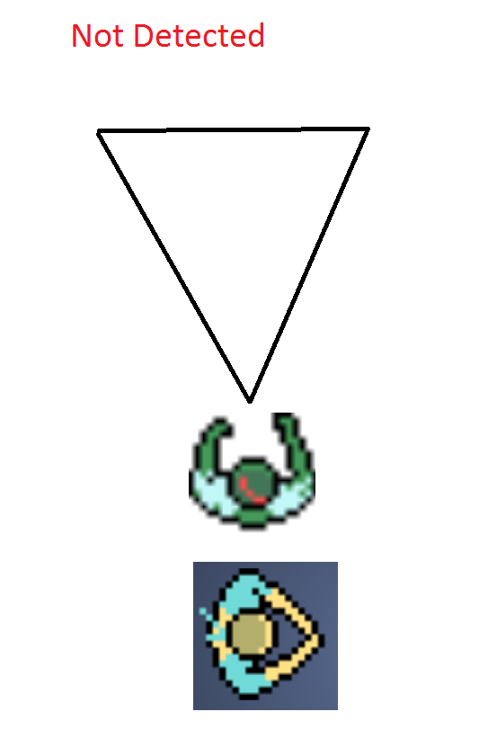
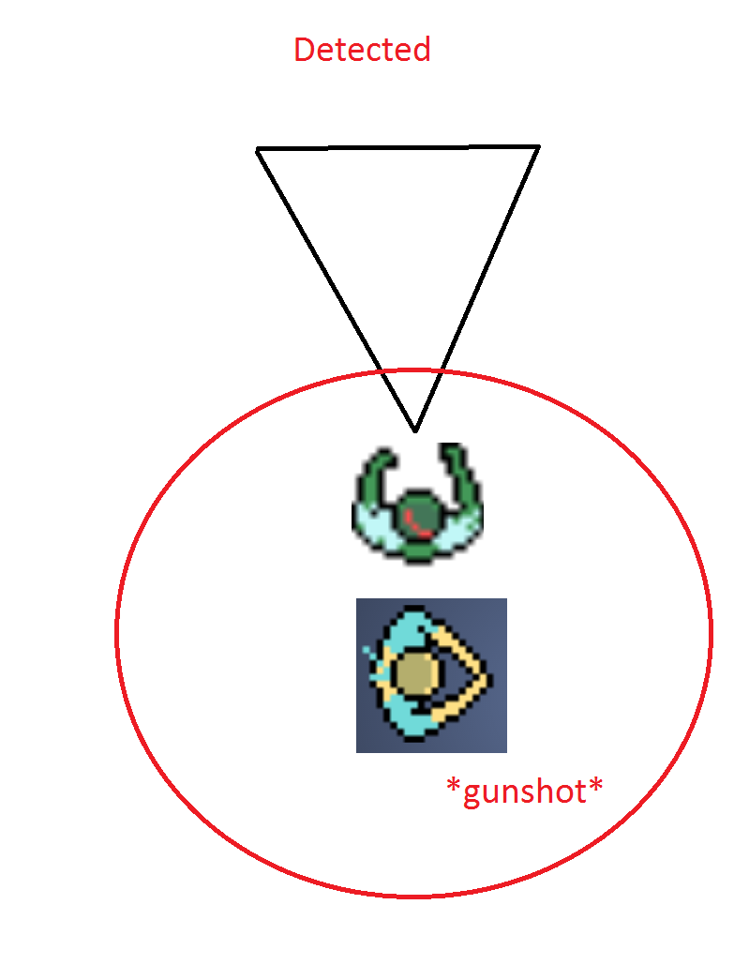
Algorithm Style - Detection States

Slide 17
Media/Art
Zombie Protagonist Ammo
Health Revolver Pistol

Slide 18
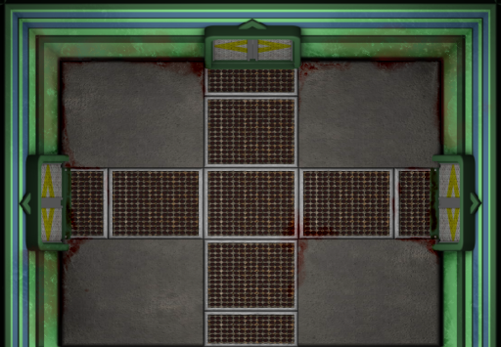
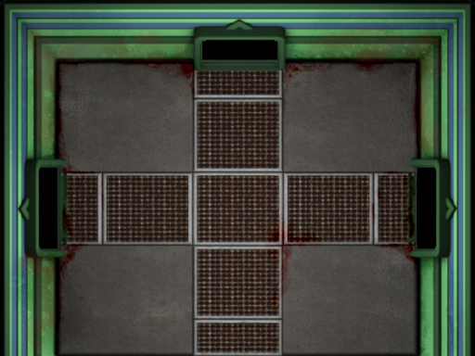
Media/Art
Basement Floor (level 0) Floor TIles
Uzi

Slide 19
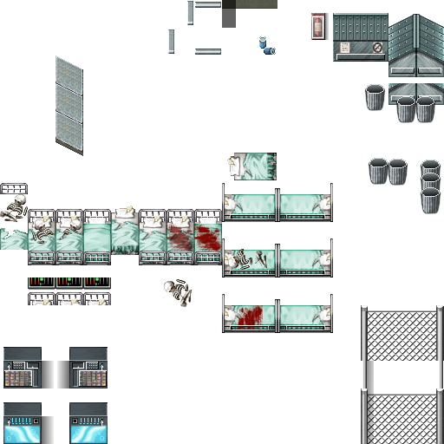
Media/Art
Hospital Items

