Slide 1
Space Rescue
Chad Seippel
Cory VanHooser

Slide 2
Story
2050 brand new International Space Station
Distress call from ISS about “alien attack”
No further communication
Special unit of soldiers sent in to rescue any survivors, you are one of those soldiers
Ship crashes when docking into ISS, you are the only survivor
Oxygen leaking in station, you must escape before it runs out

Slide 3
Gameplay
2D dungeon crawler
Player control themselves as a soldier while searching space station for survivors
Option to rescue survivors and must escape to win
Fighting enemy aliens along the way
1 hit death for player
Multiple types of aliens with strengths and weaknesses, vary in health
Boss alien

Slide 4
Gameplay
One type of weapon
Armor that allows your to take damage (one hit and you lose it)
HUD
Time remaining
Survivors found / remaining

Slide 5
Controls
WASD to move player
Arrow keys to shoot weapons
Up arrow shoots up, down shoots down, etc.
Armor automatically picked up by walking over them
Mouse click to navigate menu

Slide 6
Levels
Player has to navigate through the space station to escape
One player rescues all the survivors, he/she must defeat the boss to win

Slide 7
Scoring
No true point system
Player time is recorded
High score is fastest time completed

Slide 8
Artwork/Sounds
Futuristic space focus
Sprites with common licensing
Little to none original art
Sounds will be commons focused on ambient electronic style, lasers and explosions

Slide 9
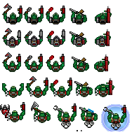

Slide 10
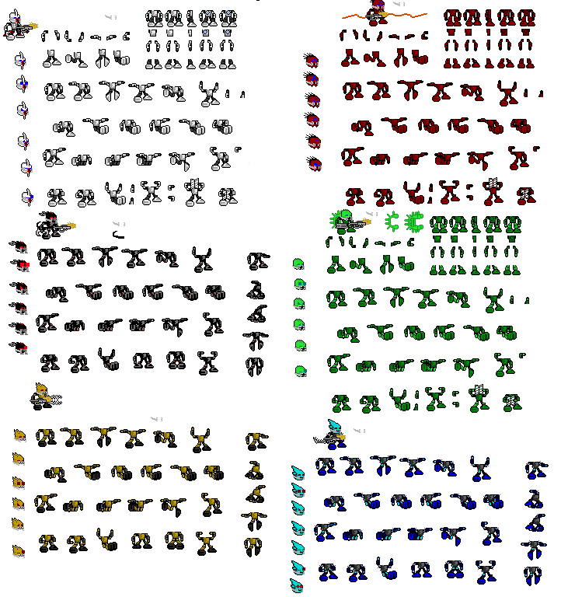

Slide 11
AI
Aliens have some sort of aggro
Passive wanders, charge on sight
Ranged attacked, melee
Bosses have special abilities used between attacks

Slide 12
Hardware/Software
Construct 2 software to implement game
Windows 7
2GB RAM
Dual Core CPU
NVIDIA GeForce GT 520 and up

Slide 13
Strategies / Motivations
Always be moving, staying still will allow for the aliens to overwhelm you.
Move quick, there is a time limit so it’s important to reach the end as soon as possible. This may include running past enemies instead of killing them.
Rescuing survivors gives you oxygen, so sometimes it’s worth the time to get them

Slide 14
Algorithm Style
Start Game
Start timer
Begin
Generate map, NPC’s, character
Loop
Background and decrease timer
Update player and NPC’s
Update collision boxes with all characters and items
Update player and NPC life and HUD
Once the level is beat restart at Begin
Once Boss or player dies or time runs out then End the Game

