Slide 1
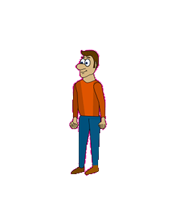
Jumpman
By: Maher and Mario

Slide 2
Executive Summary
Players will have the option to play as a character by the name of Stu or Larry. Both players will find themselves on the verge of being eaten by sharks. Players must continue jumping on moving platforms to avoid being eaten alive by the sharks underneath. With each progressive leap, the platforms will move faster and faster. There is no ending to this game as the main objective is for the user to set a high score. Each platform the user jumps on will count as 1 point and will be displayed in the upper right corner of the game. Each character will have their advantages and disadvantages. Playing Stu will allow the user to jump faster and higher as well as move quicker. However, playing as Stu will give the player less of a chance of landing on a platform underneath due to his skinnier frame. Playing as Larry will produce the exact opposite advantages and disadvantages.

Slide 3
Game Play Look and Feel
Appearance
The game will have a simple feel to it. The controls are basic so it is best to make the game look appealing while also not making it look complicated. A simple underwater background with some coral in the background should do the trick. User’s will be able to jump through one side of the screen and will emerge on the other side.
Player’s role and actions
Using the up arrow to jump and the left and right arrows to move, player’s will attempt to escape from the sharks chasing from underneath by leaping and safely landing on moving platforms.

Slide 4
Game Play Look and Feel
Strategies and motivations
Goal of the game is to set a high score by jumping as high as you can using platforms
Picking different characters have certain advantages and disadvantages
EX: Skinny Stu can jump higher but he is not as wide as Fat Frank so it is harder to land on platforms.
Story progression
Speed of platforms increases by a certain factor the higher the user gets
The higher the user gets, the less often platforms show up.
Also as you progress the platforms also being to spin like clocks (clockwise and counter clockwise) so you have to time your jumps better.
Background music will get faster the further you progress

Slide 5
Development Specification
Hardware
Computer with minimum requirements: processor: Intel Pentium D 2.8 GHz or AMD AthlonTM 64 X2 4400+ video: Integrated video card or better recommended info:
Software
Construct 2
Algorithm Style
The game will check what buttons were pressed. When the character is falling if he lands on a platform he stays on it until he moves again. This will continue up and up until the play eventually falls and loses. The game is continuous so there is no goal except to get as high as possible.

Slide 6
Audience
Casual gamer
Enjoyable by people of all ages
Great for passing time at work or at school

Slide 7
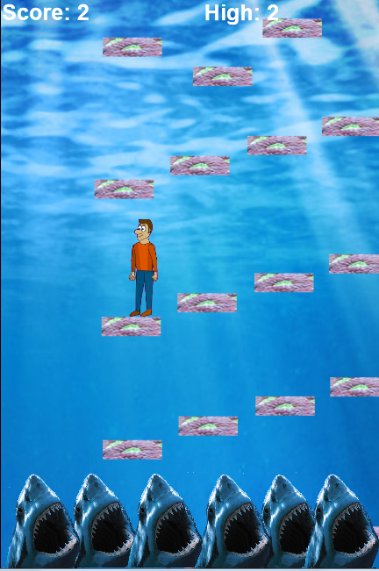
Game Art

