Slide 1
Conquer the Castle
2D Game Design Pitch

Slide 2
Game Story
An entire war is started over the colors of two neighboring kingdoms. One Red and the other Blue. Each one believes the other color is inferior and is willing to fight to the death over it. They build large fortifications to house their generals and send their armies out to war.

Slide 3
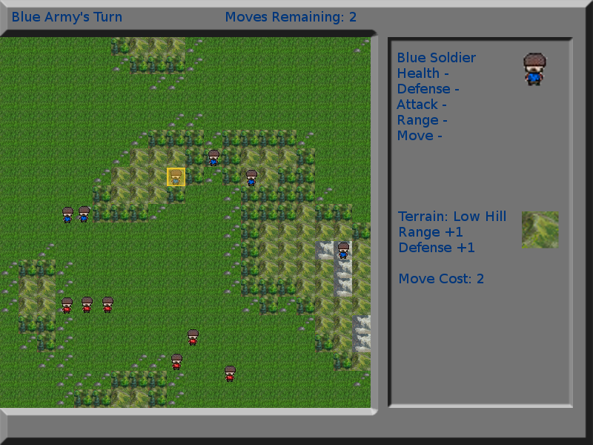

Slide 4
Appearance
Top down player view
Maximizes information for the player
The terrain is composed of tiles in a grid
The tiles look like landscapes rather than icons
Units are stylized icons wearing their colors
Shows a single unit rather an entire battalion
Information is displayed to the right side

Slide 5
The Role of the Player
The player represents a general of an army charged with the task of conquering the enemy castle. The player is not represented on the screen but rather an omnipresent being. The general is responsible for the creation, deployment, and action of his army.

Slide 6
Player Strategies
Build an army by “purchasing” soldiers of varying types using Army Points. Decide whether to concentrate on offensive capability, defensive strength, mobility, ranged or melee attacks, or some balance of the above. Players must keep in mind the map they'll be fighting on in order to built a victorious army.

Slide 7
Level Summary
Levels are randomly generated at the beginning of each match.
Maps are divided up into multiple terrains
Terrains can help or hinder units.
Trees provide cover but cost more to move through.
Mountains provide sight and range but provide little cover and cost more to move through.

Slide 8
Story Progression
Upon defeat of a castle the succeeding general receives a message from the conquered general stating that the now conquered castle wasn’t the real one and they will have to start their battle over again.

Slide 9
Required Hardware
Monitor (800x600 minimum resolution)
256MB RAM
Processor (1Ghz minimum)
Any form of Sound processing
Keyboard
Mouse

Slide 10
Required Software
IDLE (Python IDE)
Py2exe (for deployment of executable)

Slide 11
Algorithm Styles
2D Sprite Animation
Idle animations will be applied to units
Perlin Noise for map generation
Perlin Simplex Noise to provide heightmap values which are mapped to terrain types.
A* pathfinding to display possible moves
the computer will display an overlay of all possible squares that unit could move to

