Slide 1
Michael the Bicycle CIS 587 2D Game Pitch - Ruth Johnson

Slide 2
Abstract of Game Story
Michael the Bicycle has been riding alone in an experiential journey through life and has come to a point where he is very dissatisfied and sad. In this platformer / adventure style game, you will ride with Michael through interesting levels and change his life for the better by overcoming obstacles and meeting new friends. It could even be that Michael meets the friend of his dreams and finally has someone to ride with him

Slide 3
Appearance
Side scrolling adventure style game with multiple levels
Appearance of levels is designed to evoke feelings from the player
Michael will be able to move left and right with the arrow keys. The sprite image will be mirrored when turned left. The up arrow key will make him jump
Heads-up display on certain levels will indicate a count of level-specific items

Slide 4
Player Roles and Actions
Michael (main character) is controlled by the player. The player will need to guide Michael through his quest from sadness to happiness
In level 1 Michael rides off a cliff
In level 2 Michael collects minutes during his appointment with the doctor
In level 3 Michael tries doctor’s suggestions by visiting a park

Slide 5
Strategies and Motivations
Michael displays his desires through on-screen text to the player
Player will perform the actions necessary to match those desires

Slide 6
Level Summary
There are three levels in Michael the Bicycle. Each level will have obstacles to deal with. The game is designed to have a low level of difficulty, the main goal to the game is to present the story and to have the player experience the feelings Michael does.
The obstacles will be designed to slow the player down and to explain the story but there will not be any really difficult obstacles or jumps to frustrate the player by having to try over and over.

Slide 7
Story Progression – Level 1
Player is introduced to Michael and to his feeling of dissatisfaction with his life up to this point
Player experiences what Michael is thinking and feeling and must follow through with Michael’s plan

Slide 8
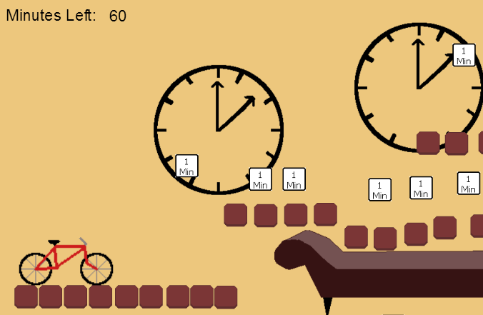
Story Progression – Level 2
Michael was unsuccessful committing suicide
Doctor says Michael has depression and needs to change to become happier
Michael is bored during the visit
Player guides Michael to collect minutes and leaves the level when minutes are collected

Slide 9
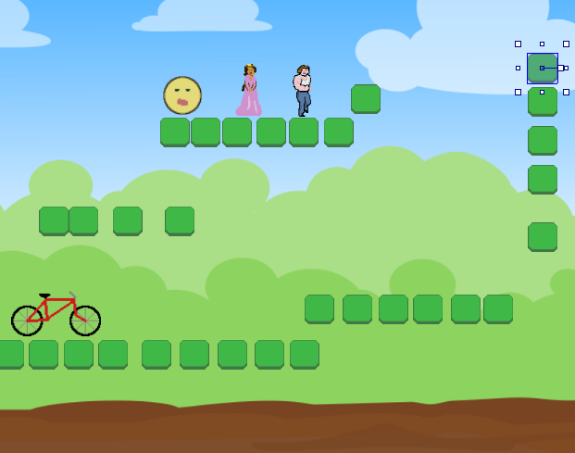
Story Progression – Level 3
Michael’s Happiest level
Park atmosphere with appealing colors
Michael meets his friends: Princess Asha, Jonathan, and Obie
Player may leave the level at any time
Player may find his Dream Friend

Slide 10
Story Progression - Ending
Depending on what the player did during level 3 will determine the outcome
Dream Friend not found then screen with Michael being much happier now
Dream Friend found then screen with Michael and Dream Friend

Slide 11
Hardware and Software
This game may be played on a computer able to run HTML 5 in a browser
A keyboard and mouse is required to play the game
This game will be built with Construct 2 so the only software that is needed is a browser that can run HTML 5

Slide 12
Construct 2 Events and Animations
The bicycle sprite will have an animation associated with it to give the look of the bicycle moving. In particular, the spokes will be seen to move
When the bicycle moves text will be shown / hidden contextually. For example, when Michael is going over the cliff there will be text displaying his screams
On the Doctor Level, Michael will be collecting minutes. As the bicycle sprite collides with a minute sprite the sprite is destroyed and the count is incremented and displayed

Slide 13
Algorithm Style
Start Level 1
Display bicycle and level including obstacles and contextual text
Loop
If pause then do not allow player to move bicycle sprite until unpaused
When player gets to end start Level 2
End Level 1
Start Level 2
Display bicycle and level including obstacles and contextual text
Loop
If pause then do not allow player to move bicycle sprite until unpaused
Decrement minute count as bicycle picks up minute sprites
When player gets to end and minutes are collected start Level 3
End Level 2
Start Level 3
Display bicycle and level including obstacles and contextual text
Loop
If pause then do not allow player to move bicycle sprite until unpaused
Increment appropritate friend count as bicycle picks runs over friend icons
When player gets to end display ending sequence based on actions during level
End Level 3

Slide 14
End – Thank you!

