Slide 1
Undead Tower Defense
Terry Holt, Joe Shunia

Slide 2
Abstract of Game Story
Storyline:
An infectious disease has spread across the world to the human and various animal populations. This disease kills the host transforming them into hideous creatures "the undead". These new creatures have a hunger for brains and infect anyone they come into contact with. Survivors must avoid contact with the creatures at all costs. The last remaining survivors are held up in a tower and must defend themselves from the oncoming onslaught of undead.
Story Goals:
Survivors must use all weapons and fortifications at their disposal to keep the undead at bay.

Slide 3
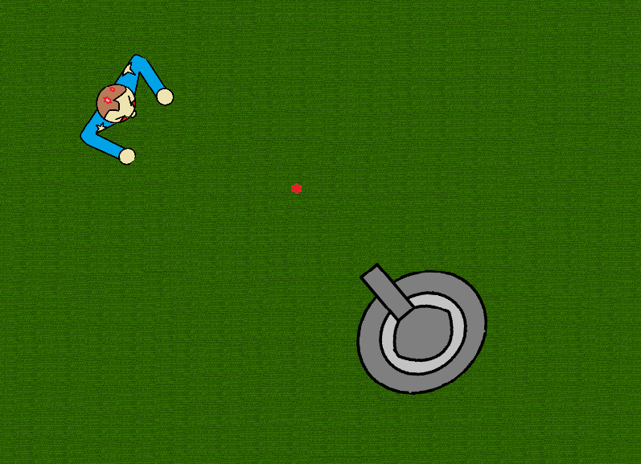
Appearance
Undead
Bullet (Ammo Types)
Tower (Main weapon)

Slide 4
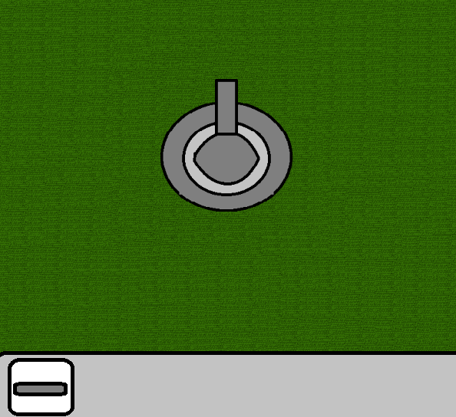
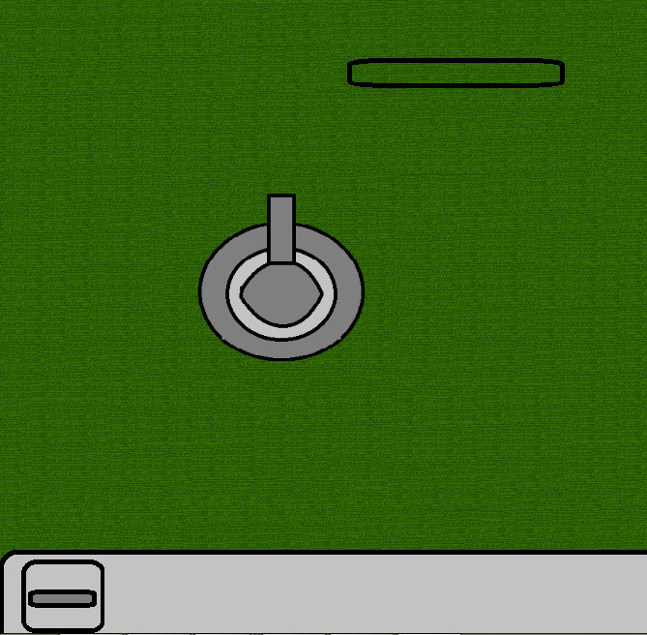
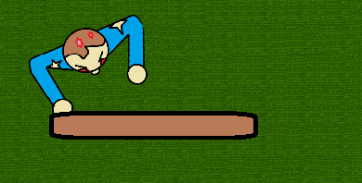
Appearance Continued...
Selector (choosing where to place fortification)
Button (for fortification)
Pushed Button
Fortification in place

Slide 5
Player Roles and Actions
Player must use whatever means necessary to keep the undead at bay and defend the last remaining human stronghold (your tower).
The tower must be defended at all costs. Once tower is lost the game is lost.
The Player uses mainly the tower's gun to kill the undead to keep them away.
Killing enemies (the undead) gains the player experience points which can be used to purchase fortifications, improvements, and upgrades.

Slide 6
Strategies and Motivations
Key motivation: survival (not outlasting the waves of enemies means death)
Additional motivation: challenge (what methods will get me the farthest, which will get me past the next wave of enemies)
Strategies that can be used:
Shooting enemies with main tower gun.
Setting traps to disable or kill enemies.
Using barricades to delay enemy movement.
Using abilities (ammo types)
Upgrading tower so that you stay stronger than your enemies.

Slide 7
Level Summary/Progression
Levels are wave based:
Player must survive a certain number of waves to get to next level.
Each wave of enemies is stronger than the last:
Enemies get faster, have more health, cause more damage, and become more numerous.
Each level might add new enemy types into the mix to add more variety in gameplay.
These enemy types would be stronger, faster, and/or have special abilities(moving past barriers).

Slide 8
Hardware
Windows OS
32MB Graphics card DirectX 9 compatible

Slide 9
Software
Visual Studio 2010
DirectX SDK (June 2010)
DirectX 9
Paint.Net and Photoshop
Windows API

Slide 10
Algorithm Style
Primarily using the kelly game engine from 2d programming language book.
game objects (enemies, bullets, tower, menubar, button,selector) will be made into classes which will hold the draw,update,and collision info for each object. These methods will be used in the main game class UndeadDefense.
Objects such as bullets will be initialized and stored in a vector list. Each time the object is created another will be added to the list.
Enemy AI: enemies will be orient and moved toward the tower. Tower position and player position is used to do this.
Tower: When arrow keys are used a turn method will be used in the tower class to turn the tower.
Bullet: When space bar is hit a fire method will be used in the bullet class to fire a new bullet.

Slide 11
Questions?

