Slide 1
CIS 487
Game pitch document
Developers :Nader Khraizat
Gamal Waza
Date: 11/7/12

Slide 2
The Planet’s Gaurdian
A single player 2D game
Shooter/Adventure game

Slide 3
Control/Instructions
Arrows to move
Health = 4
Space to shoot
If not transformed: max 6 bullets wait 3 second to reload
Power-up doubles the amount of bullets and gives you extra health
Press “T” to Transform into a tank
Transformed mode allows you to move faster
Allows to shoot Rocket (3 limit)
Rocket does twice the damage

Slide 4
Control/Instructions Cont.
Press “R” to Transform back
Rocket Ammo available at end of certain level
Tool Kit is used to fix damage

Slide 5
Summary
Special force unit Commander Jack is tasked to travel to another planet(Planet of Doom) in order to destroy the “Planet Death-Cannon”. A cannon that is capable of destroying his planet.
He is to travel through the core of the planet in order to reach the Death-Cannon and destroy it to keep his planet safe.
He will be faced with many challenges: he will fight an opposing army, tanks, and his arch nemesis!!!
Through his journey he will be able to change weapons and get power ups.

Slide 6
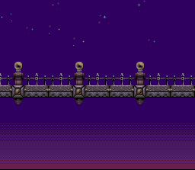
Level 1

Slide 7
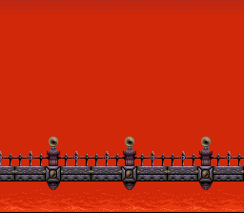
Level 2

Slide 8
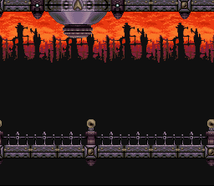
Level 3

Slide 9
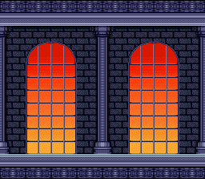
Final

Slide 10
Appearance
This is a 2D Third-Person-Shooter game.
Levels will be composed of bridges, walls, enemies and power-ups.
The camera will move as the player moves left and right.
There will be a health bar to track player’s life.
Sprites will be used for animating the character and enemies.

Slide 11
Player roles and actions
The player has a gun that can shoot 6 bullets consequently, then he has a 3 second delay to shoot again.
The player need to get the power up at the end of each level.
He can switch between his primary gun and secondary weapon (tank power up weapon).
Player gets to replenish his health, through the repair tool kit.

Slide 12
Player roles and actions
If player jumps up he has two choices shoot the target on floor of target that is standing on higher ground.
If two opposing bullets collide they cancel out each other.
Some enemies have higher ranks and thus they have either special abilities or take more damage.

Slide 13
Strategies and motivations
The player has limited health bar that decreases every time they are hit.
In every level, there will be a power-up that decreases its power with time.
As a result, the player is motivated to destroy enemies and units quicker in order to get the power-up in its full power.

Slide 14
Level summary/story progression
Game starts as Commander Jack flying a plane into the Planet of Doom.
Player has to clear the enemies on each level in order to proceed further.
End of each level there is a teleporting devise that sends Commander Jack deeper into the core of the planet.
When the player reaches the last taleporting device he has to fight his arch-nemises Commander Seth

Slide 15
Level summary/story progression
After he defeats the boss he has to defuse the cannon and destroy it
Commander Jack then returns to his ship and flies back home as a hero who saved billions of his people.

Slide 16
Hardware/Software
Hardware:
Any computer should be sufficient since it is a 2D low graphics game
Software:
Construct2

Slide 17
Algorithm
2D sprite animation.
The main algorithm of the game will be a game loop that checks for events that includes the following:
player movements to move the screen
Collisions that translate into the player getting hit or the enemies getting hit.
Physics of trajectories will be used to determine bullets positions as they are fired with different mass, angles and speed.

Slide 18
Hope you enjoy our game!!!
Looking forward to demonstrating the real deal
THE END!!!!!!!

