Slide 1
Cucumber The Super Aardvark
Team Awesome
Presents

Slide 2
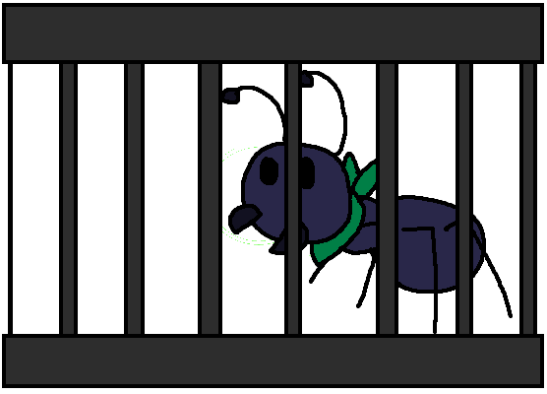
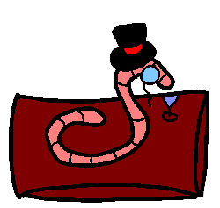
Game Story
The diabolical Count von Bayte has kidnapped all of the ants in the village, and it is up to Cucumber, the Super Aardvark, to save them from his evil “grasp”

Slide 3
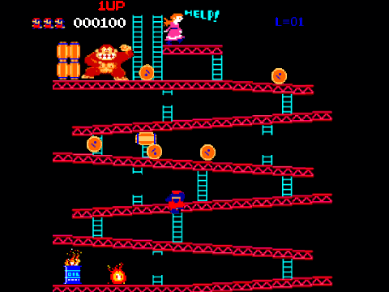
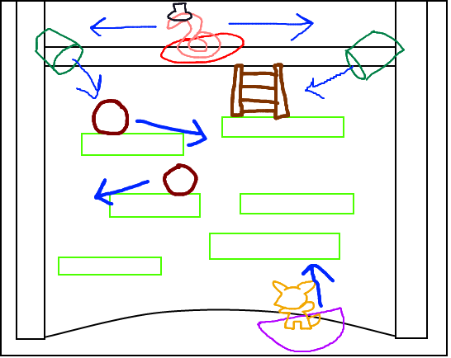
Appearance (2D platformer-esque)
Inspiration
Basic Level Design

Slide 4
Player Roles and Actions (Single Player)
The player will assume the role of our hero Cucumber, and guide him upwards through the tower to reach Count Von Bayte, freeing the caged people of the land(ants).
The perilous journey will be riddled with difficult leaps, rolling boulders, and humiliating alcoholic beverages.
If the player succeeds to the top of the tower, the confrontation begins, and the answers to our confused hero’s questions will come to fruition.

Slide 5
Player Roles and Actions (Two player)
Same as single, except the second player controls the Count!
Embarrass your friend with your strategically placed dry martinis, and prevent him/her from learning the answers Cucumber seeks!

Slide 6
Strategies
Standing still for too long is not an option, so constant movement is key to survival.
Avoid the boulders at all costs! Timing, and quick thinking are the only things keeping Cucumber from tumbling down the tower.

Slide 7
Motivations
The compelling story leaves the player only with questions.
Why is an aardvark saving ants?
Wait, why is a classy worm with top hat capturing ants?
Why the hell is a worm wearing a freakin’ top hat!?
Where the hell are his arms?
The game keeps the player moving and interacted with what’s going on the screen at all times.

Slide 8
Level Summary/Story Progression
Prior to gameplay, a cutting edge cinematic will set the story, and the player will be turned loose into the tower of horrors.
Each level (of 5) will take place on a floor that is apparently missing a wall. (How else would we see Cucumber?)
As each floor is completed, Cucumber has saved some of the villagers and is one stage closer to confronting the Count.
Each level will be designed to have an increase in difficulty by having more difficult gaps to jump, and “funneling” aspects in order to put pressure on the player to time the boulders properly.

Slide 9
Hardware
A real computer. PC only.
32MB Video Card or higher.
Keyboard
1 or 2 wired Xbox controllers

Slide 10
Software
Windows XP or higher.
DirectX 9.0c or higher.

Slide 11
Algorithm Style
Rolling projectiles
Every 3 seconds, the left or right dispenser(chosen randomly) will dispense the boulder.
Count Von Bayte’s attack
The Count’s keen footwork keeps him aligned with the x coordinates of Cucumber.
Then, due to the high level of class that the Count possesses, he will berate Cucumber by attempting to dowse him with his unlimited supply of dry-gin martinis every 4 seconds by dropping them directly below.
2D Sprite Animation

