Slide 1
Seal that leak!
A game by:
Simon Gorial
Sreekanth Gogineni

Slide 2
Executive Summary · Abstract of game story
OP - ‘s underwater drilling rig in the gulf of Mexico has been having problems with leaks underwater, and has been having tremendous bad press.
You are an independent contractor working in the gulf of Mexico that seals oil leaks underwater, and have been contracted by PB to help them out.

Slide 3
Game Play
Move around, seal leaks to make money, spend money on rescue efforts to prevent bad press and prevent from being fired, and hire spill crews to clean up spilt oil to prevent pollution.
Player can move left, right, up and down along the pipe. The user hits space bar when next to an oil leak to seal.
The user must press space bar until bar is full
Bar will take longer to fill as levels progress.

Slide 4
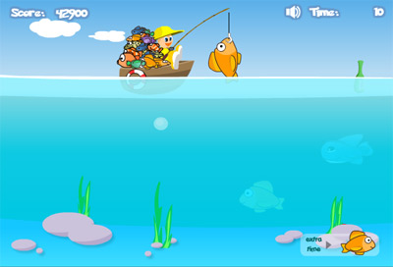
Appearance
Game play takes place in the gulf of mexico, the player has a view screen from the sky at top to the bottom where the pipeline is located.
Ex:

Slide 5
Player roles/actions
Player Role: Hired independent contractor to successfully seal all the leaks and prevent as much oil spill and contamination while minimizing ecological impact for OP.
Player Actions:
Direct control of player to move and seal leaks.
Hire oil spill control crew to clean up oil spillage.
Hire boats to bring ecological hippies to help save animals. Press always welcome!

Slide 6
Strategies/motives
Buying the right upgrades to help keep the leaks under control.
Spend money wisely on both rescue and spill crews to minimize ecological impact and helping raise company reputation.

Slide 7
Level/story line Summary
There are 10 levels to the game. Level one starting easy with minimal oil leaks and level 10 with multiple leaks.
Different events occur as the levels advance as far as upgrades go.
You can upgrade your sealing guns each level to seal the leaks quicker.
The further you advance the more money you earn per leak.

Slide 8
Hardware Spec
Very minimal computer specs.
Can be ported to most devices that can support flash
Designed on PC with Windows 7 and adobe creative suite.
Software Spec
Needs latest Flash Player installed.
Algorithm style
Timing of each level decreases as the oil leaks progress.
Fill bar becomes harder to fill in each level.

