Slide 1
Ninja Escape: Escape from the Pirate Ship
Kirit Patel
Joel Cieslak
CIS 487 2D Game Design Pitch

Slide 2
Story
You play the hero, Kirit, a ninja with questionable skills....
You awake on a pirate ship, trapped!!!! The pirates have taken most of your equipment. They however did not find your throwing knife from your super secret hiding place.
The injuries sustained prevent you from using your super ninja karate chop or your incredible ninja kick.

Slide 3
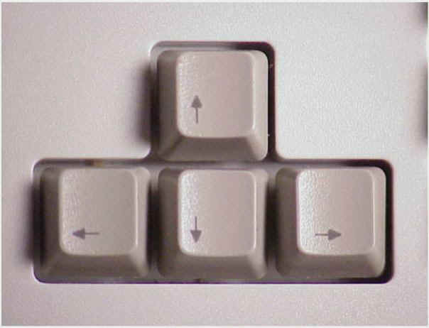
Input
Move using arrow keys (left and right arrows)
Use Space Bar shoot your throwing dagger
Use ESC key to quit the game

Slide 4
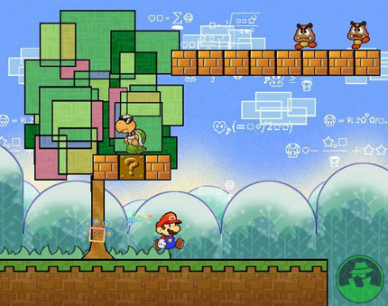
What we wanted it to look like:

Slide 5
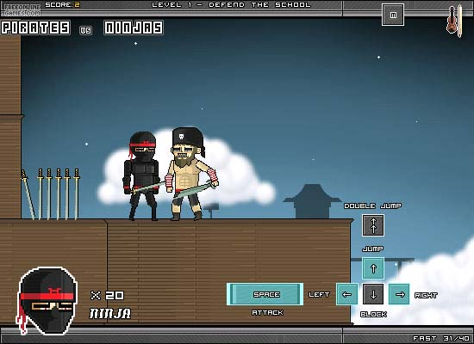
What we thought we would end up with….

Slide 6
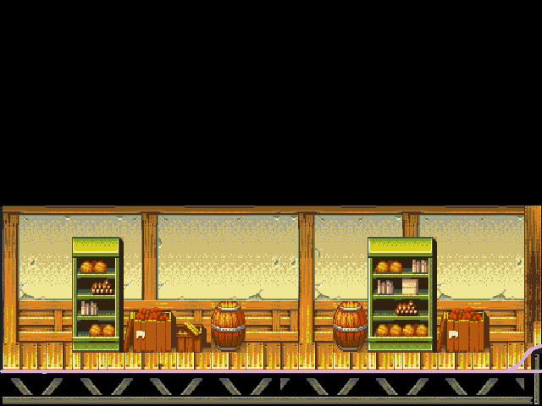
Final Game look

Slide 7
Game Feel
1 level with 4 screens
End of level has a Boss fight.
Defeating Boss ends the game
Side Scroller that moves forward as the player crosses the end of the screen.

Slide 8
Player Roles and Actions
Kirit is a ninja that currently looks like a skeleton
He throws knifes as he cant kick or punch.
Using the space bar will throw a knife out.
Kirit can move side to side using the left/right arrow keys.

Slide 9
Strategies and Motivations
As Kirit has lost his abilities to kick or punch, he must use his throwing knives to kill the pirates.
Pirates will become aware of Kirit over time or if hurt by a knife.
Kirit can only have one knife out at a time, so throwing them at close range will maximize the number of throws/sec.

Slide 10
Level Summary/Story Progression
The game starts out with Kirit just out of the jail cell.
He is trapped in the pirate ship trying to make his way out.
He must kill the pirates on his way out of the inside of the pirate ship.
At the end of the level, Kirit must battle the Captain.
Killing the Captain wins Kirit his freedom

Slide 11
Specifications
Hardware:
Intel Core 2 Duo 2.5Ghz+
2GB of System Ram
512 MB Graphics Card
DirectX 9
Keyboard
100+ MB of Hard Disk Space

Slide 12
Specifications -contd
Software:
Visual Studio 2008
DirectX SDK August 2007
Vista Operating system
Artwork done in Gimp

Slide 13
Specifications –contd
Algorithms
Collision Detection:
Simple Bounding box of each sprite is checked for overlap
Color_Scan algorithm used to see if any colors are overlapped between Sprite and background.
Script Loading:
To simplify game code, a script was used to designate where pirates should be located.
Pirates have a awareness ability, designed using random chance.

Slide 14
Due to time constraints and other problems the following features still need to be implemented or added:
Change sprite of the hero to an actual ninja
Add music
Add a second player so you can escape with a buddy
Add more levels
Add more attacks
Enhance Scripting

Slide 15
Credits and thanks go out to: Professor: Dr. Maxim Additionally: Matthew Stable (ppt slide on getting Lamothe code to work with VS 2008) Game Engine: Andre LaMothe Backgrounds: http://sdb.drshnaps.com/index.php Sprites: http://panelmonkey.org/punbb/index.php

