Slide 1
Castle Engagement
CIS 487 3D Game Design Document Version 1.3
16 December 2015
Team 2
Alexandra Alioto
Andrew Berg
Ryan McHenry
Jeffery Yackley

Slide 2
Table of Contents
Design History
Game Overview
Game Concept
Story Abstract
Game Flow Summary and Gameplay
Look and Feel
Project Scope
Gameplay and Mechanics
Gameplay
Game Mechanics
Screen Flow
Game Options, Replaying, and Saving
Level Summary

Slide 3
Table of Contents
Story, Setting, and Character
Story and Narrative
Game World
Character Bible
User Interface
Visual System
Control System
Music and Sound
Use Cases
State Transition Diagram
Design Rules
Artificial Intelligence
Technical

Slide 4
Table of Contents
Game Art
Rough Maze
Prince Edwin
Princess Regina
Sky
Castle
Management
Risk Analysis
Risk Table
Scale Tables
RMMMs
Bibliography
Lessons Learned

Slide 5
Design History
Version 1.0
Document creation, rough idea and story written down
Version 1.1
Document formatting, UI / Art Sections updated
Version 1.2
Document final format for 3D pitch, UI diagrams, all sections polished
Version 1.3
Final edits documents and all sections polished

Slide 6
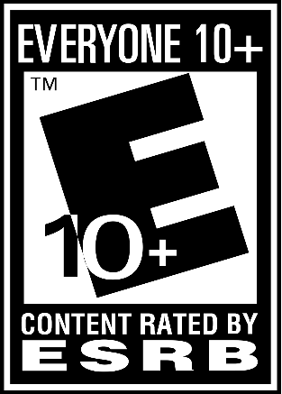
Game Overview
Appearance:
Medieval fantasy setting
“Dark/evil” style themed castle setting
Include general sample here***!!!***
Game Genre:
3D first person maze runner/chasing game
Development Platform:
Unity 5.0
MonoDevelop with C#
Target Audience:
Everyone (10+)

Slide 7
Game Concept –Story Abstract
A fair Princess named Regina who lives in a beautiful castle was betrothed to a Prince named Edwin from a far away kingdom to strengthen the Princesses eventual reign. Unfortunately, after the Prince appeared in shining armor and gave the princess a very large and expensive engagement ring he removed his helmet to reveal a disfigured, battle-scarred face. In short, he was hideous and the fair but shallow princess broke off the engagement. Yet, she kept the ring. The Prince now seeks to reclaim the ring and return to his kingdom but Princess Regina will do anything to stop him. Prince Edwin snuck into Regina’s castle and stole the ring, but Regina spotted him from her balcony and must chase him through the maze (that was built in order to stop him from stealing it) to get it back!

Slide 8
Game Concept – Game Flow Summary & Gameplay
The player takes control of Princess Regina whose goal is to catch Prince Edwin before he escapes from the castle maze with the ring.
The player moves Princess Regina with the WASD / Arrow Keys
The player moves Princess Regina head to look around with the mouse.
Prince Edwin is an AI controlled NPC whose goal is to escape the maze before the player catches him.
The player catches the prince by colliding / touching the prince.
The player starts behind Prince Edwin and runs after the Prince.
The game ends if Prince Edwin makes it through the castle maze exit and the player wins if the Princess collides with the prince anytime before the castle maze exit.
The player has no other action than chasing after the Prince.

Slide 9
Game Concept –Look and Feel
The game is in first person.
The maze will be built outside Princess Regina’s castle with a dark color scheme.
The lighting of the maze will be provided by the “sun” with a “sunset” view as the player looks up at the “sky”.
Please see “Game Art” section for art examples

Slide 10
Project Scope
Maze game
Number of Locations: 2
Balcony (Start location for introduction)
Maze
Number of Levels: 2
Easy Level
Hard Level
Number of NPCs: 1
Prince Edwin
Number of Player Characters: 1
Princess Regina
Number of Weapons / Items: 0
No weapons or items in the game

Slide 11
Gameplay and Mechanics - Gameplay
Game Progression: Getting closer and closer to catching Edwin until he either escapes and you lose or you catch him and you win.
Mission/ Challenge: Trying to cut off/find Edwin in order to capture him before he escapes.
Puzzle Structure: Finding shortcuts, or other ways to quickly get to your target, the prince.
Objectives: Capture Prince Edwin before he escapes the maze.
Play Flow:
The player starts behind Prince Edwin who gets a short head start.
The player then chases Prince Edwin through the maze attempting to catch him.
The player wins if they catch Prince Edwin through the maze.
The prince wins if he reaches the exit to the maze.

Slide 12
Gameplay and Mechanics - Game Mechanics
Game Rules:
The player and prince can only move through the maze.
They both may not move through walls and must stay on the maze path.
The prince gets a short, few second head start, as you jump off the balcony wall.
The player catches the prince by colliding with him.
The prince wins by reaching the exit to the maze without the player catching them.
Physics: Normal collision and gravity mechanics.
No moving through the ground or through walls.
No jumping.

Slide 13
Gameplay and Mechanics - Game Mechanics
Movement:
WASD or Arrow Keys: Forward / Left / Backward / Right
Look Around / Head Movement: Mouse
Objects: No objects in game that can be picked up or moved.
Actions:
Switches / Buttons: No switches or buttons
Objects: No picking up, carrying, or dropping objects
Reading: Nothing to read in the game for the characters.
Combat:
No combat in the game.
Player must collide with Edwin to win is the only potential conflict and it is modeled through the characters meshes touching.
Economy: There is no economy in the game.

Slide 14
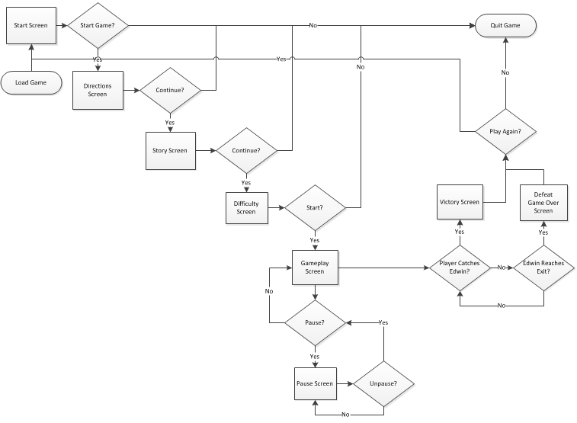
Gameplay and Mechanics – Screen Flow
Screen Flow Chart

Slide 15
Gameplay and Mechanics – Screen Flow
Screen Descriptions
Start Screen
Start Screen giving the option for the player to begin a new game, view the game credits, or exit the game.
The Start Screen leads to the Directions Screen after the start game button has been pressed.
Directions Screen
The Directions Screen informs the player of the controls and rules of the game.
The Directions Screen leads the player to the Story Screen after the continue button has been pressed.
Story Screen
The Story Screen tells the player the game story and background.
The Story Screen leads the player to the Difficulty Screen after the continue button has been pressed.
Difficulty Screen
The Difficulty Screen is where the player chooses one of three difficulty settings (easy/ medium / hard) which effects the level design.
The Difficulty Screen leads the player to the Gameplay Screen after selecting a difficulty and the start button has been pressed.
Gameplay Screen
The Gameplay Screen is where the player will actually play the game. It includes the HUD for the player as well as the first person view of the game from Princess Regina’s point of view.
The player from the Gameplay Screen can either move to the Pause Screen by pressing the pause button, Victory Screen by catching the prince, or Defeat Screen by letting Edwin exit the maze.
Pause Screen
The Pause Screen is where the player can freeze the game or unfreeze the game.
Victory Screen
The Victory Screen displays to the player that they have won the game and gives them the option to restart or quit the game.
Defeat Screen
The Defeat Screen displays to the player that they have lost the game and gives them the option to restart or quit the game.

Slide 16
Gameplay and Mechanics – Game Options, Replaying, and Saving
2 Game Options: – Effect the level of difficulty and the level design of the game.
Easy:
The player will move faster than the AI.
Hard:
The AI will move faster than the player.
Replaying: The player may select to restart the game from the pause screen, victory screen, or defeat screen. Selecting restart the game results in taking the player back to the difficulty selection screen. No data is saved from the previous play through.
Saving: There is no option to save a game or any data in this game.

Slide 17
Gameplay and Mechanics – Level Summary
Synopsis:
Regina’s castle built to capture Prince Edwin.
Physical Description:
A dynamic maze with many directions to got, but with some clues as to where Prince Edwin is. Some windows and high up places will be accessible by the player so they can figure out how to cut them off. A dark castle like design will be implemented on a flat terrain surface. The maze will have four exits where at the start of the game, the AI will choose a path to take to one of the exits.
Objective:
The player must figure out which exit they are going for and cut them off to capture them.

Slide 18
Story, Setting, and Character – Story and Narrative
Plot Summary:
Backstory: A fair Princess named Regina who lives in a beautiful castle was betrothed to a Prince named Edwin from a far away kingdom to strengthen the Princesses eventual reign. Unfortunately, after the Prince appeared in shining armor and gave the princess a very large and expensive engagement ring he removed his helmet to reveal a disfigured, battle-scarred face. In short, he was hideous and the fair but shallow princess broke off the engagement. Yet, she kept the ring. The Prince now seeks to reclaim the ring and return to his kingdom but Princess Regina will do anything to stop him. Prince Edwin snuck into Regina’s castle and stole the ring, but Regina spotted him from her balcony and must chase him through the maze (that was built in order to stop him from stealing it) to get it back!
Plot Elements:
Exposition: See backstory. It is presented to the player on the Story Screen before the start of the game.
Rising Action: As the game starts, the player sees Prince Edwin with the ring in the center of the maze and jumps off her balcony to begin to chase him.
Climax: The player as Princes Regina chases Prince Edwin through the maze in hectic race for control of the ring.
Falling Action: The player catches the prince or he escapes the maze with the ring.
Resolution: The player is presented with either the victory or defeat screen based upon the event that occurred in the falling action.

Slide 19
Story, Setting, and Character – Story and Narrative
Game Progression:
There will be four scenes:
Opening/balcony scene: This scene will be the start of the game where Princess Regina will see Prince Edwin running into her maze castle with her engagement ring. Princess Regina will have to jump/fall off her balcony to start chasing Prince Edwin
Running through castle scene: This scene is where the player will be able to move and control
Victory scene: This screen will be an opaque yellow color over the gameplay screen with the statement “victory” and a button to start the game again or quit.
Defeat scene: This screen will be an opaque yellow color over the gameplay screen with the statement “defeat” and a button to start the game again or quit.
There will be two levels but only one maze. Each level will be based upon the difficulty chosen by the player at the beginning of the game
License Considerations: There are no licensing considerations related to the story, characters, or places.

Slide 20
Story, Setting, and Character – Story and Narrative
Scenes and Storyboards:
Scene 1: Maze Chase Beings
Actors: Prince Edwin and Princess Regina
Description: The prince begins to run with the ring from the center of the maze towards the exit. The princess watching from her balcony overlooking the center of the maze jumps from the balcony to chase after the prince.
Storyboard: TBD
Script: The script has no dialogue. The camera pans down from the balcony representing the princesses point of view in order to see the prince beginning to run from the center of he maze. A few seconds later the princess jumps down from the balcony into the center of the maze and beings chasing the prince.
Scene 2: Maze Chase
Actors: Prince Edwin and Princess Regina
Description: The prince runs through the maze attempting to reach the exit while the princess pursues him in an attempt to catch the prince before he leaves the maze.
Storyboard: TBD
Script: The princess will shout a few select random phrases at the prince. The prince runs non-stop towards the exit traveling through the maze. The princess pursues him as per the players controls until the prince reaches the exit and the player loses or the player catches the prince and wins.

Slide 21
Story, Setting, and Character – Game World
General Look and Feel of World:
The game takes place in a medieval fantasy setting of a large castle (belonging to the princess) with a maze built outside of it.
The maze will have a generally dark color scheme to help represent that the main character is the antagonist of the story.
The maze will be brightly lit with the “sun” and a sunset sky.
Area 1: Balcony Overlooking Maze
General Description: A simple, stone balcony overlooking the center of the maze inside the castle courtyard.
Physical Characteristics: Small, stone, relatively low to the maze so a jump from the balcony to the maze wouldn’t be too unrealistic from a survival standpoint.
Levels That Use Area 1: Easy/ Hard Levels
Connections to Other Areas: Overlooks the maze which is reached by jumping (“falling”) down to the maze floor.
Area 2: Maze
General Description: A complicated maze of stone and hedge-work built into the castle courtyard and castle walls.
Physical Characteristics: Long and winding, flat path brightly lit by numerous torches .
Levels That Use Area 2: Easy / Hard Levels
Connections to Other Areas: Maze is the final area of the game and while the princess can get to the maze from the balcony there is not way to get back up to the balcony from the maze.

Slide 22
Story, Setting, and Character – Character Bible
Character 1: Princess Regina
Backstory: The princess grew up spoiled with all the wealth and power of her parent’s kingdom at her fingertips. She is know for being vain, capricious, and cruel to all those she deems beneath her which was undoubtedly caused by her lax and spoiled upbringing. She has slowly helped bankrupt her kingdom through expensive purchases and lavish parties. She now looks to solidify the kingdoms finances through an arranged marriage to a noble and extremely wealthy prince from a far away kingdom.
Personality: Shallow, vain, capricious, and cruel.
Look:
Physical Characteristics: Beautiful, tall, blonde woman in her prime
Animations: None
Special Abilities: None
Relevance to Game Story: Main Character and Protagonist
Relationship to other Characters: Formerly betrothed to Prince Edwin

Slide 23
Story, Setting, and Character – Character Bible
Character 2: Prince Edwin
Backstory: The prince is the second son of royalty from an extremely wealthy and far away kingdom. He was raised to be a warrior, general, and defender of the commons. He and his family give bountiful alms to the unfortunate and established social welfare programs in their kingdom. The prince’s elder brother will inherit the throne and so he and his parents have decided to attempt to extend their families global influence through an arranged marriage to princess from a family with an ancient line and large, but financially distressed kingdom. The prince was once wounded savagely in combat while successfully defending an orphanage against a troll assault single handed. His face remains scarred to this this day.
Personality: Nobel, valiant, and kind.
Look:
Physical Characteristics: Ugly, tall , strongly-muscled male physique
Animations: Whole body running animation with moving legs, arms, and torso.
Special Abilities: None
Relevance to Game Story: Main Character and Antagonist
Relationship to other Characters: Formerly betrothed to Princess Regina

Slide 24
User Interface - Visual System
Camera:
The camera angle will be as though the player is Princess Regina.
The camera movement will be in first person and directed by the mouse.
Rendering System:
We will be using Unity for our rendering system.
Lighting Models:
We will be using Unity for our lighting models.
HUD:
There isn’t any HUD in the game.

Slide 25
User Interface -Visual System
Menus:
Start menu before the game begins.
It will have start button to begin the game which will transition to the story.
It will have a quit button for the player to quit the game.
Directions menu will appear after the story.
This menu will inform the player what controls they will need to use
Difficulty menu will appear after the directions menu.
This menu will allow the player to select “easy” or “hard” which will change the speed and intelligence of the players.
Pause menu will appear if the player hits the “P” key.
The menu will give the player the option to continue the game
End menu will appear after the game is competed.
This menu will grant the player the option to replay the game or to try again based upon if they won or lost.

Slide 26
User Interface - Control System
“WASD”/arrow key will move the character
Mouse will be used to direct the camera movement
“Space” key will be used to pause the game.

Slide 27
User Interface - Music and Sound
Music:
Opening Title Music: “Take a Chance” by Kevin MacLeod (incompetech.com)
Running Music: “Full On” by Kevin MacLeod (incompetech.com)
Victory Scene Music: “Take a Chance” by Kevin MacLeod (incompetech.com)
Defeat Scene Music: “Hero Down” by Kevin MacLeod (incompetech.com)
Sound Effects:
Running sound effect when Princess Regina is moving

Slide 28
User Interface - Use Cases
Start Menu
Story Screen
Directions Screen
Difficulty Screen
Gameplay
Pause Screen
Victory Screen
Defeat Screen

Slide 29
User Interface - Use Cases

Slide 30
User Interface - Use Cases

Slide 31
User Interface - Use Cases

Slide 32
User Interface - Use Cases

Slide 33
User Interface - Use Cases

Slide 34
User Interface - Use Cases

Slide 35
User Interface - Use Cases

Slide 36
User Interface - Use Cases

Slide 37
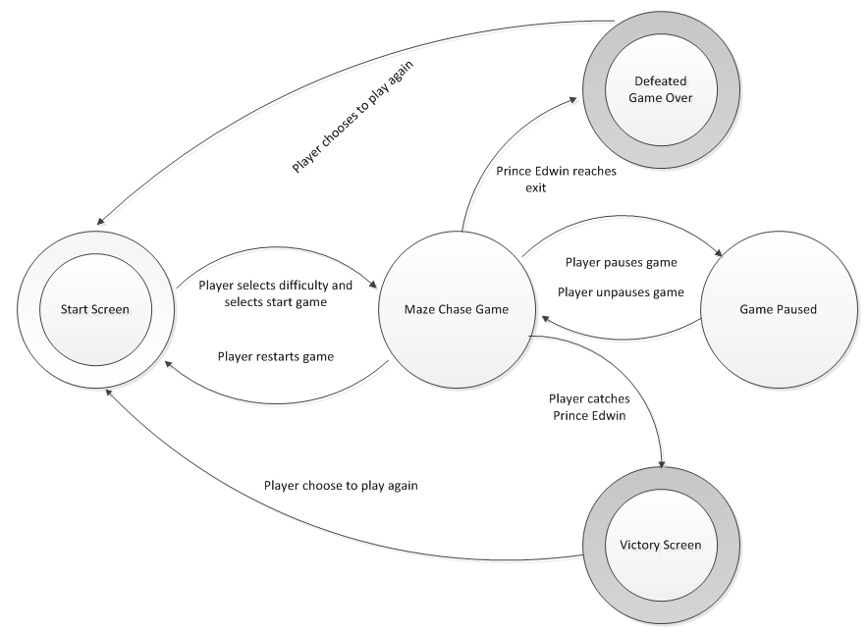
User Interface - State Transition Diagram

Slide 38
User Interface – Design Rules
Keep the design within the fantasy genre and medieval castle setting.
Keep the target audience in mind when developing the control scheme and HUD.
The princesses castle should have a darker color scheme to reflect that she is the evil person in the game.

Slide 39
Artificial Intelligence
Opponent AI: Prince Edwin
The player’s opponent is Prince Edwin who will be controlled by the game with artificial intelligence.
The prince will be running on a generated path created through node path finding.
Nodes will be given different weights based distance to maze exits and distance to the player.
At the start of the game, Prince Edwin will select one of eight paths to four possible doors to exit the maze.
There will be two possible paths to each door that Prince Edwin can take.
Enemy / Friendly / Other AI: There are no other non-combat characters, friendly characters, or reactive items in this game.
Support AI: Princess Edwin and Princess Regina will have collision detection with each other and the walls of the maze.

Slide 40
Technical
Software / Hardware User and Development Requirements
Operating System: Windows XP or later/ Mac OSX
10 or later
Graphics: DX9+
CPU: Pentium 4+
Memory: 2+ GB RAM
Hard Disk Space Required: ~15MB

Slide 41
Game Art– Rough Maze

Slide 42
Game Art –Prince Edwin
Notes:
https://www.assetstore.unity3d.com/en/#!/content/48768

Slide 43
Game Art –Princess Regina
Notes:
https://www.assetstore.unity3d.com/en/#!/content/7004

Slide 44
Game Art –Sky
Notes:
https://3dwarehouse.sketchup.com/model.html?id=u75b0a1e8-1cad-4e27-b5e5-d9bdf32ae194

Slide 45
Game Art –Castle
Notes:
https://3dwarehouse.sketchup.com/model.html?id=d96ec2200bd7c8e0ca40d48ec57bb53

Slide 46
Management –Risk Analysis
Risk 1: Power Outage
Give that the winter is beginning and that the team is using computers to complete this project there is a concern that there could be a power outage causing work to be deleted and/or the project to be delayed.
Risk 2: Illness
Given that the winter is coming there is a concern that one or more of the members of the team might fall ill causing the project to be delayed.
Risk 3: Program Failure
Given that we are using computer and programs there is a concern that one or more of the computer's and/or programs used can be corrupted causing work to be deleted and/or the project to be delayed.
Notes:
Risks with statements CTC format
Risk table
RMMM

Slide 47
Management –Risk Analysis
Risk 4: Timing
Given that the project is due at a set date and time there is a concern that the project may not be fully completed causing the project to be turned in uncompleted.
Risk 5: Lack of Knowledge
Given that most of the team has not created games before there is a concern that we will have to research how to complete and implement certain tasks the team would like to include in the game causing the project to be delayed and/or not fully completed.
Notes:
Risks with statements CTC format
Risk table
RMMM

Slide 48
Management –Risk Table
Risk Table
Risk Number | Risk Name | Probability | Impact | RM3 Pointer
1 | Power Outage | 50% | 2 | RMMM 1
2 | Illness | 75% | 4 | RMMM 2
3 | Program Failure | 80% | 4 | RMMM 3
4 | Timing | 30% | 1 | RMMM 4
5 | Lack of Knowledge | 60% | 3 | RMMM 5

Slide 49
Management –Scale Tables
Probability Scale Table
Probability Meaning | Percent Value
Very Improbable | 10%
Improbable | 25%
Probable | 50%
Very Probable | 75%
Almost Certain | 90%
Impact Scale Table
Catastrophic | 1
Critical | 2
Marginal | 3
Negligible | 4

Slide 50
Management –RMMM 1
Risk: Power Outage
Probability: 50%
Impact: Critical
Description: Give that the winter is beginning and that the team is using computers to complete this project there is a concern that there could be a power outage causing work to be deleted and/or the project to be delayed.
Mitigation/monitoring: Checking weather conditions and possibilities for a power outage.
Management/contingency plan: Have team members work at another facility with power, i.e. school, home, coffee shop etc.
Trigger: Mitigation steps unproductive.
Current status: Mitigation steps initiated.

Slide 51
Management –RMMM 2
Risk: Illness
Probability: 75%
Impact: Negligible
Description: Given that the winter is coming there is a concern that one or more of the members of the team might fall ill causing the project to be delayed.
Mitigation/monitoring: Have team members get enough sleep and practice good hygiene.
Management/contingency plan: Redistribute tasks, if needed, until team member is better. Give team member :lighter” and less critical tasks to complete, from home, until they are better.
Trigger: Mitigation steps unproductive.
Current status: Mitigation steps initiated.

Slide 52
Management –RMMM 3
Risk: Program Failure
Probability: 80%
Impact: Critical
Description: Given that we are using computer and programs there is a concern that one or more of the computer's and/or programs used can be corrupted causing work to be deleted and/or the project to be delayed.
Mitigation/monitoring: Enforce team members to save work every 15 to 20 minutes. Create backup copies incase files become corrupted.
Management/contingency plan: Load backup files and correct any corrupted files and/or redo any work deleted.
Trigger: Mitigation steps unproductive.
Current status: Mitigation steps initiated.

Slide 53
Management –RMMM 4
Risk: Timing
Probability: 30%
Impact: Catastrophic
Description: Given that the project is due at a set date and time there is a concern that the project may not be fully completed causing the project to be turned in uncompleted.
Mitigation/monitoring: Have team create a schedule of when tasks will be completed and which team member will be completing the tasks. Have team members check in on one another to make sure tasks are being completed on time and correctly.
Management/contingency plan: Recreate schedule if team has fallen behind. Redistribute tasks if needed.
Trigger: Mitigation steps unproductive.
Current status: Mitigation steps initiated.

Slide 54
Management –RMMM 5
Risk: Lack of Knowledge
Probability: 80%
Impact: Marginal
Description: Given that most of the team has not created games before there is a concern that we will have to research how to complete and implement certain tasks the team would like to include in the game causing the project to be delayed and/or not fully completed.
Mitigation/Monitoring: Have team members begin research over break of possible future tasks that will need to be built.
Management/Contingency plan: Divide up tasks based upon student's current knowledge.
Trigger: Mitigation steps unproductive.
Current status: Mitigation steps initiated.

Slide 55
Bibliography
Prince Edwin Game Art:
https://www.assetstore.unity3d.com/en/#!/content/48768
Princess Regina Game Art:
https://www.assetstore.unity3d.com/en/#!/content/7004
Castle Game Art:
https://www.assetstore.unity3d.com/en/?gclid=Cj0KEQiAtMSzBRDs7fvDosLZmpoBEiQADzG1vB8JWc1tcJ_V2oQ9ZXBEYvvk8t8WNkQpm78_-MW_VYkaAhkY8P8HAQ#!/content/23699
Sky Game Art:
https://www.assetstore.unity3d.com/en/?gclid=Cj0KEQiAtMSzBRDs7fvDosLZmpoBEiQADzG1vB8JWc1tcJ_V2oQ9ZXBEYvvk8t8WNkQpm78_-MW_VYkaAhkY8P8HAQ#!/content/4183

Slide 56
Lessons Learned
Better communication and updating one another when things were completed.
Not waiting until the last minute to complete things.
We underestimated the difficulty of certain aspects.
Designing and aligning scenes was harder than the programming portion.

