Slide 1

Zombyrinth
3D Game Pitch
Niki Farquhar

Slide 2
Overview
Appearance
  This game will be simple in appearance/graphics. The player will be inside of a 3D world in which they can move freely around. This will be set outside with trees and walls as obstacles affecting sight.
Story Abstract
  The player will enter a level which consists of a maze. Throughout the level there will be zombies running around which the player must kill. To move on to the next level the player must first find a key which will unlock a door in the maze that they must use.

Slide 3
Overview
Gameplay
  The player will use the mouse and keyboard controls to move around and attack.
  Weapon will be an axe.
Development Platform
  This game will be developed using the Unity software platform.

Slide 4
Game Mechanics
User Interface Description
  Main level camera will be first person from the eyes of the player
  The main level screen will have a HUD display.
    HUD display:
      Lives/health
      Maze map and current location if picture in picture is possible.
      Key indicator (to show if player has found key)
  Plans to have a game over/restart screen

Slide 5
Game Mechanics
Storytelling
  There is no real story to the game, it will be a simple level progression. You look for the keys while killing zombies throughout a maze. Once you move on to the next level it will be a new maze design with an increased difficulty of zombies.

Slide 6
Game Mechanics
Level Summary
  Each level will contain an open layout with trees and walls as obstacles, there will also be a maze the player must work through.
  While navigating the level the player must locate the key, once they have found the key they then must locate the door that has opened. This will act as a portal to the next level.

Slide 7

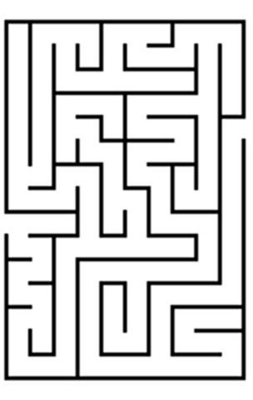

User Interface Design
Key Screen Images

Slide 8
User Interface Design
Control Summary
  Mouse click to attack
  Move mouse to control camera viewing (where the player is looking)
  Use keyboard controls to move about the world

Slide 9
User Interface Design
State transition diagrams:
Menu screen
Game Over
Navigating
Game play
searching
attacking

Slide 10
Artificial Intelligence
Opponent AI
  Zombies will not attack the player in an animated way, but they will walk towards the player if they walk into the player before he can kill them he will lose health.
  Zombies will walk in packs

Slide 11

Game Progression
Flowchart:
  Explore level → find key → find door/portal → move to next level → repeat
Level and scene details
  Skybox to portray outside
  Trees (zombies could hide behind these)
  Walls to make up maze

