Slide 1
Space Zombies
Presented by:
Gary Darby
Mike Schanck
Joe Sloan
Scott Keling
Chris Purchase

Slide 2
Overview

Slide 3
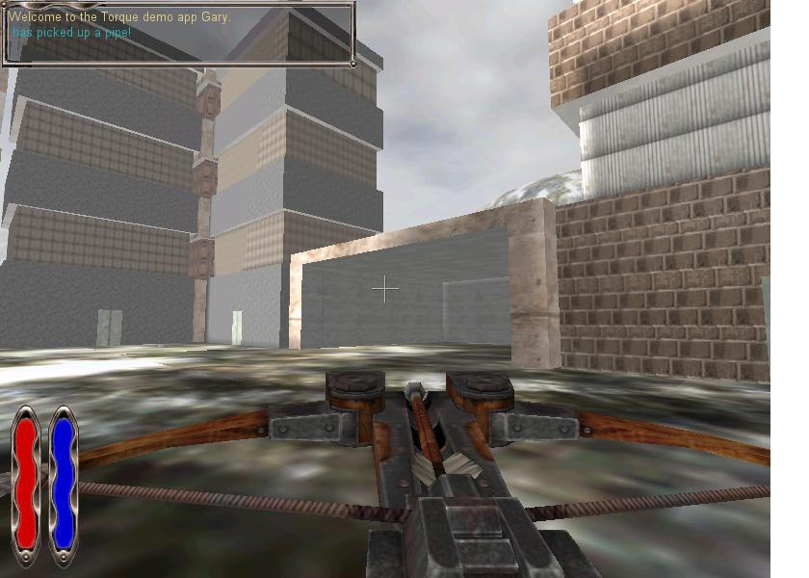
Appearance
First Person Shooter

Slide 4
Story Abstract
You are a member of an alien race that lives on the outermost reaches of the known galaxy.
You are a member of BRAINZ (Bureau Responsible for Annihilating the Infernal Nonhuman Zombies).
You were a member of the team that killed Zomg, the first and last zombie to have ever been created. Or so you think...
Now your peaceful city is being overrun by zombies and it is up to you (and any teammates that may be there with you) to try to stop this invasion and defeat Zomg once and for all!

Slide 5
Gameplay & Target Audience
Type of Game: first person shooter
View : first person with the option to toggle to third person
The audience we are aiming for are teens and adults.
The audience does not include people who have never played a first person shooter or similar game types. We will not be teaching people how to play any FPS, just our FPS.

Slide 6
Development Platform
PC
Specifications will be defined after the game has been created

Slide 7
Game Mechanics

Slide 8
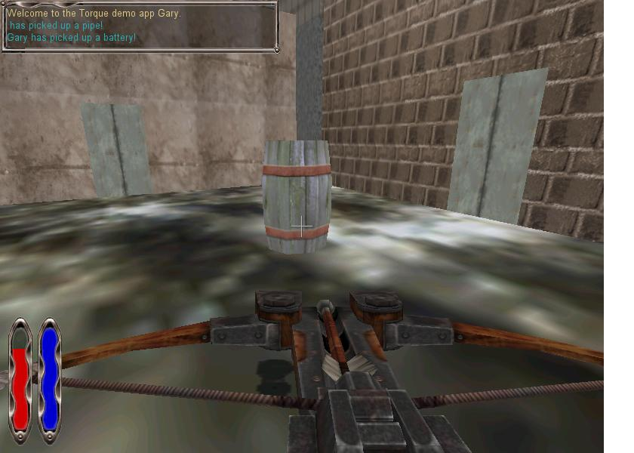
User Interface Description

Slide 9
User Interface Description Continued
1: Targeting Reticle. This is location where your weapon is currently targeted.
2: Shield Bar. This bar displays the amount of shield power you have left. When it reaches 0 the character will die.
3: Weapon: Crossbow with explosive bolts.

Slide 10
Multiplayer
Multiplayer works but doesn’t flow well while players are loading, but is fine when all players are loaded and ready to go.

Slide 11
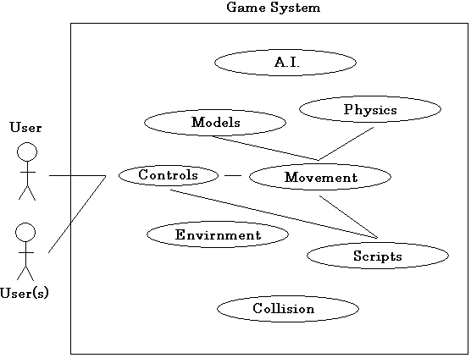
Use Cases
Simple Example

Slide 12
Storytelling
The basic premise of the story is given at the beginning of the game during loading. Further events are described in the text box as certain triggers are crossed.

Slide 13
Level Summary – Level One
The city is located on a satellite without a natural atmosphere. To make up for this, the citizens have an energy shield surrounding the city, allowing it to have its own sustainable atmosphere.
The zombies have started to break through the shield in certain areas.
To stop the zombie invasion you must fix the shield generator by finding parts scattered throughout the city.

Slide 14
Level Summary – Level Two
After fixing the shield generator, you find that the hordes of zombies were controlled all along not by Zomg as you originally feared, but by the activist group P.E.T.Z (People for the Ethical Treatment of Zombies).
Your only recourse is to flee the planet by way of teleporter. You find yourself in a sectioned off canyon, trying to escape the activists and armed only with your trusty concussion cannon. You must scale the mountain and reach the teleporter…. If it still works…
This level is actually our credits page, more of a mini-game than a second level.

Slide 15
Replaying and Saving
The game does not implement any save feature, however it circumvents the issue.
You are given infinite lives and when you’re killed, you respawn at the beginning of the stage, but you retain any item you’ve gotten and all the work you’ve done is preserved.

Slide 16
User Interface Design

Slide 17
Control Summary
W – forward
S – backward
A – strafe left
D – strafe right
Left-Click Mouse - fire weapon
Alt+Tab – toggle first/third person view
Moving the mouse will move the targeting reticle around the screen

Slide 18
Artificial Intelligence

Slide 19
Opponent A.I. (Level 1)
The zombies will check if the closest player is within 70 yards.
If he is, they just blindly charge and fire when close
If he isn’t, they will find the nearest path point to the player and use A* pathfinding to reach it
Friendly fire is on

Slide 20
Opponent A.I. (Level 2)
The Activists in level 2 use the Improved AI guard player written by Twisted Jenious.
They are equipped with rocket launchers and have a high detect range, however their weapons deal no damage. They merely propel the opponent, as their goal in this level is to keep you from reaching the top of the mountain.

Slide 21
Non-Player Characters
P.E.T.Z. Activists:
4 lead activists each equipped with the latest VIKING-class IV anti-explosive armor and a Grade 3 Concussion Cannon.
Zombies:
The zombie hordes, each equipped with VIKING-class armor.

Slide 22
Reactive Items
No reactive items are planned to be implemented in the game at this time

Slide 23
Story Overview

Slide 24
Plot Summary
The player is a member of the team that defeated Zomg (the super-zombie). Now he has come back for revenge.
Start out by killing zombies while trying to fix the failing shield generators.
After the shields have been fixed the player will get a call for help from the surviving villagers who are hiding in the mansion.
The player will make their way to the mansion and will end up confronting Zomg in a battle to the death.
After the player kills Zomg they will leave the mansion and attempt to escape from the village

Slide 25
Character Bible: Players
Players
The players were members of the most elite unit of zombie killers ever assembled by BRAINZ. They were part of the team that defeated Zomg in his place of power. After the battle, which came only at the cost of a great many members of the squad, all of the surviving members decided to retire to a life of peace in a little city near the edge of the known universe. They did this to get as far away from their problems as they possible could. They just wanted to live out their lives in peace.

Slide 26
Character Bible: Zomg
Zomg
Zomg is the first, and most powerful, zombie that has ever existed. No one knows how old he is, or how he came into being, but he has been a plague on the living beings of the universe for centuries. That is, until he came across BRAINZ. Against them he found an adversary that was his equal. The battles they waged against each other were both brutal and frequent, resulting in heavy losses to both sides. This led to a desperate gambit by BRAINZ. Two years ago, they sent in a small team of soldiers to infiltrate Zomg's space station. They defeated his guards and fought an epic battle with him that ultimately led to them herding him to an airlock and ejecting him into space. The team thought the battle was won. They knew that nothing could live in space. Fortunately for Zomg, living is not a condition he suffers from. Since that fateful day he has been floating around the site of his greatest failure and planning the revenge he will take on those that did this to him. Recently, he hitched a ride on a passing ship. Now he has an entire crew at his disposal, with only one thing on his mind, BRAINZ!

Slide 27
Character Bible: P.E.T.Z
P.E.T.Z.
The activist group P.E.T.Z (People for the Ethical Treatment of Zombies) was formed 2 decades ago and has become surprisingly popular in their own minds. Though no one outside their own organization gives them even the slightest amount of respect, they struggle on to show the world that zombies are more than just flesh-eating monsters. Widely renowned to be the most annoying of all activist organizations, they have begun to use heavier and more drastic measures to get their message across.

Slide 28
Game Progression

Slide 29
Main Menu
Flowchart
Create/Join Game
Level One
Game Menu
Level Two
Game Menu
Exit
Level Three
Game Menu

Slide 30
Level and Scene Details / Storyboard

Slide 31
Bibliography
Finney, Kenneth C. Advanced 3D Game Programming All in One. Boston: Thomson Course Technology PTR, 2005. Print.
Maurina III, Edward F. Game Programmer’s Guide to Torque. GarageGames Inc, 2006. Print.

Slide 32
Lessons Learned
Documenting a game before it is made is a lot of work.
Always… ALWAYS write your levels in the same game engine.
Music is a pain to implement, have it well researched
No matter how well planned or thought out, you will be using orcs with crossbows at some point.

