Slide 1
Unreal Script: An Introduction Parts 6
Brandon Holbert

Slide 2
6. Scaleform
In this section we’ll go over creating
A Main menu using Scaleform with a play game button and mouse control
Player HUD with an ammo bar
We’ll be creating a very simple map with a PLAY button.
Open flash and start a new Flash (Actionscript 2.0) file

Slide 3
Scaleform
If you haven’t done so enable the scaleform extension in flash
Help > Manage Extensions. Click install at the top of the window
In the file browser that pops up you need to look for the scaleform mxp file (<UDKDirectory>\Binaries\GFx\CLIK and find “Scaleform CLIK.mxp”
Then to show the launcher tool go to Window > Other Panels > Scaleform Launcher (Window is next to Help)
Always import png’s

Slide 4
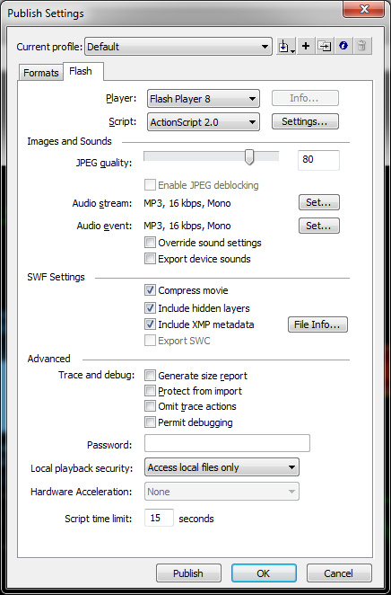
Menus
Goto File > Publish Settings
In the Flash tab set the Player to Flash Player 8
Set the Script to Action Script 2.0
This is because Action Script 3.0 and the later flash players aren’t supported in UDK yet.
Create a menu logo and/or button for your menu in your favorite image editor and save it as a PNG
Remember that UDK only supports images that are sized with a power of 2 (256, 512, 1024,etc..) this image will need to be imported with the SWF into UDK in future steps. So make sure that your version of UDK can import the image(s) properly.

Slide 5
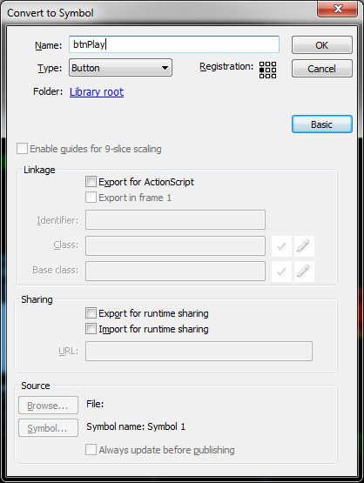
Menu Cont’d
Back in flash import you picture to your stage
(Import > Import to stage)
NOTE: Your abilities in Flash and image editing will determine how you will create images, buttons, and other menu items. For instance I created a button in photoshop and imported it into Flash and made it a button. But if you can figure out how to draw in flash you can convert your drawing to a button as well (actually easier).
Okay so now you have an image for a button (you may have others that aren’t buttons) on the screen. Select it and go to Modify > convert to symbol
remove the default name and put something meaningful in there like “btnPlay”, “btnExit”, etc… In the drop down select button. Then hit OK.

Slide 6
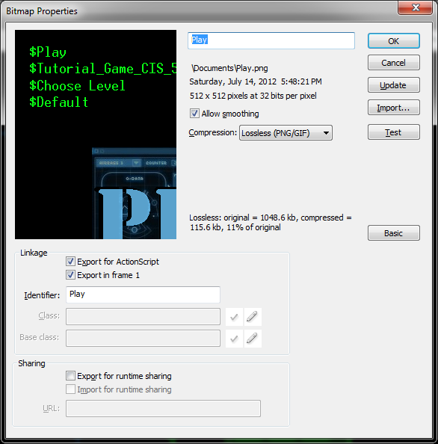
Menu Image Prep
For all images in your Flash library (everything in your flash project that you’re working on). You’ll want to set them up to properly run in UDK. UDK doesn’t import file extensions properly and will reassign names if you’re not careful.
So in your library tab right click your images and go to properties.
In properties
Remove the file extension and check off allow smoothing
At the bottom check off Export for ActionScript and Export in Frame 1
Remove the file extension for the identifier name
The compression drop down list set it to Lossless (PNG/GIF)
If you don’t see the settings at the bottom for action script click the advanced button.

Slide 7
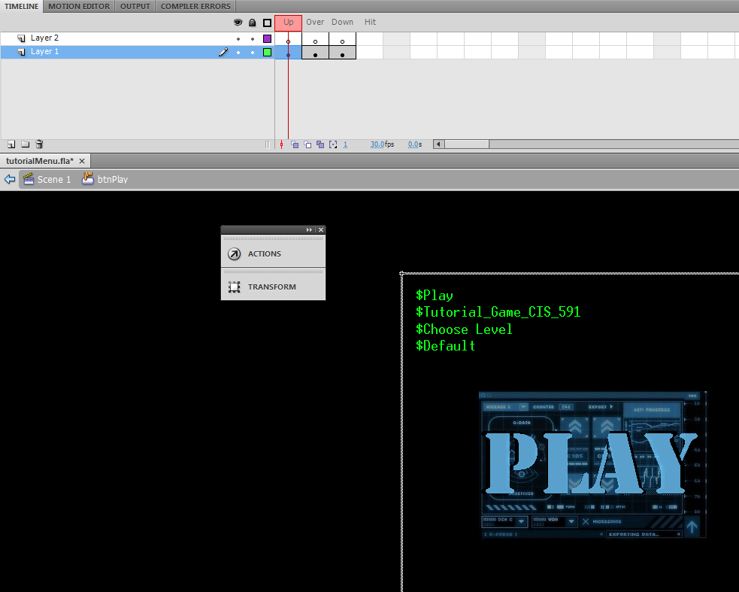
Menu Cont’d
With our button still selected, right click it and select Edit In place. You’ll notice you have replaced your timeline with an events list. The events listed should be UP, Over, Down, Hit.
You have the freedom to modify any of the states you would like but in this tutorial we will select the Up, Over and Down states
right click select Insert KeyFrame
So now you should have Up, Over, Down keyframes.

Slide 8
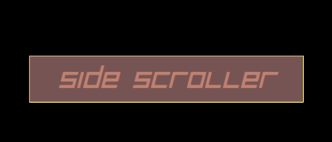
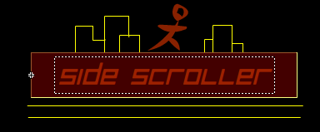
Menu Cont’d
Highlight the state you wish to modify, and just like editing a keyframe in any other scenario in Flash, go on and modify the screen. I did the Over state and just drew a line on the screen to tell me that I’m hovering over the button.
Up Over Down

Slide 9
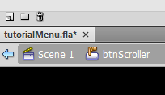
Menu Cont’d
To test what you have so far. Go to the top menu bar Control > test, or click the Test with FxMediaPlayer button.
If you don’t have that button go to Window > Other Panels > Scaleform Launcher
When you’re done you want to head back to the main timeline. So in the top left you should see “Scene 1” next to your button name. Click scene 1 to go back.
Now we need to make a cursor.

Slide 10
Menu Cont’d
Create a new layer and lock the other one(s)
In this layer same as before import or create a drawing, and this will represent your mouse cursor.
I just drew 4 lines to make a mouse look-a-like
Select the image and go back to Modify > Convert to Symbol. Convert your selection to a movie clip.

Slide 11
Menu Cont’d
Now we want to test what we have
Before we head back to UDK, In “UDK\UDKGame\Flash\” create a folder for your flash file. For any images you added to flash (like for the button) that will also need to be imported separately. Include a sub folder and place those images in there.
A folder for the SWF and FLA and a sub folder for the png’s
Otherwise if you forget that step UDK will take them from their current location on your hard drive, but that wont’ work once you deploy your game!
Also make sure that your pipeline for flash goes to this folder. If not, you will notice that UDK isn’t showing your latest changes! That’s a pain in the neck.

Slide 12
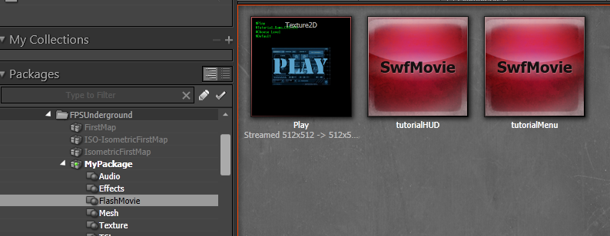
Menu Cont’d
Create a new map for your Menu (you don’t have to if you want to include your map in the menu).
In the content browser in UDK Editor import your SWF file.
You’ll notice that you may not be able to choose what package it imports to, but you can move it after you import it
When you’re done you should see your SwfMovie object and any images imported with it that go with your flash file.

Slide 13
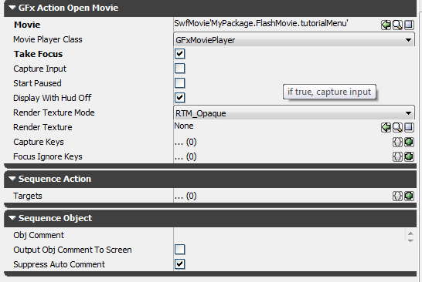
Menu Cont’d
Go into Kismet
In kismet add a Level Loaded object.
Event > Level Loaded
Also add a GFx Movie object
Action > GFx UI > Open GFx Movie
Connect Loaded and Visible from the Level Loaded to the In on Open GFx Movie
With your SWF movie selected in the Content browser (double check) and the Open GFx Movie object selected go under the Action Open Movie set of options and look for “Movie”. Click the green arrow on the right side to add your selection to that line.
If you play the level in the editor you should see your work in progress.

Slide 14
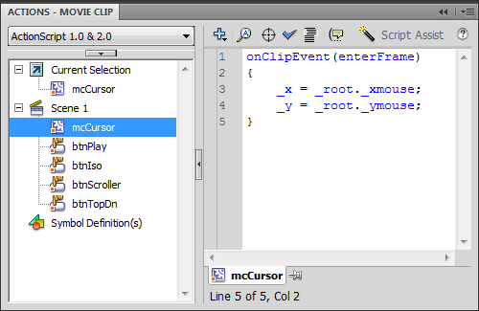
Menu Cont’d
If you didn’t like what you saw. Go back before we get into action script.
AC2 Code!
Okay we need to get the cursor moving. In flash select your cursor object, right click and go to Actions. The window that pops up is your Actions script code window.
Put this in there
onClipEvent(enterFrame) { _x = _root._xmouse; _y = _root._ymouse; }
All that says is when our cursor is within our frame we want to move the movieclip’s X and Y coordinates.
Press ctrl+Enter and you can test your SWF file. You should see your cursor moving with your mouse now.

Slide 15
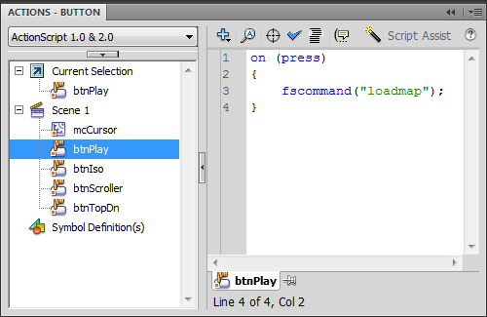
Menu Cont’d
Now edit the Actions on your Play button
Enter this
on (press) { fscommand("loadmap"); }
Fscommand is a method used to allow the SWF file to talk to what ever is hosting it (in our case UDK).
Publish your SWF file (File > Publish)

Slide 16
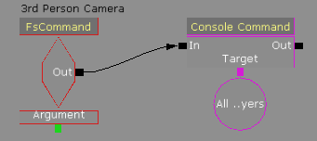
Menu Cont’d
Back in UEd
In the content browser right click and Reimport on your SWF file
In kismet select the Open GFx Movie object and check off “Take Focus”
Now add an FsCommand event (Events > GFx UI > FsCommand)
Set the FSCommand property to the name of the command you set on your button back on flash. Here it was “loadmap”
Now with your SWF file selected in your content browser set the movie property for the FSCommand object
Make sure that Player Only isn’t checked

Slide 17
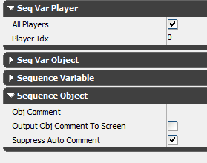
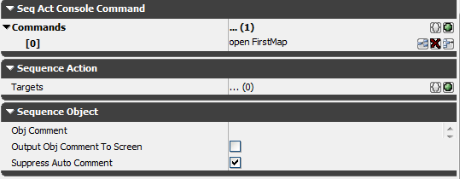
Menu Cont’d
Add a console command object
Actions > Misc > Console Command
Connect the Console Command Input to the Fscommand out
Add a new command (delete any blank commands)
Set the command to “open DM-Deck” or whatever map you’d like to open
Add a new Player variable (New Variable > Player > Player)
Set the player index to 0
Set the target of console command to the player variable

Slide 18
HUDS
This will be pretty similar to the menu creation. We’ll need a flash project, actionscript to act as a middle man between the SWF movie we’ll make and unreal, and of course we need unreal script to take our in-game data and display it on the screen.
If you haven’t done so enable the scaleform extension in flash
Help > Manage Extensions. Click install at the top of the window
In the file browser that pops up you need to look for the scaleform mxp file (<UDKDirectory>\Binaries\GFx\CLIK and find “Scaleform CLIK.mxp”
Then to show the launcher tool go to Window > Other Panels > Scaleform Launcher (Window is next to Help)

Slide 19
Huds cont’d
So open up a new flash actionscript 2.0 file
Set up the publish settings just like the menu tutorial (File > Publish Settings. Change to Flash Player 8.0 and AC2.0)

Slide 20
Huds cont’d
We’re going to create a simple ammo bar
If you look at the flash file that came with this tutorial you’ll see that I made an object called ammobar. In ammobar there are 3 components (bar, text, background).
So let’s create it from scratch
Name your current layer main.
On main draw a rectangle on the screen for where you want your ammo bar to be located. Shape it and color it any way you’d like

Slide 21
Hud cont’d
Double click the ammobar box (btw name it ammobar ) this should open up a new sub-layer for you. Name the layer you’re in now “background” and add two more layers “bar” and “text”.
In the text layer add a text box to say what you’re going to display (ammo, ammo count, health, mana, etc..)
In the bar layer add a rectangle
In the bar layer right click and convert it to a symbol
Text
Bar

Slide 22
Hud Cont’d
Choose a Movie Clip for the symbol type and give it a name
An interesting note is that here you can change how your bar will look as it “drains”.
You’ll noticed the Registration area in the symbol creation window. Next to that a 3x3 set of squares and one of them is black. That refers to the actual local reference point for that symbol. So if you want this bar to drain right to left place that black dot somewhere on the left most column, for left to right do the other way. If you want top to bottom choose something on the bottom row.

Slide 23
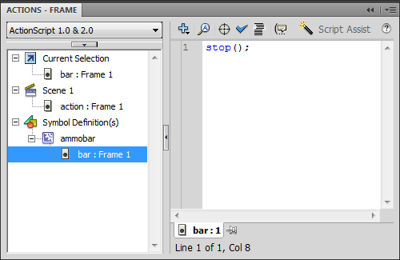
HUD cont’d
Right click the bar layer and click “Actions”
Include this small bit of actions script “stop();”
This layer has a movie clip (the rectangle you just made), and we want to know that it won’t play when we don’t want it to.

Slide 24
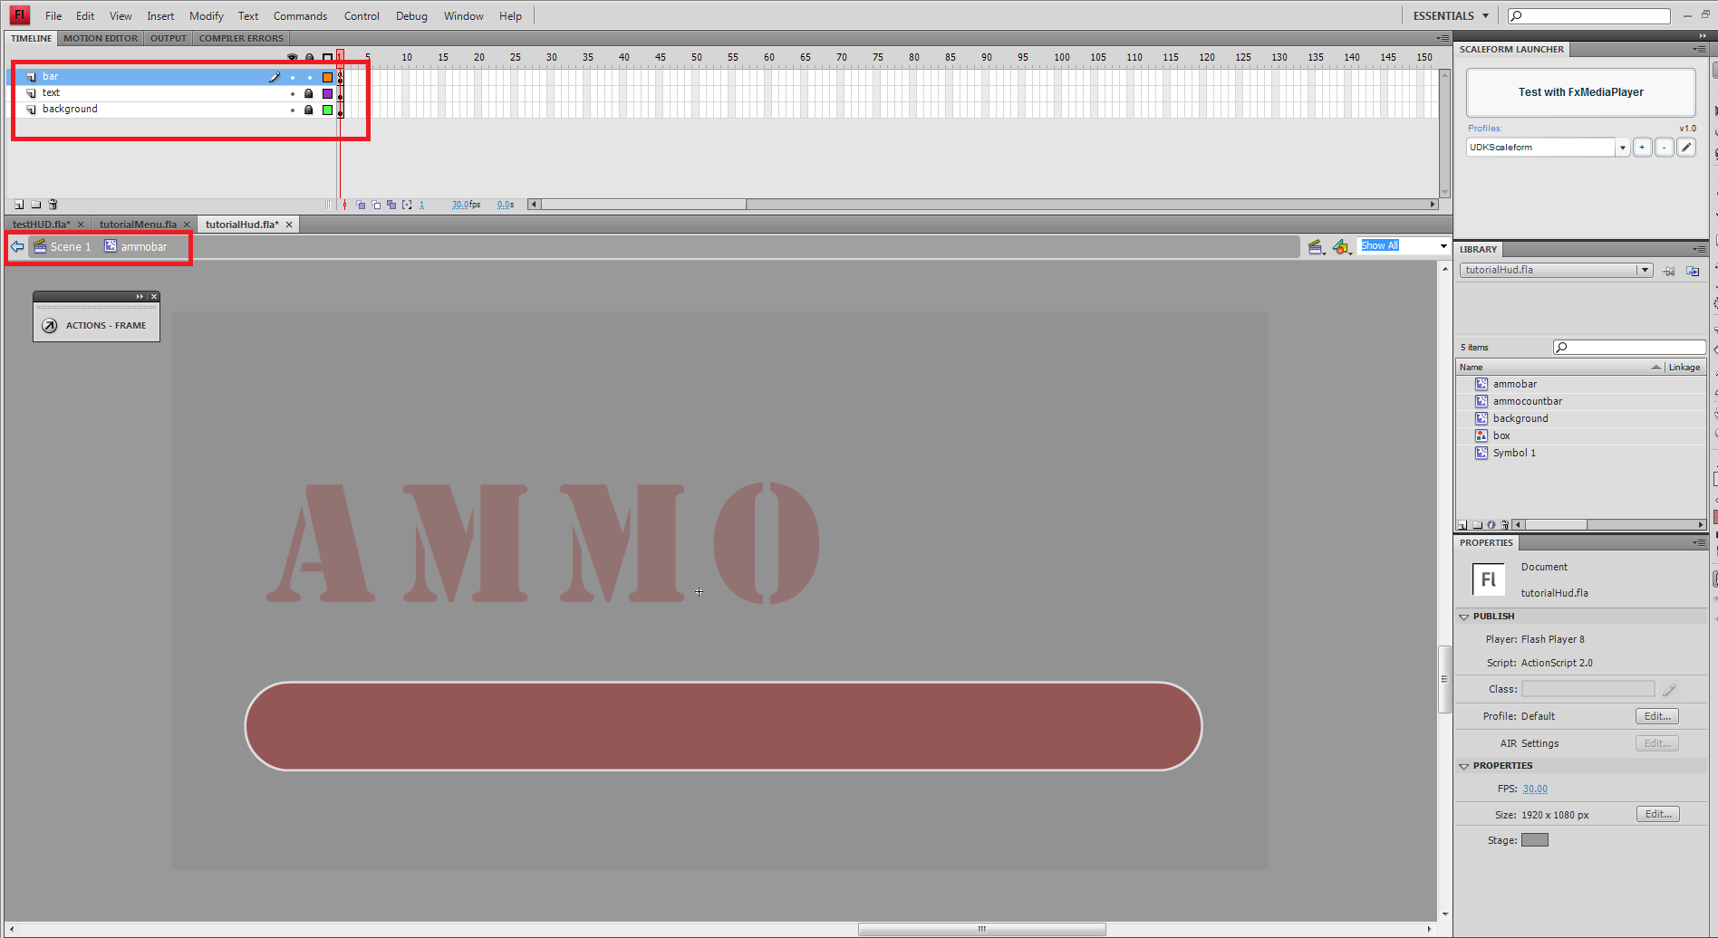
Huds Cont’d
What your window should look like

Slide 25
Huds Cont’d
Don’t forget to name and save your work. Navigate back to scene 1.
In Scene1 you should only have 1 layer and 1 object called ammobar and it contains 3 items. The background, the text, and the bar. Double click it to check this.

Slide 26
HUD cont’d
Add a new layer to Scene1 and call it actions
This is where you’ll add your action script.
For this tutorial we’re going to do some cool 3D effect, but there are many more to try out for yourself
Right-click the the keyframe on the actions layer in the timeline and select “Actions”
Input this code:

Slide 27
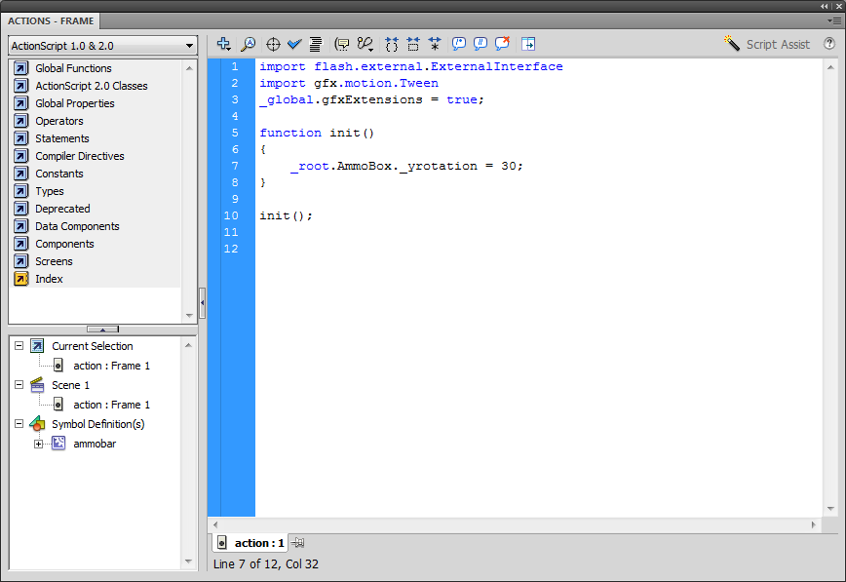
Hud Cont’d

Slide 28
Huds Cont’d
If you run that code verbatim it may not work
Make sure that your instance name for your ammobar object in scene 1 is called “AmmoBox”.
This is also a good point to go back and double check that all of your instance names for your components inside ammobar have values. This is important because this is how flash will know what you’re talking about. So you must name everything so you can reference it in flash and in udk.
A good thing to note is that if you can’t see what you want in flash through the scaleform launcher. Then you won’t see it in game. So make sure it runs correctly in flash first.

Slide 29
HUD cont’d
Now With the scaleform launcher you should be able to run it and see that your object with the 3D effect we applied to it.

Slide 30
HUDS Cont’d
Just like we did with the menu, import your SWF and any images that go along with it into the desired UDK package using the UDK editor

Slide 31
HUDs Cont’d
Okay there will be 3 files that you’ll need to update to get your new HUD in game.
You game mode need to know what HUDType to call
You need to handle how the HUD draws to the screen and how UDK will interact with the Flash symbols like the ammo bar

Slide 32
HUDs Cont’d
Change your default hud type
In this tutorial we’re using IntroGame as our game type. IntroGame just inherits from UTDeathmatch and changes a few of its base properties
In the IntroGame class add to the default properties
HUDType=class'UnrealScriptIntro.tutorialHUD'
bUseClassicHUD=true //This allows us to manually set HUDType
We’ll create that tutorialHUD class next

Slide 33
HUDs Cont’d
Create a new class and call it tutorialHUD, or whatever you set your default property to in IntroGame.
tutorialHUD will inherits from UTHUDBase
We’re just going to add a variable and add to the PostBeginPlay() and PostRender() methods
In PostBeginPlay() we want to tell UDK that we have a HUD swf file that we want to use as our hud and that we want to play it. So we call the movie’s initialize function inherited from GFxMoviePlayer and we also want to call the Tick() every time the PostRender event is called.

Slide 34
HUD: Code for tutorialHUD.uc
class tutorialHUD extends UTHUDBase;
var HUDMoviePlayer HudMovie; // the reference to our hud movie
singular event Destroyed()
{
if(HudMovie != none)
{
//garbage collection
HudMovie.Close(true);
HudMovie = none; // similar to setting it to NULL
}
super.Destroyed();
}
//Call the post begin play function, only run on Client side
simulated function PostBeginPlay()
{
super.PostBeginPlay();
HudMovie = new class'HudMoviePlayer';
// Set the timing mode to match up to what will run in UDK
HudMovie.SetTimingMode(TM_Real);
//init HudMovie
HudMovie.Init(LocalPlayer(PlayerOwner.Player));
}
// This is called for every tick the HUD should be updated
event PostRender()
{
HudMovie.TickHUD();
}
DefaultProperties
{
}

Slide 35
tutorialHUD.uc
What we just did was declare a HUDMoviePlayer object
The event Destroyed() is our garbage collector. We want to remove and close our HUDMovie reference
We add to PostBeginPlay that we want to set our HUDMovie and initialize it
In PostRender() we want to update the properties that we will use to change the look of the HUD. This will be with the TickHUD() function.

Slide 36
HUD Cont’d
Now we have tutorialHUD and it manipulates this HUDMoviePlayer object.
We need to create that class now

Slide 37
HUD: Code for HUDMoviePlayer.uc
class HudMoviePlayer extends GFxMoviePlayer;
// state variables, holds the current state for the ammo count
var float LastAmmoCount;
// variables for holding the flash movieclip references
var GFxObject AmmoMC;
var GFxObject AmmoBarMC;
// Called from tutorialHud's PostBeginPlay()
function Init(optional LocalPlayer PC)
{
//start and load the SWF file
Start();
Advance(0.f);
// Set the last count variable so it gets updated on the first tick
LastAmmoCount = -201;
AmmoMC = GetVariableObject("_root.AmmoBox");
AmmoBarMC = GetVariableObject("_root.AmmoBox.left");
super.Init(PC);
}

Slide 38
HUD: Code for HUDMoviePlayer.uc
// a function that will be called every frame
function TickHUD()
{
local UTPawn utp;
local UTWeapon item;
utp = UTPawn(GetPC().Pawn); // We need to make sure there is a pawn that exists so we can talk to it
if(utp == none)
{
return;
}
item = UTWeapon(utp.Weapon);
LastAmmoCount = UTWeapon(utp.Weapon).AmmoCount;
AmmoBarMC.SetFloat("_xscale", (LastAmmoCount > 100) ? 100.0f : LastAmmoCount);
}
// a function for rounding off a float
function int RoundNum(float num)
{
local int convertedNumber;
convertedNumber = int(num);
if(num >= 0.5f)
{
return convertedNumber + 1;
}
else
{
return convertedNumber;
}
}

Slide 39
HUD: Code for HUDMoviePlayer.uc
function float GetPercentage(int val, int max)
{
return (float(val) / float(max)) * 100.0f;
}
DefaultProperties
{
bDisplayWithHudOff=false
MovieInfo=SwfMovie'MyPackage.FlashMovie.tutorialHUD' //Package name, package section, file name
bEnableGammaCorrection = false
}

Slide 40
HUDMoviePlayer.uc
We have variables at the top that represent the items that we want to manipulate (The AmmoBox, and the ammobar)
Next is the Init function. In here we call two actionscript esque calls: “Start()” and “Advance()” This tells UDK that we want to play our HUD. So show it on the screen.
Also in init we set our variables to the items in the SWF file (the instance names).
Finally we call the GFxMoviePlayer’s Init() function.

Slide 41
HUDMoviePlayer.uc
TickHUD() updates our HUD every tick
So here we want to access our player’s stats. In this case it’s the weapon’s ammo. But you could have player properties like mana, health, and other things that you’d want to keep track of also.
In order to show that we are using ammo we scale back the size of our ammo bar in the x (horizontal) direction. So we adjust a property of that bar using “_xscale” which comes from actions script, and we set that to our new value.
We finally add a couple default properties
We tell UDK that we want to display our hud so we make sure that bDisplayWithHudOff is false
We also set our MovieInfo object to reference our imported SWF file, and the location of that file is the full name of the SWFMovie object in the UDK editor’s Content browser.

Slide 42
Hud Cont’d
If you’ve imported you most recent copy of your SWF file and that file includes objects that have instance names and action script that properly references them and you’ve followed along with the code samples and adjusted the code when needed then you should be able to run your game and see your new hud!
Just properly import and play the game

Slide 43
HUDs Notes
Two classes to look into for extra info
UTGFxHudWrapper.uc
GFxMinimapHud.uc
There are sample files that you can mess with in the Development\Flash\AC2 The base folder for any UT hud.
Every HUDBase movie (HUD, PauseMenu, InventoryMenu, etc…) are all managed by the HudWrapper class and there is a team based wrapper too for team based games
UTGame
GenericPlayerInitialization
Tells the game what wrapper to use, after PostLogin()
This is where you define the team hud wrapper or the normal one

