Slide 1
Unreal Script: An Introduction Parts 1 to 4
Brandon Holbert

Slide 2
1. Environment Setup
Project File Structure
3rd Party tools
Nfringe (Visual Studio Plugin)
http://wiki.pixelminegames.com/index.php?title=Tools:nFringe:Releases
Source Control
http://tortoisehg.bitbucket.org/download/index.html
Setting up UDK

Slide 3
File Structure
After you’ve installed the most recent UDK on your PC you’ll see a new Folder in your C:
Something like C:\UDK\UDK-2012-05
UDK isn’t designed for multiple games to be developed on one installation
Keep in mind the easiest way to start over is just to install a fresh copy of UDK
Inside the “UDK-2012-05” (or equivalent) Folder there will be four more Folders
Binaries
This contains all the library files and project executables that you’ll be using in your game.
Development
Contains all source files for the project along with items for flash and action script (for menus, HUDS, the games UI)

Slide 4
File Structure
Engine
Contains the base files for the Unreal Engine. DON’T CHANGE ANYTHING IN HERE.
UDKGame
Contains config files that you’ll change or update if your project requires it.
Default; config files that wont’ ever be updated by the system.
Materialized ; usually start with the UDK prefix. These config files will be updated over time
Also contains your logs, built script files

Slide 5
File Structure
The files that will be most important to us in relation to these tutorials is in Development\Src\

Slide 6
Project File Setup
In Visual Studio you’ll create a new project
If you have Nfringe you should see under Installed Templates UnrealScript
With that selected, highlight UnrealEngine 3 Licensee Project
If you don’t have Nfringe, get it
In either case make sure that all of the relevant files are located in the same folder for your game.
For example Nfringe users will get a “.ucproj” file which needs to be in the same directory as the .sln and .suo files
NOTE: Don’t have “Create Directory for solution” checked when you create a new project

Slide 7
Project File Setup
Moving over the other script folders into your new project
Open up your Development\Src\ and you should see your newly created project folder and inside you should see a few files that visual studio created for you
In that folder (…\Development\Src\YourGame\) create a new folder called “Classes” this is where you’ll be saving your script files to
This actually is the specific file name that the compiler looks for
Cut and copy the .suo, .sln, and .ucproj files up into the parent directory (…\Development\Src\)
This is so you can see all of the script files necessary for an unreal game
If you can’t see the .suo file, make sure you’re able to see all hidden folders and their extensions

Slide 8
Project File Setup
Moving over the other script folders into your new project (cont’d)
Back in the classes folder create a new text file and name it to “something.uc” and say yes to the dialog that pops up
This is a temp file so you can view your project folder inside visual studio
Double click your .ucproj folder, and when visual studio opens you should see a new list of folders in your solution explorer window including your project’s folder

Slide 9
Configuring the new project
In visual studio with your project loaded, right-click your project in the solution explorer and click on properties and go to these tabs
General
Set the UCC Path to C:\UDK\UDK-2012-01\Binaries\Win32\UDK.exe
Debug
Set the Start Game Executable to C:\UDK\UDK-2012-01\Binaries\Win32\UDK.exe
A thing to note here is that there are some options you can set to make things easier for debugging, for now just set these
Check Disable startup movies, and
Force windowed mode
Make sure to save your project after you’ve changed these properties

Slide 10
Configuring the new project
Now there should be a project made and a folder created in <UDKDirectory>\Development\Src\YourProjectName\ called classes
What you’ve created is called a package. In this case it’s a Mod package. The engine doesn’t know of it’s existence yet. So if you were to make a script file and compile, you wouldn’t see any of your changes in game. So let’s fix this.
Goto <UDKDirectory>\UDKGame\Config\ and find the file UDKEngine.ini
When you change something and the engine needs to be aware about it. It’s a good habit to go back through these config files that start with UDK. Some of these you can change through the UDK editor, but most of the time you’ll have to go into these files and manually make changes.

Slide 11
Configuring the new project
Inside UDKEngine.ini
Under the “[UnrealEd.EditorEngine]” heading
Find the section where you see EditPackages
Add a new line “ModEditPackage=<YourGameName>”
To see where these compiled files go to, navigate to the folder <UDKDirectory>\UDKGame\Script\. There you’ll see a lot of .u files. .U files are compiled packages. These compiles packages contain scripts, and all other assets that belong with what you’re making.
This is a method put in place to make Unreal Script build quicker and for the Engine to run quicker.
So now if we had a script file to compile you’d see “myGame.u” inside <UDKDirectory>\UDKGame\Script\

Slide 12
Hello World
Let’s get to coding!
Now you should have a new empty project so let’s make a script file!
In the solution explorer in VS2010 right click on your project folder’s Classes and Add > New Item > UnrealScript File
Name it IntroGame and click Add in the bottom left

Slide 13
Hello World
You should see something like this
Class IntroGame extends Object;
DefaultProperties
{
}
What we’re going to do here is show how we can create our own game mode and then we’ll make a map that will use that game mode.

Slide 14
Hello World
The biggest thing to understand about how Uscript works. It’s all about inheritance.
If you were to make a totally different game that doesn’t even have a .1% similarity to Unreal Tournament than you could start from scratch.
But in a small team and as a hobby it’s smart to use what’s already there. That’s what we’re going to do. So it’s all about the inheritance.

Slide 15
Hello world
In this example we’ll modify the UTDeathmatch game mode.
You could do Capture the flag, Team Deathmatch, or any other pre-made game mode, but it just depends on what you want in your new game mode.
We’re going basic here and that’s extending UTDeathmatch.

Slide 16
Hello world
Edit your IntroGame class and tell it that we want to use UTDeathmatch’s properties and functions
class IntroGame extends UTDeathmatch;
Inheritance similar to Java
Keyword is extends
That right there is all you need for the code! We also need to change a line in the DefaultGame.ini configuration file (<UDKDirectory>\UDKGame\Config\DefaultGame.ini)

Slide 17
Hello World
Near the top you’ll see the section [Engine.GameInfo].
Change “DefaultGame”, “DefaultServerGame”, and “DefaultGameType” to equal <YourProjectName>.IntroGame
Add this
“DefaultGame=UnrealScriptIntro.IntroGame”
“DefaultServerGame=UnrealScriptIntro.IntroGame”
“DefaultGameType=UnrealScriptIntro.IntroGame”

Slide 18
Hello World
With that you should be able to go into Unreal Editor (UEd) and fire up a blank map or a created one and see your new game mode.
With a map loaded go to the top menu bar View > World Properties. Go to the Game Type Section and change “Default Game Type” and “Game Type for PIE” to your new Game Type Class.
Welcome to Unreal Script!

Slide 19
Compile your project
nFringe will simply build your project like you normally would using visual studio. It calls the same actions that Unreal Frontend calls or the included “Make.bat” file calls. They all build your project.
Because nFringe can be buggy itself I’ve made a batch file to double check that my most recent changes compile and will be accessible in the editor or in game.

Slide 20
Compile your project
So add a make.bat file under <UDKDirectory>\
Add this to it
@echo off
cls
.\Binaries\UDKLift make
This will compile your project/package when you double-click the batch file
EVERY TIME YOU COMPILE!
Make sure that the editor or any instance of the game is closed. This will give you a compiler error and if you don’t get why it was thrown you may spend a lot of time trying to figure out what’s wrong. So CLOSE THE EDITOR.

Slide 21
Source Control
No matter what you’re using for your source control, create a repository on your UDK-2012-01 folder (in C:\UDK\)
That will cover any changes made to the game, unreal packages, maps, scripts, assets, etc…
Make sure after every change you’re committing those changes!

Slide 22
Source Control
For work and at home with personal project I use Mercurial which is a way to do source control.
It is very intuitive and free.
I use it on project that only exist on one computer just to make notes and track changes (source control) or shared files on a server (home server, rented server, work, etc…)

Slide 23
Source Control
I don’t work for mercurial or anything but I do advise that you check out
http://hginit.com/
http://tortoisehg.bitbucket.org/download/index.html
Mercurial is a source control tool that even Epic uses. So it’s very popular and easy to use.

Slide 24
Putting it all together
So far we’ve covered setting up you new game in visual studio using nFringe
This involved setting the project properties
File structure for the game
Handling source control
UDK Setup
Understanding that Unreal Script is about inheritance

Slide 25
2. Language Overview
Comparison of Unreal Script to other common programming languages
Commonly used data types

Slide 26
Unreal Script features
Uscript is case-insensitive
Only and exactly one class declaration can be made per .uc file
There only exists one layer of packages and all classes for your game must be contained in a named package
Don’t confuse these packages with .upk’s which are content packages for UDK. Those hold game assets and .u’s are packages for your scripts.
There are no #include, import, or using statements so if one package needs a file in another package you will add to the proper config fie (INI file) what package you want to use/reference . You do that with the “ModEditPackages=<myPackage>” call
There is no method overloading but there is overriding
There is no exception handling and unreal script doesn’t handle generics
You can call `warn for error handling (go to Debug section)

Slide 27
Unreal Script features
Unreal script was originally based on java. You’ll notice that they’re both pretty similar.
Unreal Script must be encapsulated in class objects. You can’t reference anything that isn’t in a class.
Uscript doesn’t use constructor or destructor methods
Uscript doesn’t provide pointers because memory addresses aren’t accessible via unreal script.

Slide 28
Unreal Script features
Multi-dimensional array aren’t supported and arrays must be explicitly declared as static or dynamic
Static
var type varname[length]
Dynamic
array< type > arrayName
Conditions in If statements and While statements must be of type bool
if (condition) statement;
while (condition) statement;
Structs aren’t public, they represent a collection of variables

Slide 29
Variable Declaration
Var & local
Var (instance variables)
A declaration for a new variable within the class
var type Name;
Local
A declaration for a new variable within a function
Function Foo() …. { local type Name; } ….

Slide 30
Common Datatypes
Byte A single-byte value ranging from 0 to 255.
Int A 32-bit integer value.
Bool A boolean value: either true or false.
Float A 32-bit floating point number.
String A string of characters.
Constant A variable that cannot be modified.
Enumeration
A variable that can take on one of several predefined named integer values. For example, the ELightType enumeration defined in Actor describes a dynamic light and takes on a value like LT_None, LT_Pulse, LT_Strobe, and so on.

Slide 31
Strings
String
literals are enclosed in “double quotes”
var String MyString = “MyString’s string”;
Concatenation
MyString $= “SOMETHING”;
MyString = String & ( coerce “A”, coerce “B” );
Concatenation: two strings with a space between them
String @ (coerce “A”, coerce “B” );
More string logic covered at http://udn.epicgames.com/Three/StringsInUnrealScript.html
coerce forces the caller’s parameter to be converted to a specified type
In this case it would converted to a string

Slide 32
Common Datatypes
array<Type>
A variable length array of Type.
Static
var type varname[length]
Dynamic
array< type > arrayName

Slide 33
Common Datatypes
struct
Similar to C structures, Uscript structs let you create new variable types that contain sub-variables. For example, two commonly-used UScript structs are vector, which consists of an X, Y, and Z component; and rotator, which consists of a pitch, yaw, and roll component. (see Structs for more information)

Slide 34
Type casting
Implicit
var int myInt;
var float myfloat;
myInt = 2;
myfloat = 1.24;
myInt = myfloat; //now myInt = 1
Explicit
typeToCastTo(valueToCast);
float(myInt);

Slide 35
Function definition
function returnType (params)
{ …..
}

Slide 36
Struct Declaration
Struct structName
{
var int A,B,C;
structdefaultproperties
{ …..
}
};
Declaring struct variables
var structName Name;

Slide 37
Uscript Control Structures
If statements
if (condition)
{
statement
}
else if (condition) {}
else {}

Slide 38
Uscript Control Structures
Switch statement
switch (object)
{
case value:
break;
default:
break;
}

Slide 39
Uscript Control Structures
For loops
for(starting value; condition; loop expression)
Do loop
do
{
} until (condition);
While loop
while (condition)
{
}

Slide 40
Uscript classes
Each class is declared with a class name and its parent class.
class ClassName extends ParentName;
Class specifiers
class myClass extends parentClass specifier1, specifier2;
Native
Indicates that this class has “behind the scenes” c++ support. It is expected that this class contains implementation in c++ code for the EXE.
Abstract
Declares the class as an abstract base class. This prevents the user from adding actors of this class in the game world.

Slide 41
Uscript classes
Config(iniName)
Indicates that this class is allowed to store data in a config file specified as a parameter in the Config declaration. If no config file is declared then it means that this class’s variables can be stored in any config file.
Placeable
In editor this indicates that the class can be created in UnrealEd and placed into a level
NotPlaceable
Explicitly states that this class can’t be placed as an object in unlrealEd. You’ll use this usually when inheriting from a base class that is placeable.
HideDropDown
Prevents this class from showing up in the UnrealEd property window.

Slide 42
Default properties
At the end of every class you’ll see a section called default properties
This is the place where you initialize all variables, and set any properties that belong to your class or your parent’s class.
If you’re referencing a value like 1 or a filename in the content browser.
Then it all goes into default properties. (no semi-colons needed to end a line).

Slide 43
Default properties
Class className extends parentClass;
defaultProperties
{
myVariable = 1
myFileName=“C:\UDK”
}
If you have a blank defaultproperties block then you can remove it. It isn’t necessary.
Same goes for the defaultpropeties block in a struct.

Slide 44
Section 2 Summary
We learned about the different data types and coding styles that Epic uses in the Unreal Development Kit with Unreal Script.
Section 2 is a good reference to go back to if you’re stuck in the later sections

Slide 45
3. Kismet
This will cover
Adding functionality to Kismet with Unreal Script
Creating a Kismet action
Adding input
Adding output
Adding variables

Slide 46
Connect Uscript to Kismet
We will inherit from kismet related classes to get our Uscript into kismet.
Kismet is the visual scripting language developed just for the UDK.
It is a preferable tool for many people who can and can’t code.

Slide 47
Connect Uscript to Kismet
The point of modding a Kismet object is to create a custom type that Kismet doesn’t support (an event, action, or a condition).
Things that are for maybe objects that you created from scratch and it could be a custom event like “Enter Train” which may define the ending of a level or something like that.

Slide 48
Connect Uscript to Kismet
In nFringe you can add a “Kismet Action”, “Kismet Condition”, or a “Kismet Event”
Action
What will be acted on an object, a physics object, static mesh, etc
Condition
Logic flow (if statements, etc..)
Event
More like an event listener for a specific game state like a trigger being fired.
We’ll create our class from scratch.
nFringe provides a template with empty functions and attributes for your class.

Slide 49
Uscript to Kismet
In your classes folder add a new class and have it extend from SequenceAction. We’re going to create a kismet action!
Class MySeqAction extends SequenceAction;
event Activated() //Whenever an input is fired or triggered
{
//logic for when the action is triggered
}
defaultProperties
{
ObjName=“MySeqAction” // The actual name in the Kismet Block
ObjCategory=“AnyName” // The category that the
// kismet action exists in
// like “<MyProjectName> Actions”
}

Slide 50
Uscript to Kismet
The default properties variables are what you’ll see when you right click the empty background in Kismet.
Before we finish we want to add some inputs to our our Kismet Action
If you explore the SequenceAction class inside the Engine folder you’ll see a list of properties and functions that you can use an manipulate from the SequenceAction class.

Slide 51
Uscript to Kismet
Let’s add two inputs to our kismet action
In default properties we’ll adjust the InputLinks array that is inherited from SequenceOp which is the parent of SequenceAction
var array<SeqOpInputLink> InputLinks;
This means that Inputlinks is a dynamic array that takes objects of type SeqOpInputLink

Slide 52
Uscript to Kismet
We also want to describe the link we’ll add.
This is the actual wording that will appear in Kismet on the action block.
So we’ll use “LinkDesc” from SequenceOp
Add this
InputLinks(0) = (LinkDesc = “MyInput”)
InputLinks(0) = (LinkDesc = “MyCustomInput”)

Slide 53
Uscript to kismet
You’ll notice that we didn’t add any output links.
This is because by default your action will be given an output.
If you open up your editor (after you built your project) you’ll see in Kismet when you right-click the empty background and in the pop-up under Actions you’ll see your action category and action name.
You can add it to Kismet and see the inputs you defined, and outputs, and variables if you included any of those!

Slide 54
Kismet
In this example we made a kismet action and we added two input links which show up in kismet as two inputs that we can connect to with other Kismet objects.
To add an output use OutputLinks(index)
var array<SeqOpOutputLink> OutputLinks;
Just like input links this is defined in SequenceOps which SequenceCondition, SequenceAction, and SequenceEvent Derive from
OutputLinks(0) = (LinkDesc = “MyOutput”)

Slide 55
Kismet
To add a variable section (What will be on the bottom edge of the kismet box)
Use “VariableLinks(index)”
var array<SeqVarLink> VariableLinks;
Also declared in SequenceOps
VariableLinks(0) = (LinkDesc = “MyVariable”)

Slide 56
4. Debugging
We’ll Cover
nFringe debugging
Debugging if you don’t have nFringe
Tips and tricks
Common build errors

Slide 57
Debugging
The really simple way is if you’re using nFringe through visual studio. Just like in any other solution, file, or project you can place break points and run your game through visual studio using nFringe.
The point we’re at now in this tutorial is that we have a game mode (and hopefully you have a map of some sort). Let’s set up the development environment to run our game in debug mode.
If you haven’t done so, now is the time to open up your map in UEd or make a new map and set the “default game type” and “game type for PIE” (view > world properties) to the game type you just made (IntroGame).
PIE stands for “Play In Editor”. If you don’t plan on running you game inside the editor then there is no need to set this. But you MUST set the default game type.

Slide 58
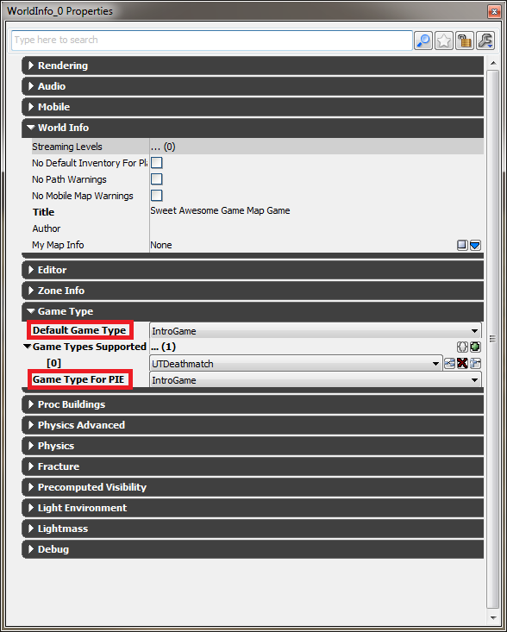
Debugging
If you want to explore some code. Do it now and place some break points in some script files and see when they fire.
Right now if you were to build and run your game you’d launch unreal tournament and it would go to the same menu I’m sure you’ve seen many times (UDKFrontEndMap). We’re going to override that.
For the next step we’ll need to change your projects settings so you can launch right into your project and what you’re trying to debug.

Slide 59
Debugging
If you want to explore some code. Do it now and place some break points in some script files and see when they fire.
Right now if you were to build and run your game you’d launch unreal tournament and it would go to the same menu I’m sure you’ve seen many times (UDKFrontEndMap). We’re going to override that.
For the next step we’ll need to change your projects settings so you can launch right into your project and what you’re trying to debug.

Slide 60
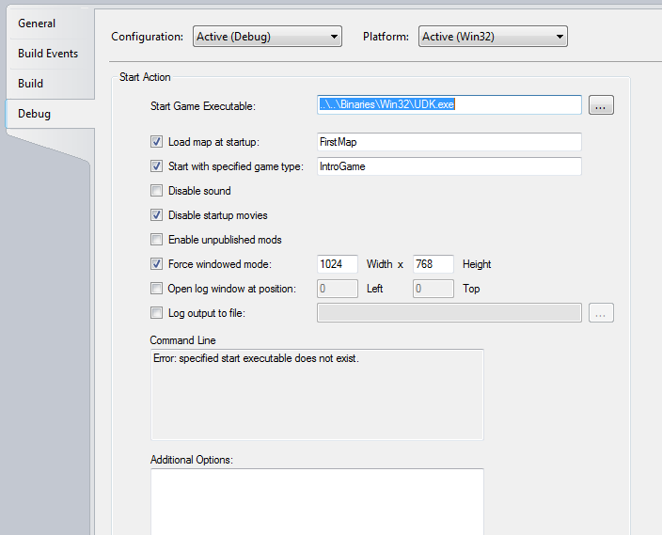
Debugging
Set “Load map at startup:” to the map you want to launch to
The map you want to debug on maybe?
Set “Start with specified game type:” to the game

Slide 61
Debugging
Set “Load map at startup:” to the map you want to launch to
The map you want to debug on maybe?
Set “Start with specified game type:” to the game

Slide 62
Debugging
It’s that simple. Now when we add more to the project you can run through debug to see what is wrong or what values you get at certain points in the game loop.

Slide 63
Use the `LOG!
Even if you have nFringe the log is a great tool to use.
To call it
`log(<whatToDisplayInLog>);
That’s a backquote by the way.
To see it
Launch your game via Unreal Editor or building and running your game through nFringe
Hit the “~” key to open up the console
Type in the console “showlog”
A new window will pop up and will display your log output.
Also you can view your log output in your log text files
<UDKDirectory>\UDKGame\Logs\

Slide 64
Common errors
Let’s be honest nFringe isn’t perfect. You’re not perfect (sorry, truth). UDK isn’t perfect and wasn’t built to be perfect when creating unreal script. So you’re going to come across some silly errors.
So we won’t go over syntax errors because really they’re expected and will be caught when you build your game.
A tip when writing unreal script is to go slow because nFringe isn’t quick to pick up all of your changes. So make sure you properly pair up your braces, and declare variables properly. Those are the two more common syntax errors.
When you build your game and you get errors that make no sense they usually are errors brought about by something being mispelled, a missing semi-colon, or a missing brace or parenthesis.

Slide 65
Common errors
In this example
simulated function ProcessTouch(Actor Other, Vector HitLocation, Vector HitNormal)
{
// If the object isn't ourself
if(Other != Instigator
{
Other.TakeDamage(Damage,InstigatorController,HitLocation,MomentumTransfer * Normal(Velocity), MyDamageType,, self);
Shutdown();
}
}
It threw this error:
Error, Bad or missing expression for token: Instigator, in 'If‘
What it was referring to was the fact that the if clause was missing a closing parenthesis around it’s condition block and nFringe didn’t detect it so I didn’t know about it until I compiled.

Slide 66
Common Errors
Speaking of compiling, a huge error that usually comes up with different error codes is when you compile and you have the editor, frontend or the game itself running.
This WILL throw an error EVERY TIME.
What we will go over is your mindset for how you’ll attack the beast that is UDK.
It seriously has so many code files to inherit from with thousands of lines of code that you couldn’t in a lifetime remember or read on your own.
As long as you have the general understanding that you’re inheriting from a base class you’ll be okay.

Slide 67
Common Errors
You should also know that you should explore that base class first.
Sometimes you’ll assume class X has this method (like the rocketlauncher class has a fire function) because it makes sense that it would, but in reality it was the child class or it’s parent that owns that function, or variable, or property of some type.
So you’ll save yourself a lot of work in the end if you look for what you want to use before you call it.
Coming from experience this has saved my skin a few times.
Another thing is don’t touch the original files!
Even if you use correct code it can still throw errors.
Not all of the time, but it’s a bug that Epic is still working out.

