Slide 1
User Experience Design
Bruce R. Maxim
CIS 487/587
UM-Dearborn

Slide 3
Ambience
Everything that contributes to the innate look and feel of a game
Sound
Vision
Touch
Ambience all about figuring out how to tell a story without full motion videos or cut-scenes

Slide 4
Touch
Touch refers to the game developers’ handling of the game
It is important to convey the physical feeling of the game environment from the player’s perspective

Slide 5
Establishing Focus
What is it about your game that makes it compelling?
What is your game trying to accomplish?
What sort of emotions is your game trying to evoke in the player?
What should the player take away from your game?

Slide 6
Establishing Focus
How should your 2D game be unique?
How is it different from other 2D games?
What sort of control should the player have over your 2D world?
Note:
Answers to these question should be one page long.
You want every team member to carry these answers around in their head during development.

Slide 7
Desirable Properties for Game User Interfaces
Attractiveness
Graphics, sound, animation, etc.
Usability
Easy to learn
Easy to use
Related to playability
Usability is no longer an art and there are technical solutions to usability problems

Slide 8
Work vs Fun
Work is less productive if software is really hard to use
Games are not fun unless some difficulty is involved
A button marked “solve the problem”
Great for work
Worst possible game design

Slide 9
Wrong Ideas
Usability is not an issue for games, they are supposed to be challenging
User can do whatever they want in games, so there are no goals
If sales are good the UX must be OK
No one is complaining, therefore there are no problems

Slide 10
Technical Usability
It is not a matter of opinion or a list of things you are supposed to do
Usability means easy to learn and easy to use
If a system is hard to learn or hard to use, customers will eventually switch to other products

Slide 11
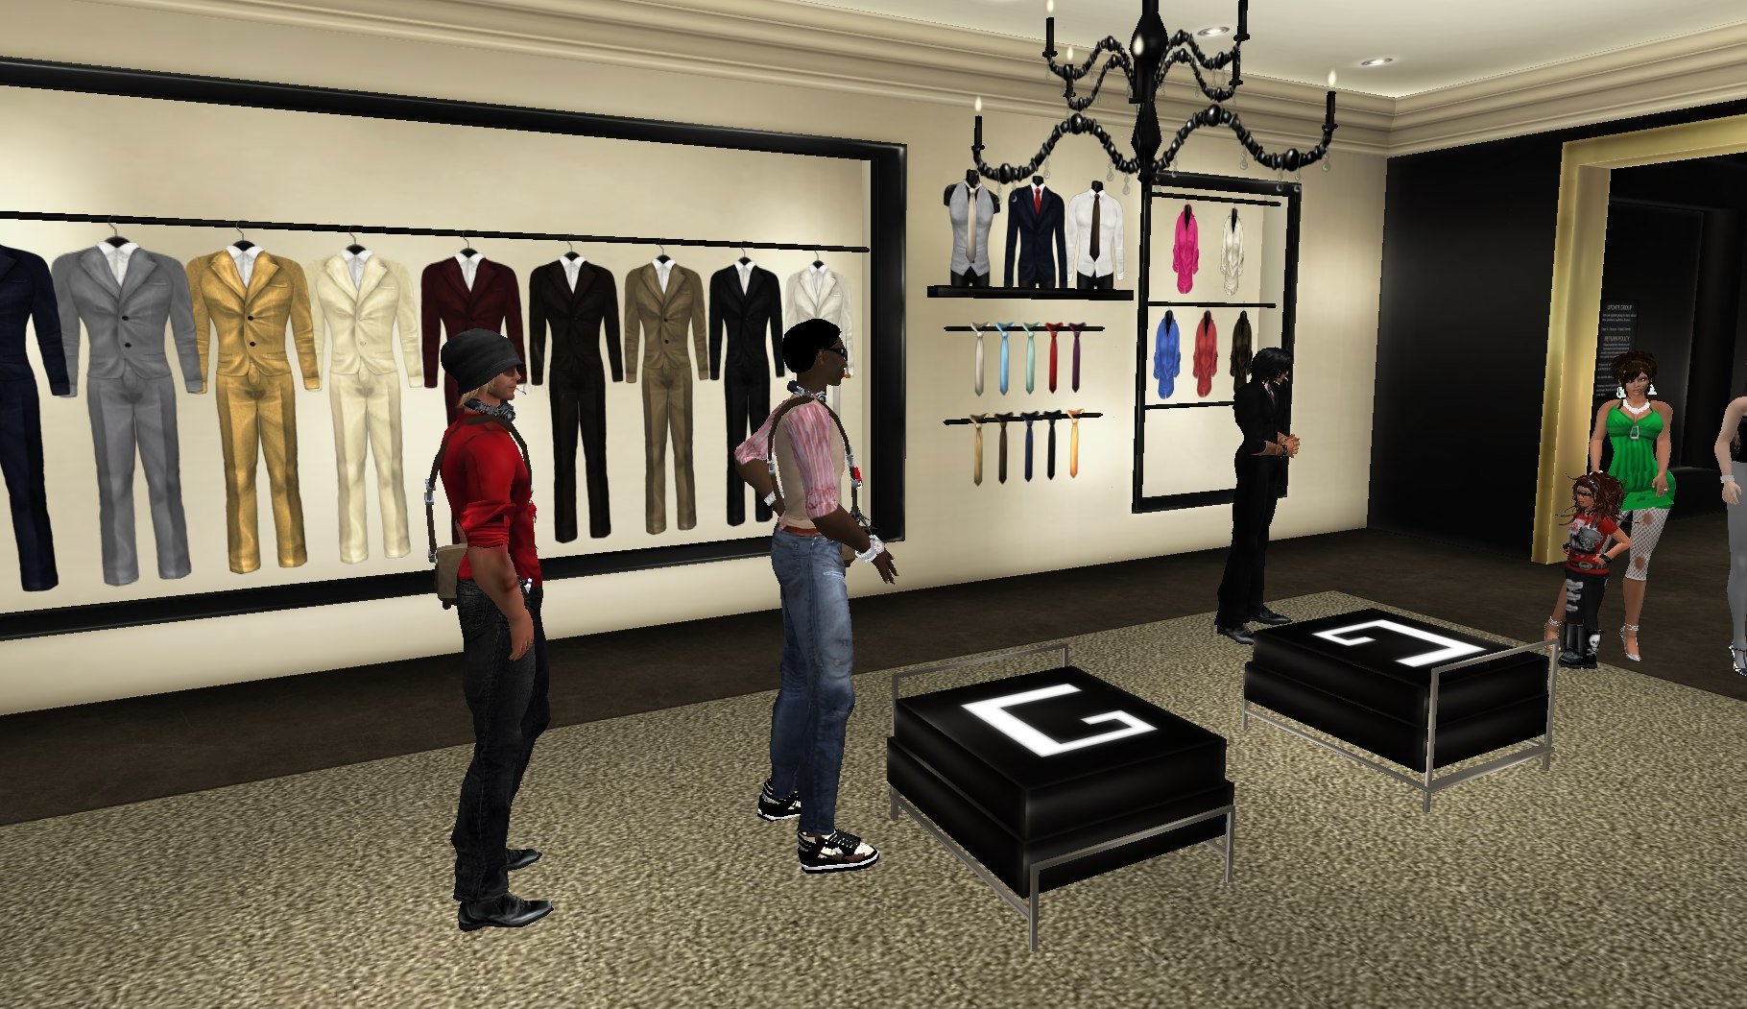
What is happening here?

Slide 12
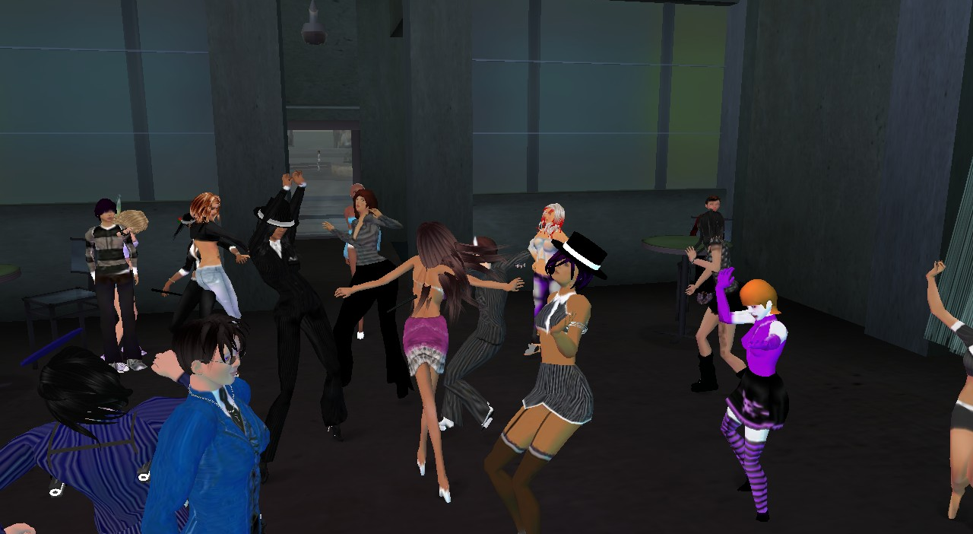
What should the player do?

Slide 13
Guiding the Player
The more you work on a game, the more you internalize its systems and levels
However, a new player won't have any of that knowledge
You must ensure that players who have never seen your game before intuitively understand it
This requires careful, sometimes invisible guidance
13

Slide 14
Methods of Direct Guidance
Instructions (wordy and boring)
Process Improvement Game
Call to Action (game tells play what to do)
Legend of Zelda
Map or Guidance System (mindless play)
Grand Theft Auto
Pop-Ups (distracting)
Assassin’s Creed
14

Slide 15
Direct Guidance
What forms of direct guidance are you using in your 2D game?
How can you tell if they are working in your 2D game?
How will you know your direct guidance is failing?

Slide 16
Indirect Guidance
Constraints (players given explicit choices)
Menus listing choices
Goals (given or chosen by player)
Mindcraft – player can craft to get out of danger
Physical Interface
Rumble strips in racing games
Visual Design
Light, camera, breadcrumbs, landmarks
16

Slide 17
Indirect Guidance
Audio Design
Music and sound effects
Player Avatar
Avatar characteristics may influence player actions (give her a sword she wants to hit things)
Non-Player Characters
Modeling behavior for player, emotional connections,
17

Slide 18
Indirect Guidance
Write down the types of indirect guidance you are using in your 2D game?
Constraints
Goals
Physical Interface
Visual Design
Audio Design
Player Avatar
Non-Player Characters
How will you know if they are working?

Slide 20
Developing Usable Games
Write out the entertainment goal
What makes the game entertaining?
What needs to be difficult to make it fun?
Identify difficulties that are not part of the entertainment goal and “fix” them using standard usability design concepts

Slide 22
Usability Design Process - 1
Perform a task analysis
What does the user need to do?
Identify what the user really wants to do (goals not commands)
Choose system functions to support then user’s task
How can the system help the user do the task? (not always obvious)

Slide 23
Examples of (users) goals
Buy a pair of (virtual) high heels
Learn how to ...
Have a good time
Meet other people
etc. ...

Slide 24
Examples of (business) goals
Sell stuff
Teach visitors something
Keep people in my building
Present a brand favorably to visitors
Change their attitude
etc. ...

Slide 25
Usability Design Process - 2
Set usability targets (e.g. learn basics in 15 minutes)
Choose initial design for chosen functionality
Ease of learning, speed, accuracy
Usability guidelines
Evaluate usability of the design
Correct problems and repeat evaluation until no more problems identified

Slide 27
Principles of Good Design
State and action alternatives are visible
Conceptual model is consistent with system image
Interface should include mappings that reveal relationships among task stages
User should receive continuous feedback

Slide 28
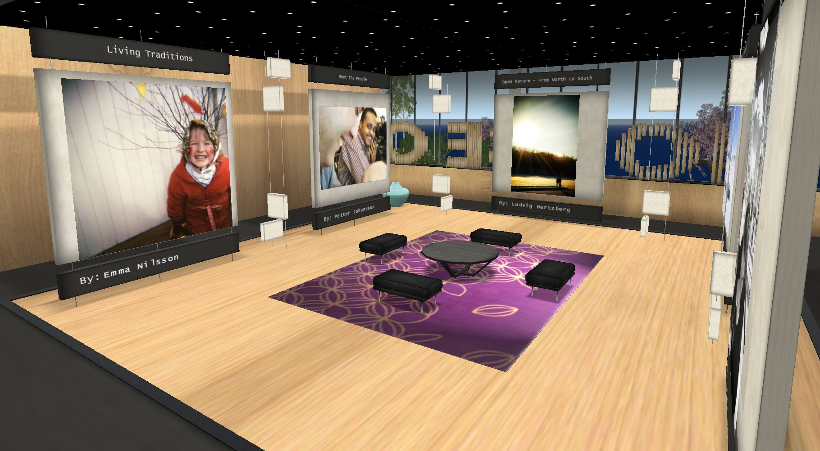
What is the purpose here?

Slide 29
Where is failure likely as users try to accomplish task goals?
Users form inadequate goals
Users fail to find the correct interface object due to poor labeling
Users might not know how to specify or execute a desired action
Users receive poor feedback

Slide 30
Goal is to Fulfill User Expectations
Something that looks like an avatar ... ... should behave like an avatar
Something that looks like a car ... ... should behave like a car
However, do not micromanage the activity
And don’t overdo “creativity” in the UX
Make it simple
Tell your users, what you want
Tell your users, what they can expect

Slide 31
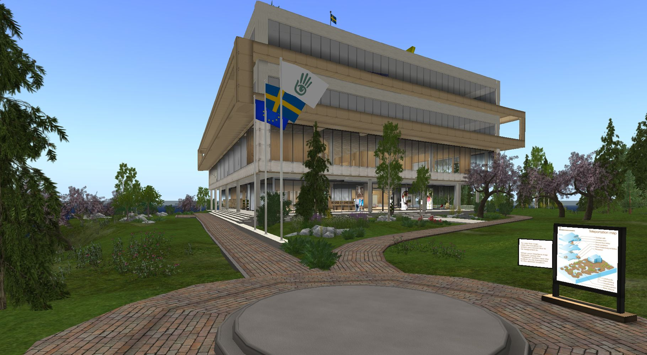
What are your expectations here?

Slide 32
Interface – 1
Game interfaces should not interfere with the player’s game experience
A good user interface is easy to learn and easy to use
A realistic user interface mirrors controls familiar to players in the real world

Slide 33
Interface - 2
Game controls should not intrude into the game display
Game controls can be designed so that they are context sensitive and “second” guess what the player want to do
Alternatively the “guess” for control behavior could be based on what the player has done in the past

Slide 34
Interface Design
Draw a sketch of the user interface of the main screen of your 2D as it exists now.
Draw a sketch of a HUD-less version of the interface of your 2D game
Write down how you plan to communicate the HUD information from the current user interface in the HUD-less version
If your original game was HUD-less design a version of using a HUD instead.

Slide 35
Rules of Thumb
Design for the Avatar, not for a human!
Do walk-throughs often!
Do fly-throughs, too!
Always make clear:
Where am I?
What can I do here?
Where can I go from here?
Where have I been?
Billboards are not necessarily evil

Slide 36
UX Testing Principles
You are Not the Audience!
Test early
Test often
Design test cases as you implement user stories
Use real users for your tests
Recruit them from your target audience
Believe your test results

Slide 37
Nokia Top 10 Usability Recommendations
Provide a clear menu structure
Simplicity is key
Provide help when needed
Be relentlessly consistent
Don’t waste the user’s time
Allow user to skip introduction
Do not require re-entry of data
Use natural controls

Slide 38
Nokia Top 10 Usability Recommendations
Enable save and pause
Conform to real-world expectations
Realistic physics model
Go easy on sound
Use for feedback
Allow it to be turned off
Make game playable with sound off
Implement a high score list

Slide 39
Plan for Next Week
Write down three questions you want answered by the play testers of your 2D game paper prototype next week.
Write a script you want your testers to follow to help you answer these questions about your game design.

