Slide 1
Game Design Documents
CIS 487/587
Bruce R. Maxim
UM-Dearborn

Slide 2
Design Documentation Stages
Design Concept or One Page
Game feasibility
Design summary/treatment documents
Pitch document or proposal
Design specification/product specification/production document
Functional product specification

Slide 3
What is a One Page?
One Page is a document the shows the main features of a game product in a brief attractive way.
On regular basis, this document is sent or to a stakeholder who needs to know at-a-glance about the USP's (Unique Selling Points) of our project.
You want it to stand out, but you need to keep it simple to send a clear idea about the game.
Feel free to configure it as you want, as long as it feels more efficient to communicate to your audience

Slide 4
One Page Contents
Concept: the sentence which explain the game/product briefly (required).
Product info.: game genre, platform and target audience should appear here (required).
Summary: a more in-depth info about the plot and the objectives in the game.
Outline: it explains a bit more about the concept and dynamic of the game.
USP's (Unique Selling Points): the main points which make our game different from the competition (required).

Slide 5
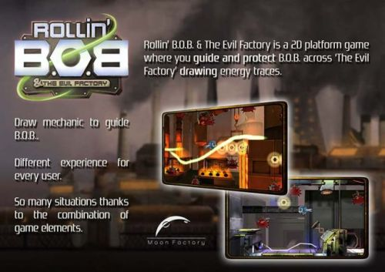
What do you think about this one?

Slide 6
Game Treatment or 5/10 Page
Game story
Abstract or “Reader’s Digest” type overview
Game play and look
Focus on appearance
Player roles and actions
Strategies and motivations
Development Specification
Hardware
Software
Algorithm style

Slide 7
Game Design Document
More formal and complete than game treatment
What does the player do?
What is the interface?
What is the plot?
Level Details
What are the levels?
Who are the characters?
How do characters interact?

Slide 8
Outlining Your Game
Describe universal elements- common features to every part of the game
scoring rules
names
special powers
anything else?
Details of every scene or game level
Name for scene
Resource details
Physical and audio appearance

Slide 9
Outlining Your Game
Details of every scene (continued).
Background or playfield
Foreground objects and characters
Animations present for the scenes
Music and sound effects
Script for characters
Scenes and transitions
Flow charts for story branches
Miscellaneous elements (credits, saving games, setup, etc.

Slide 10
Game Specification
What is it like to play the game?
Interface mock-up
Story-line summary
Major: final accomplishments
Minor: intermediate tasks
Storyboards
Prototype artwork and screen sequences

Slide 11
Game Specification
Character bibles
Profiles and biographies for each character
Flowcharting
What are the decision points and scene transitions?
Scripts
What happens in each scene and during each level?

Slide 12
Product Specification
Who is the production team?
Target audience
Gameplay
Shelf-life?
Production tools
Schedule with milestones and deliverables

Slide 13
Character Bible
Journal in which the designer writes a profile and biography for characters used in the script
Script may not be linear, so hypertext technology may need to be used to maintain continuity

Slide 14
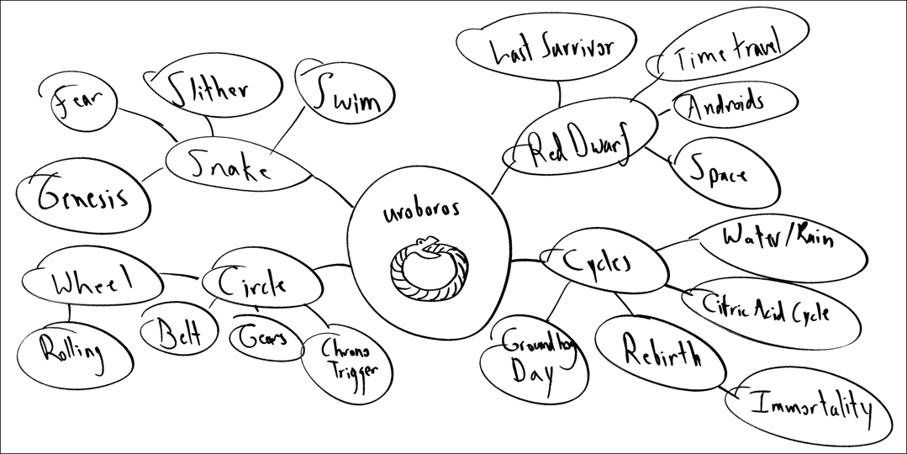
One Page Ideation
Step 1: Expansion
Create concept map around game theme

Slide 15
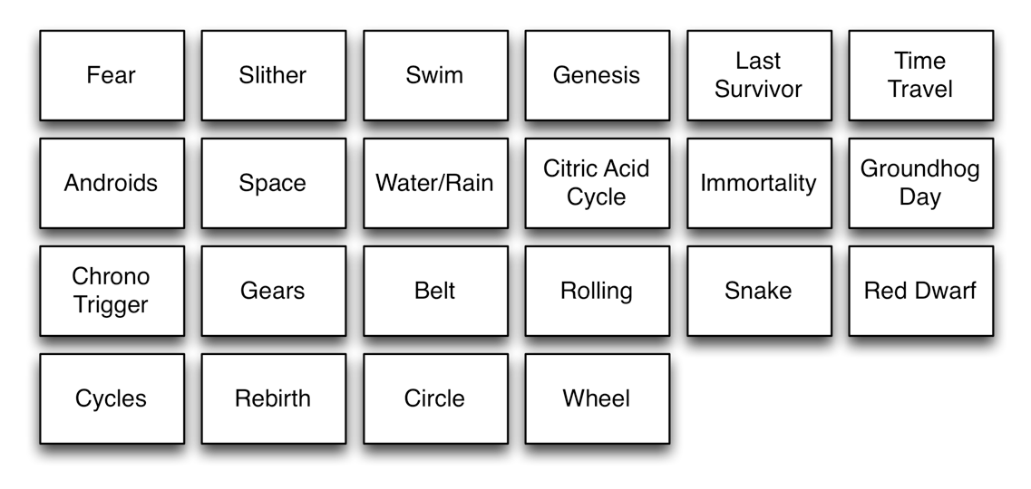
One Page Ideation
Step 2: Collection
Create idea cards for the nodes in your map using post-it notes

Slide 16
One Page Ideation
Step 3: Collision
You each need to pick two idea cards
Work as a team to come up with three game ideas inspired for each pair of idea cards

Slide 17
One Page Ideation
Step 4: Rating
Take turns picking two ideas each from the collision step that have the most merit
Decide independently which of two of these ideas you like the most

Slide 18
One Page Ideation
Step 5: Discussion
Discuss your reasons for selecting the items you picked in the rating step
Are there other ideas you might consider?
Create a one page for your 2D game concept as it exists now

