Slide 1
PUZZLES
1

Slide 2
Puzzles Are Almost Everywhere
Most single-player games include puzzles
But non-cooperative multiplayer games often do not
Both single-player games and puzzles rely on the game system to provide challenge to the player
Multiplayer games often rely on other players
Learning to design puzzles will aid your design of any game with a single-player mode
2

Slide 3
What is a Puzzle?
"A puzzle is fun, and it has a right answer."
– Scott Kim
Puzzle Designer
3

Slide 4
A Puzzle is Fun…
Kim states that there are three elements of fun for puzzles
Novelty
Many puzzles rely on a certain specific insight to solve them
Once the player has gained that insight, finding the puzzle's solution is rather simple
A large part of the fun of solving a puzzle is that flash of insight
Appropriate difficulty
Puzzles must also be matched to the player's skill, experience, and type of creativity
Each player has a level of skill and a certain level of frustration that she is willing to experience before giving up
Some of the best puzzles have both an adequate solution that is of medium difficulty and an expert solution that requires advanced skill
Often want to create a puzzle that appears to be simple though it is actually quite difficult.
4

Slide 5
A Puzzle is Fun…
Kim states that there are three elements of fun for puzzles
Tricky
Many great puzzles cause the player to shift her perspective or thinking to solve them
Even after having that perspective shift, the player should still feel that it will require skill and cunning to execute her planned solution
Example: Mark of the Ninja by Klei Entertainment
Puzzle-based stealth combat game
The player must use insight to solve the puzzle of how to approach a room full of enemies
Once she has a plan, she must then execute that plan with precision
5

Slide 6
…And It Has a Right Answer
Every puzzle needs to have a right answer
Many puzzles have several right answers
Once the player has found the right answer, it should be clearly obvious to her that she is right
If the correctness of the answer isn't easily evident, the puzzle can seem muddled and unsatisfying.
6

Slide 7
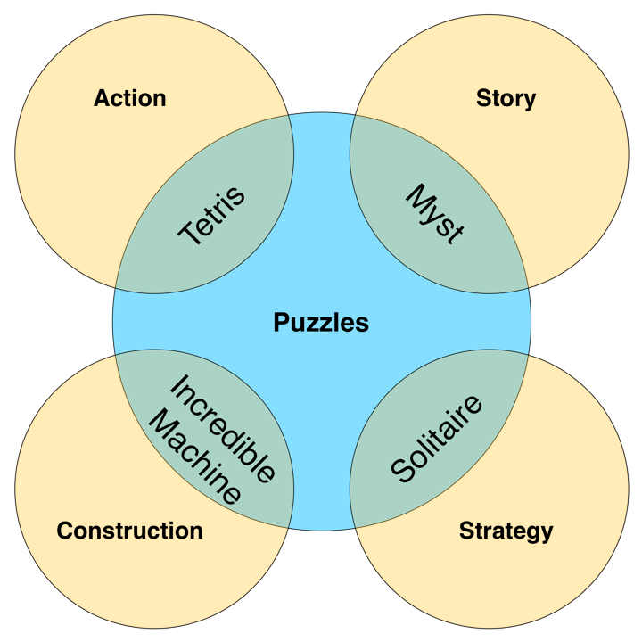
Genres of Puzzles
Kim identifies four genres of puzzles
Each causes the player to take a different approach and use different skills
7

Slide 8
Genres of Puzzles
Action – Example: Tetris
Have time pressure and allow players a chance to fix their mistakes
Combine an action game with a puzzle mindset
Story – Example: Myst, Professor Layton, hidden object games
Players must solve puzzles to progress through the plot and explore the environment
Combine narrative and puzzles
Construction – Example: The Incredible Machine
Players build an object from parts to solve a certain problem
Some construction games include a construction set that allows the player to design puzzles
Combine construction, engineering, and spatial reasoning with puzzles
8

Slide 9
Genres of Puzzles
Strategy – Example: Chess & Bridge puzzles
Solitaire versions of the kinds of puzzles that players encounter in games that are traditionally multiplayer
Include things like
Bridge puzzles present players with various hands in a bridge game and ask how play should proceed
Chess puzzles give players a few chess pieces positioned on a board and ask how the player could achieve checkmate in a certain number of moves
Combine the thinking required for the multiplayer version of the game with the skill building of a puzzle to help players train to be better at the multiplayer game
Pure Puzzles – Example: Sudoku & Crossword
Don't fit any of the other four genres
Don't combine puzzles with anything other genre
9

Slide 10
Four Major Reasons People Play Puzzles
Challenge
People like to feel challenged and the joy of overcoming those challenges
Puzzles are an easy way for players to feel a sense of achievement, accomplishment, and progress.
Mindless distraction
Some people are more interested in having something interesting to do to pass the time
Puzzles like Bejeweled and Angry Birds don't provide the player with a big challenge but rather a low-stress interesting distraction
Puzzle games of this type should be relatively simple and repetitive rather than relying on a specific insight (as is common in puzzles played for challenge).
10

Slide 11
Four Major Reasons People Play Puzzles
Character and Environment
People like great stories and characters, beautiful images, and interesting environments
Puzzle games like Myst, The Journeyman Project, the Professor Layton series, and The Room series rely on their stories and art to propel the player through the game
Spiritual journey
Some puzzles mimic spiritual journeys in a couple of different ways
A Rubik's Cube and many mazes can be seen as rites of passage
Either you've solved them or you haven't
Puzzles can mimic the archetypical hero's journey
The player starts in regular life and encounters a puzzle that sends her into a realm of struggle
She fights against the puzzle for a while, gains an epiphany of insight, and then can easily defeat the puzzle that had stymied her just moments earlier
11

Slide 12
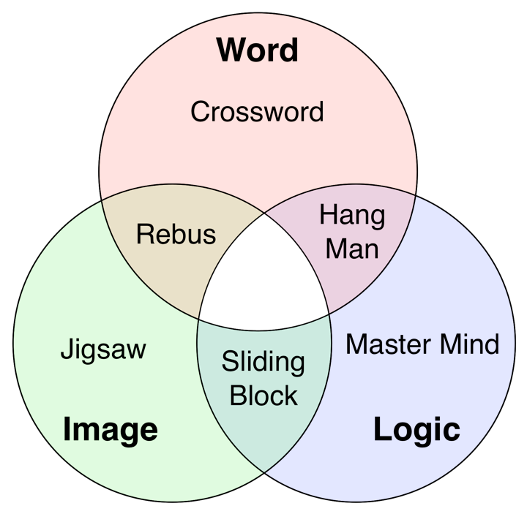
Modes of Thought Required by Puzzles
Puzzles require players to think in different ways to solve them
Most players have a preferred mode of thought
12

Slide 13
Examples of Mixed-Mode Puzzles
13

Slide 14
Kim's Eight Steps of Digital Puzzle Design
Step 1 – Inspiration
Inspiration for a puzzle can come from anywhere
Alexey Pajitnov says his inspiration for Tetris was the mathematician Solomon Golomb's concept of pentominoes
12 different shapes, each made of five blocks, that could be fit together into an optimal space-filling puzzle
Pajitnov wanted to use them in an action game
Step 2 — Simplification
Usually need to simplify to get from your original inspiration to a playable puzzle
Pajitnov felt there were too many different five-block pentomino shapes
He reduced it to the seven four-block tetrominoes found in Tetris
14

Slide 15
Kim's Eight Steps of Digital Puzzle Design
Step 2 — Simplification (continued)
Identify the core puzzle mechanic, the essential tricky skill required.
Eliminate any irrelevant details, narrow the focus.
Make pieces uniform
Example: In a construction puzzle, move the pieces onto a uniform grid
Simplify the controls
Ensure the controls for the puzzle are appropriate to the interface
A Rubik's Cube feels in real life but how terrible it would be to manipulate a digital version with a mouse and keyboard
Step 3 – Construction Set
Build a tool that makes construction of puzzles quick and easy
Many puzzles can be built and tested as paper prototypes
If that isn't the case for your puzzle, this is the first place that you will need to do some programming
15

Slide 16
Kim's Eight Steps of Digital Puzzle Design
Step 4 – Define and clarify the rules
Includes defining the board, the pieces, the ways that they can move, and the ultimate goal of the puzzle or level
Step 5 – Make some levels of the puzzle
Create different levels that explore various elements of your design and game mechanics
Step 6 – Testing
Just like a game, you don't know how players will react to a puzzle until you place it in front of them
Even with his many years of experience, Kim still finds that some puzzles he expects to be simple are surprisingly difficult, while some he expects to be difficult are easily solved
Playtesting and iteration are key in all forms of design!
16

Slide 17
Kim's Eight Steps of Digital Puzzle Design
Step 7 – Put the levels in a meaningful Sequence
Introduce a new concepts in isolation
Require the player to use just that concept in the most elementary way
Progressively increase the difficulty of the puzzle that must be solved using that concept
Finally, create puzzles that mix that concept with other concepts that the player already understands
Very similar to the sequencing in Chapter 13, "Guiding the Player"
Step 8 – Presentation
Refine the look of the puzzle
Refine the interface
Refine the way that information is displayed to the player
17

Slide 18
Seven Goals of Effective Puzzle Design
User Friendly
Puzzles should be familiar and rewarding to their players
Can rely on tricks, but shouldn't take advantage of the player or make the player feel stupid
Ease of Entry
In 1 minute, the player must understand how to play the puzzle
In 4 minutes, the player should be immersed in the experience
Instant Feedback
Should be "juicy" in the way that Kyle Gabler (co-creator of World of Goo and Little Inferno) uses the word
The puzzle should actively react to player input in a way that feels physical, active, and energetic.
18

Slide 19
A Shocking Puzzle
Challenge: In groups of 3 or 4, design the prototype of a puzzle in which the goal is to ensure that electrical current is passed from one side of the screen to the other
Provide the beginning state, objectives, and player actions
You may use any interface you like as long as it requires the use of spatial reasoning
Brainstorm
How does the current get from one side to the other?
What does success look like to the player?
What does failure look like to the player?

Slide 20
A Shocking Puzzle
Create Mechanics
Define player actions
What are the effects of each action on the game state as shown in the paper prototype?
Create Puzzle
Make the puzzle as a paper prototype
Create the solution
Test Puzzle
Have someone outside your team test the puzzle prototype
Do you need to create a tutorial version to teach the basic mechanics to the user?

Slide 21
Puzzle Examples in Action Games
Sliding Blocks / Position Puzzles – e.g. Tomb Raider
Physics Puzzles – e.g. Portal
Traversal – e.g. Assassin's Creed
Stealth – e.g. Metal Gear Solid
Chain Reaction – e.g. Bioshock
Boss Fights
The first time the player performs the correct action to damage the boss, it is often a surprise to her
The second time, she is experimenting to see if she now has the insight to defeat the puzzle/boss
The third time, she is demonstrating her mastery over the puzzle
Most stages of boss fights throughout the modern Legend of Zelda series can be defeated in three attacks
21

Slide 22
Bad Puzzles
Unnecessary repetition
Restore puzzle
find answer to puzzle when you die
Arbitrary puzzles
cause should be linked to effects instead of random
Designer puzzles
only designer can solve the puzzle
Binary puzzle (e.g. wrong answer = death)
Hunt the pixel
Unnecessary interludes

Slide 23
Good Puzzles
Solvable
Being fair
No down time
Some randomness – different each time you played
Naturalness to environment
Amplify a theme
Principle of least astonishment

Slide 24
Hints
Bread crumbs – at first everything works well and then give less direct help, if user struggles give more help
Proximity of puzzle to solution – a fair game gives users everything they need to know
Alternate solutions
Red herrings (things that “don’t compute”)
Steering a player

