Slide 1
Cost Estimation
CIS 375
Bruce R. Maxim
UM-Dearborn

Slide 2
5WHH Principle
Why is the system being developed?
What will be done and When?
Who is responsible for a function?
Where are they organizationally located?
How will the job be done technically and managerially?
How much of each resource is needed?

Slide 3
Management Spectrum
People
Product
Process
Project

Slide 4
Critical Practices
Formal risk management
Empirical cost and schedule estimation
Metric-based project management
Earned value tracking
Defect tracking against quality targets
People-aware program management

Slide 5
Resource Estimation
Human Resources
number of people required and skills needed to complete the development project
Project Methods and Tools
Reusable Software Resources
off-the-shelf components
modifiable components
new components
Development Environment
hardware and software required during the development process

Slide 6
Estimation Options
Delay estimation until late in the project.
Base estimates on similar projects already completed.
Use simple decomposition techniques to estimate project cost and effort.
Use empirical models for software cost and effort estimation.
Automated tools may assist with project decomposition and estimation.

Slide 7
Decomposition Techniques -1
Software sizing
fuzzy logic
function point calculation
standard component
%change
Process-based estimation
decomposition based on tasks required to complete the software process framework

Slide 8
Decomposition Techniques - 2
Problem-based estimation
using lines of code (LOC) decomposition focuses on software functions
using function point (FP) decomposition focuses on information domain characteristics

Slide 9
Empirical Estimation Models
Experiential Models
Typically derived from regression analysis of historical software project data with estimated person-months as the dependent variable
Static Estimation Model
does not include time as an independent variable
Constructive Cost Model (COCOMO)
Dynamic Estimation Models
usually takes time or development phase into account
Software Equation Model

Slide 10
Expert Guessing
A = The most pessimistic estimate.
B = The most likely estimate.
C = The most optimistic estimate.
Ê = (A + 4B + C)
6
(Weighted average; where Ê = estimate).

Slide 11
Delphi Technique
Group of experts, make "secret" guesses.
"secret" guesses are used to compute group average.
Group average is presented to the group.
Group, once again makes "secret" guesses.
Individual guesses are again averaged.
If new average is different from previous, then goto (4).
Otherwise Ê = new average.

Slide 12
Scrum Poker – Story Points
Each team member given cards with a range of values (e.g. 1, 2, 3, 5, 8, 13, 21, 40, 100, ?)
Product owner reads Product Backlog Item
Each team member plays card face down
All cards turned over at the same time
If they match – that is the value
If they do not match – high and low bidders need to explain the reasoning
Each member plays card with their new bid

Slide 13
Problems with Expert Judgement
It is subjective. (consensus is difficult to achieve)
Extrapolating from one project to another may be difficult.
Users and project managers tend not to estimate costs very well.
Cost matrices require periodic updates.

Slide 14
Process Measurement
Wherever possible quantitative process data should be collected
Organizations without process standards may have to be define processes before measurements can be made (since they won’t know what to measure)
Process measurements should be used to assess process improvements
Organization objectives drive process improvement, not measurements

Slide 15
Process Measurement Classes
Time taken to complete process activities
e.g. calendar time to complete a milestone
Resources required to complete processes or activities
e.g. person months
Number of event occurrences
e.g. number of defects found
Product Size
e.g. lines of code (LOC)

Slide 16
Example: Building Costs
Problem
The builder needs to know the floor area (in sq. ft.) to estimate the cost of construction.
Clients normally cannot describe their needs in square feet.
They usually can describe the type and number of rooms they want.
Solution
Use rooms as a proxy for size.
Use historical (typical) data to translate from rooms to square feet.
Notes:
To explain how proxies work for estimating, let's look at an example from outside the software field.

Slide 17
Example: Customer Requirements
Bedrooms: 1 large, 2 medium, and 1 small
Bathrooms: 1 large and 2 medium
Kitchen: 1 medium
Living room: 1 large
Dining room: 1 medium
Family room: 1 large
Utility: 1 medium
Notes:
A client might have the following requirements for their new house.

Slide 18
Historical Building Data
 | Small | Medium | Large
Bedrooms | 90 | 140 | 200
Bathrooms | 25 | 60 | 120
Kitchens | 100 | 130 | 160
Living rooms | 150 | 250 | 400
Dining rooms | 100 | 140 | 200
Family rooms | 150 | 240 | 340
Utility | 25 | 50 | 80
Notes:
The builder can use historical data to build this table showing typical room sizes.

Slide 19
Proxy Calculation
Bedroom | 1 large | = | 1 x | 200 | = | 200
Bedroom | 2 medium | = | 2 x | 140 | = | 280
Bedroom | 1 small | = | 1 x | 90 | = | 90
Bathroom | 1 large | = | 1 x | 120 | = | 120
Bathroom | 2 medium | = | 2 x | 60 | = | 120
Kitchen | 1 medium | = | 1 x | 130 | = | 130
Living room | 1 large | = | 1 x | 400 | = | 400
Dining room | 1 medium | = | 1 x | 140 | = | 140
Family room | 1 large | = | 1 x | 340 | = | 340
Utility | 1 medium | = | 1 x | 50 | = | 50
 |  | Total (sq. ft.) |  |  | = | 1870
Notes:
We can combine the two sets of information to calculate the estimated area of the client's new house.
Could animate this to fill in the table in stages. Start with the first 2 columns, then add the rest of each row (row 1, row 2, then the rest, with total row as final step)

Slide 20
Software Product Proxies
Classes, functions, and procedures
Product elements
database elements
screens, reports, scripts, files
book chapters
Lines of code
Notes:
For software development, we need to identify suitable proxies.

Slide 21
Example C++ Class Size Ranges
LOC per item
Type
VS
S
M
L
VL
Calculation
2.34 5.13 11.25 24.66 54.04
Data
2.60 4.79 8.84 16.31 30.09
I/O
9.01 12.06 16.15 21.62 28.93
Logic
7.55 10.98 15.98 23.25 33.83
Set-up
3.88 5.04 6.56 8.53 11.09
Text
3.75 8.00 17.07 36.41 77.66

Slide 22
Example: Size Estimation
Problem
Software engineer needs to know the size of a program (in LOC) to estimate the costs prior to submitting a bid.
Clients normally cannot describe their needs in LOC.
They usually can describe the input/output screens and the types of calculations (but not the details).
Solution
Use classes as a proxy for size.
Use historical (typical) data to translate from classes to lines of code (LOC).

Slide 23
Customer Requirements MPG App
Input screen: 1 large
Output screen: 1 very large
Calculation: 1 small
Input | 1 large | = | 1 x | 21.62 | = | 21.62
Output | 1 very large | = | 1 x | 30.09 | = | 30.09
Calculation | 1 small | = | 1 x | 2.34 | = | 5.13
 |  | Total (LOC) |  |  | = | 56.84

Slide 24
Function Points
Parameter
Simple
+
Average
+
Complex
=
F_{i}
Distinct input items
3( )
+
4( )
+
6( )
=
?
Output screens/reports
4( )
+
5( )
+
7( )
=
?
Types of user queries
3( )
+
4( )
+
6( )
=
?
Number of files
7( )
+
10( )
+
15( )
=
?
External interface
5( )
+
7( )
+
10( )
=
?
Total
=
?

Slide 25
Function Point Questionnaire
Backup.
Data communication.
Distributed processes.
Optimal performance.
Heavily used operating system.
On-line data security.
Multiple screens.
On-line master file update.
Complex inputs, queries, outputs.
Complex internal processing.
Reusable code.
Conversion or installation.
Multiple user sites.
Ease of use.

Slide 26
Function Point Equation
http://groups.umd.umich.edu/cis/course.des/cis375/projects/fp99/main.html
F.P.’s = T * (0.65 + 0.01 * Q)
T = unadjusted table total
Q = score from questionnaire
(14 items with values 0 to 5)
Cost of producing one function point? May be organization specific.

Slide 27
Converting LOC to Person Months
Programmers are not usually paid per line of code produced
Some people write tighter code that others
You would not want to pay for unneeded code
Some programming languages provide more powerful statements than others
LOC is does not directly help us estimate the time it takes but can be equated to person months
Person months are typically more useful to project managers

Slide 28
COCOMO - I
Effort in person months = a S^{b} * m(x)
S measured in KLOC = LOC/1000
BASIC
INTERMEDIATE
MODE
a
b
a
b
Organic
2.4
1.05
3.2
1.05
Semidetached
3.0
1.12
3.0
1.12
Embedded
3.6
1.20
2.8
1.20

Slide 29
Basic COCOMO
Computes software development effort (and cost) as a function of program size, expressed in estimated lines of code.
m(x) = 1

Slide 30
Basic COCOMO/SemiDetached
E = a S^{b} * m(x) person months
E = 3.0 (56.87/1000.0)^{1.12} * (1.0) person months
E = 3.0 (0.403) = 0.1209 person months
1 person month = 8 hrs/day * 21 days/month
= 168 hrs
E = 0.1209 * 168 = 20.31 hrs
http://groups.umd.umich.edu/cis/course.des/cis525/js/f00/kutcher/kutcher.html

Slide 31
Static Linear Models
Often built using regression analysis
Effort = c₀ + Σ c_{i} * x_{i}
C = regression coefficient
X = product or process attribute

Slide 32
Static Non-Linear Models
Examples
Effort = c₀ + Σ c_{i} * x_{i}^{di}
C_{i} and d_{i} are non-linear regression constants
or
Effort = (a + b S ^{C}) * m(X)
where S is size in KLOC
a, b, and c are regression constants
http://groups.umd.umich.edu/cis/course.des/cis525/js/f00/gamel/cocomo.html

Slide 33
Intermediate COCOMO
Computes software development effort as a function of program size and a set of "cost drivers" that include subjective assessments of product, hardware, personnel, and project attributes.
m(x) = π m(x_{i})

Slide 34
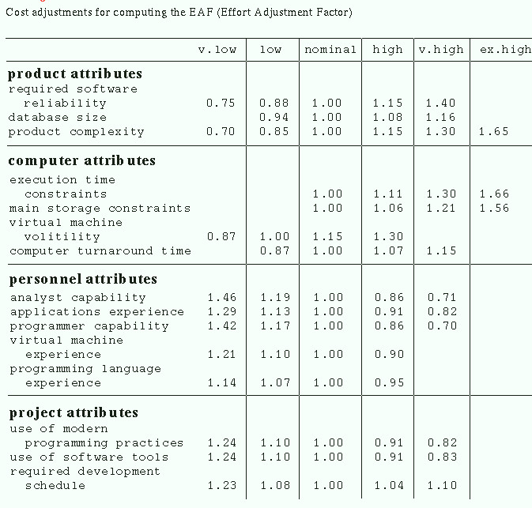

Slide 35
Static Model Problems
Existing models rely at least in part on expert judgment
Most static estimates require estimation of the product in lines of code (LOC)
Not clear which cost factors are significant in all development environments

Slide 36
Dynamic Models
It is helpful to know when effort will be required on a project as well as how much total effort is required
Most models are time or phase sensitive in their effort computations
COCOMO2 does this
http://csse.usc.edu/csse/research/COCOMOII/cocomo_main.html

Slide 37
COCOMO II
Allows one to estimate the cost, effort, and schedule when planning a new software development activity.
Consists of three submodels, each one offering increased fidelity the further along one is in the project planning and design process (Applications Composition, Early Design, and Post-architecture).
http://csse.usc.edu/tools/COCOMOII.php

Slide 38
Make Buy Decision
It may be more cost effective to acquire a piece of software rather than develop it.
Decision tree analysis provides a systematic way to sort through the make-buy decision.
As a rule outsourcing software development requires more skillful management than does in-house development of the same product.

Slide 39
Decision Process
Develop specifications.
Estimate internal cost & delivery.
Select 3 or 4 candidate packages.
Select reasonable components.
Build a cost-benefit comparison matrix (key function performance) or use conduct benchmark tests of candidate software
Evaluate each software package or component based on history with the product or vendor.
Contact other users.

Slide 40
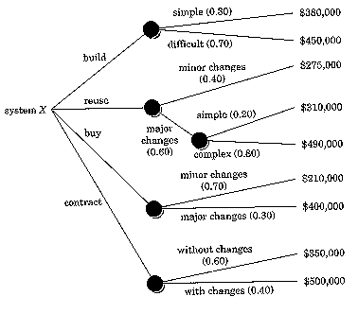
Decision Tree

