Slide 1
CRC Modeling (class-relationship-collaborator)
CIS 375
Bruce R. Maxim
UM-Dearborn

Slide 2
OOA Tasks
Basic user requirements must be communicated between the customer and the software engineer.
Use CRC cards to find classes, responsibilities, and collaborators.
Use UML (unified modeling language) diagrams to record class relationships.
Document classes and member functions.
Model object behavior
Reapply 1 through 5 iteratively until model is complete

Slide 3
OOA Generic Steps
Elicit customer requirements for system
Identify scenarios or use cases
Select classes and objects using basic requirements as a guide
Identify attributes and operations for each system object
Define structures and hierarchies that organize classes
Build object-relationship model
Build object-behavior model
Review OOA model against use-cases (scenarios)

Slide 4
Use Case Objectives
Define the functional and operational requirements of system by defining a scenario of usage agreed upon by the end-user and software engineer
Provide an unambiguous description of how the end-user and system interact with one another
Provide a basis for validation testing

Slide 5
Class-Responsibility-Collaborator (CRC) Modeling
Develop a set of index cards that represent the system classes
One class per card
Cards are divided into three sections
class name
class responsibilities
class collaborators
Once a complete CRC card set is developed it is reviewed examining the usage scenarios

Slide 6
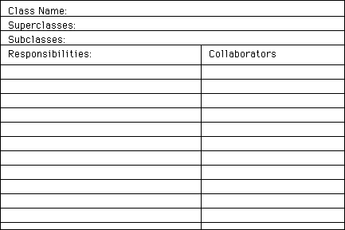
CRC Card

Slide 7
Creating a CRC Model
Find 3 to 5 main classes and give them meaningful names
Find responsibilities (what a class does and what information does it retain)
Define collaborators (classes that may need to be defined to respond with requests for information or requests to perform tasks)
Move the cards around on the table and see how they fit together

Slide 8
Criteria CRC Class Inclusion
Class information (data) should be retained
Class Provides needed services
Contains multiple attributes
Common set of attributes apply to all object instances
Common set of operations apply to all object instances
External entities that produce or consume information

Slide 9
Criteria for Defining Collaborators
Any time a class cannot fulfill a responsibility on its own it needs to interact with another class
A server object interacts with a client object to fulfill some responsibility

Slide 10
Reviewing CRC Models - 1
Each review participant is given a subset of the CRC cards (collaborating cards must be separated)
All use-case scenarios and use-case diagrams should be organized into categories
Review leader chooses a use-case scenario and begins reading it out loud
Each time a named object is read a token is passed to the reviewer holding the object's card

Slide 11
Reviewing CRC Models - 2
When the reviewer receives the token, he or she is asked to describe the responsibilities listed on the card
The group determines whether one of the responsibilities on the card satisfy the use-case requirement or not
If the responsibilities and collaborations on the index card cannot accommodate the use-case requirements then modifications need to be made to the card set

Slide 12
CRC Model for ATM System
Form a group of 4 and look over the ATM user stories
Create a set of CRC cards for the ATM system
Determine the primary responsibilities for each card (both function and information)
Determine the set of collaborations needed to allow each class fulfill its responsibilities

Slide 13
Deriving Object-Relationship Model
Was it easy to model a network of collaborators once the CRC cards are created?
Would it have been better for you to create your own use case before reviewing the CRC card model?
Did you make it to the end of your use case?
How many new classes did you need to define?
Did you need to move responsibilities?
Do you believe we could continue the process until a complete object-relationship model has been produced?

Slide 14
Allocating Responsibilities to Classes (Refactoring)
Distribute system intelligence evenly
State each responsibility as generally as possible
Information and its related behaviors should reside within the same class
Localize all information about one entity in a single class
Share responsibilities among related classes when appropriate

