Slide 1
Scrum Scenes
Video Case Study
Video Case Study Module Number: VS04
This course material was developed with NSF – TUES award # 1245036

Slide 2
Agile Software Development
Agile software engineering represents a reasonable alternative to conventional software engineering for certain classes of software and certain types of software projects
Agile development processes can deliver successful systems quickly
Agile development stresses continuous communication and collaboration among developers and customers

Slide 3
Agile Software Development
Agile software engineering embraces a philosophy that encourages customer satisfaction, incremental software delivery, small project teams (composed of software engineers and stakeholders), informal methods, and minimal software engineering work products
Agile software engineering development guidelines stress on-time delivery of an operational software increment over analysis and design

Slide 4
Manifesto for Agile Software Development
Proposes that it may be better to value:
Individuals and interactions over processes and tools
Working software over comprehensive documentation
Customer collaboration over contract negotiation
Responding to change over following a plan

Slide 5
Agility Principles - 1
Highest priority is to satisfy customer through early and continuous delivery of valuable software
Welcome changing requirements even late in development, accommodating change is viewed as increasing the customer’s competitive advantage
Delivering working software frequently with a preference for shorter delivery schedules (e.g. every 2 or 3 weeks)
Business people and developers must work together daily during the project

Slide 6
Agility Principles - 2
Build projects around motivated individuals, given them the environment and support they need, trust them to get the job done
Face-to-face communication is the most effective method of conveying information within the development team
Working software is the primary measure of progress
Agile processes support sustainable development, developers and customers should be able to continue development indefinitely

Slide 7
Agility Principles - 3
Continuous attention to technical excellence and good design enhances agility
Simplicity (defined as maximizing the work not done) is essential
The best architectures, requirements, and design emerge from self-organizing teams
At regular intervals teams reflects how to become more effective and adjusts its behavior accordingly

Slide 8
Agile Process Models
Extreme Programming (XP)
Adaptive Software Development (ASD)
Dynamic Systems Development Method (DSDM)
Scrum
Feature Driven Development (FDD)
Agile Modeling (AM)

Slide 9
Scrum Terminology
Story points: Estimated time required for the team to complete a user story.
Business Priority: The ranking of the user story based on the Product Owner.
PBI: Product Backlog Item
Product Backlog: an ordered list of the work to be done in order to create, maintain and sustain a product. Managed by the Product Owner

Slide 10
Scrum Terminology
Scrum Master: the role within a Scrum Team accountable for guiding, coaching, teaching and assisting a Scrum Team and its environments in a proper understanding and use of Scrum.
Scrum Team: a self-organizing team consisting of a Product Owner, Development Team and Scrum Master.
Sprint Backlog: an overview of the development work to realize a Sprint’s goal, typically a forecast of functionality and the work needed to deliver that functionality. Managed by the Development Team.
Sprint Goal: a short expression of the purpose of a Sprint, often a business problem that is addressed. Functionality might be adjusted during the Sprint in order to achieve the Sprint Goal.
Source: https://www.scrum.org/Resources/Scrum-Glossary

Slide 11
Scrum Meetings
Sprint Planning Meeting
Backlog Refinement Meeting
Daily Scrum Meeting
Spring Review Meeting
Sprint Retrospective Meeting

Slide 12
Scrum Meetings – Product Backlog Refinement Meeting:
This meeting is used to create and prioritize the Product Backlog Item.
The Product Backlog Item represents User Stories a team needs to complete.
User Stories are thin, vertical slices of product functionalities.
These stories are groomed and prioritized throughout the project because with incremental development there is constant feedback & testing.
The PBI continues to evolve and change as more information is gathered.
The Product Owner is responsible for creating and maintaining the Product Backlog Item.
The goal of Product Backlog Grooming is to review all the PBI and rank them so that they can be consumed by the sprint teams.
A form as shown below is used to record Product Backlog Grooming.

Slide 13
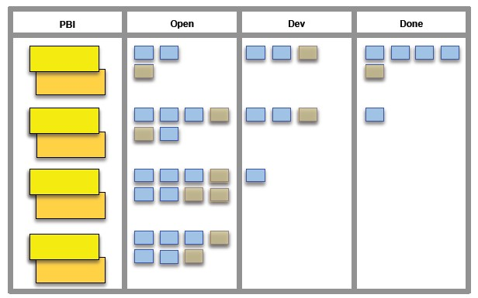
Project Backlog Grooming Form
In Progress

Slide 14
Scrum Meetings - Sprint Planning Meeting
The goal of the Sprint Planning Meeting is to agree on the sprint goals and negotiate which items from the PBI should be committed to the Sprint Backlog.
In addition the Sprint Team should also come up with an initial list of tasks to complete the committed PBIs.
The Sprint Backlog represents User Stories a team needs to complete in a Sprint.
The Sprint plan is usually two weeks long and is planned out in a 4 hour time boxed Sprint Planning Meeting.

Slide 15
Scrum Meetings - Daily Scrum Meeting or Stand up
This meeting is facilitated by the scrum master
Time boxed usually to 15 minutes
Used to answer the following three questions:
What did you do yesterday
What will you do today
What are your impediments

Slide 16
Scrum Meetings - Daily Scrum Meeting
It is expected that every team member be punctual in attending this meeting.
The product owner however may or may not participate.
During this sprint items for discussions may arise.
Such items should be listed in a side bar and be addressed after the scrum meeting.

Slide 17
Scrum Meetings – Sprint Review Meeting
This meeting is open to all stakeholders.
The agenda for this meeting is:
Product Demonstration
Status Assignment
Velocity Measurement
Stakeholder feedback
The product owner declares if a sprint backlog is completed or not.

Slide 18
Scrum Meetings – Sprint Review Meeting
Product velocity is measured if necessary
Stakeholder feedback is obtained.
For every week of Sprint, 1 hour is time boxed for this meeting.
It is expected that every team member be punctual in attending this meeting.
It is very important that the product owner be present

Slide 19
Burndown Chart
Shows the velocity of the team’s progress by tracking the number of user stories in the sprint backlog each day
Most useful on 2 to 4 week sprints
Best for teams that do about the same amount of work each day otherwise progress displayed my be misleading

Slide 20
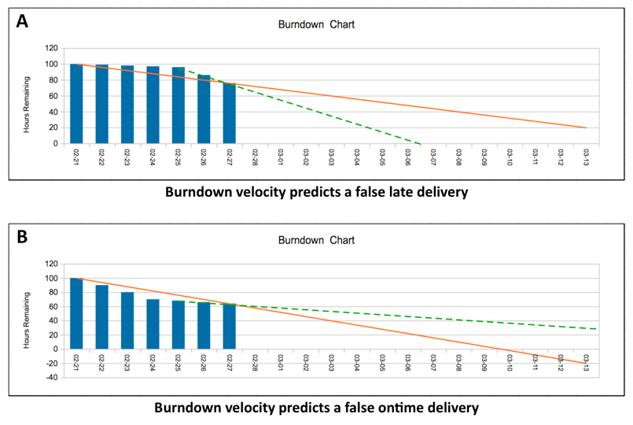
The Burndown Chart
20

Slide 21
Scrum Meetings – Sprint Retrospective
This meeting is open to all stakeholders.
The purpose of this meeting is to assess the quality of the most recently completed Sprint by ensuring that the SCRUM meetings are being productive.
It is expected that every team member be punctual in attending this meeting.
It is very important that the product owner be present.

Slide 22
SCRUM Card Game
Each team should have 4 members
Create a task board with 3 labels:
TODO, IN PROGRESS, DONE
Sprints are 3 days long (15 minutes real time)
Team selects the story points it wants to complete during the current sprint and moves the story cards to IN PROGRESS
Teams draw their ideal line on the sprint burn down chart and begin the sprint

Slide 23
Sample

Slide 24
Daily Standup Activities
Each team member:
Selects a story card from the IN PROGRESS column
Tosses the dice to determine work down
Updates the story points on a story card post it
Pulls a chance card from the envelop (deck) and follows the directions written on it
Unblocked cards with zero points can be moved to the DONE column
After all team members finish their turns the burn down chart is updated for the

Slide 25
Chance Cards
Events take immediate effect
Problem cards block DONE status of story card selected but does not prevent team from reducing points remaining
Solution cards correct specific problems and can be saved up to prepare for future problems
A story is moved to DONE only when the remaining points are zero and any blocking problem cards have been cleared

Slide 26
Ending the Sprint
After completing the 3 daily stand ups put all:
the EVENT cards
solved PROBLEM cards
used SOLUTION cards
back in the chance deck (envelop)
DONE stories remain where the are

Slide 27
Setting Up a New Sprint
The team selects the STORY cards to work on in the next sprint using their past efforts to help determine how many story points they will try to complete
Draw the ideal line on a new burn down chart and start the next 3 day sprint
You repeat this one more time to complete 3 sprints in all

Slide 28
Discussion
How many stories and story points did your team complete?
What prevented you from completing all of the user stories?
What would you do differently if you played this game again?
Would bigger teams help or hinder play?

Slide 29
Scrum Scenes
Case Study Video: Scrum Scenes
Developed by: Robert Morris University
What is this ?
brief dramatizations
demonstrates steps taken in software development using Scrum (Agile Methodology).

Slide 30
SCENE - 1
Product Backlog Refinement Meeting

Slide 31
Video Case Study – SCENE 1
Anil asked Sam the Scrum Master to go over the ranking of the User Stories. Is this necessary?
Was it okay for Sam to respond to Anil’s request the way he did?
Why does Anil insist that the database needs to be understood more?

Slide 32
SCENE - 2
Sprint Planning
Meeting

Slide 33
Video Case Study – SCENE 2
Is Yang being unreasonable when he says “that’s asking for a lot of testing in such a short period”?
Marlon says “if anyone comes to you and wants to add tasks to our Sprint goals that person needs to come to me first”. Is this a reasonable request? Why?
What is the relationship between User Stories and Sprint times?
How does the sprint team know when it completes a sprint.

Slide 34
SCENE - 3

Slide 35
Video Case Study – SCENE 3
Why do you think team members should be punctual in the Daily Scrum?
Should the Daily Scrum be used to solve problems?
Are all team members expected to expected to understand the three questions?

Slide 36
Video Case Study – SCENE 3
Should Marlon be in the Daily Scrum meeting?
Yang talks about being is Facebook is this appropriate? Why?
What are other activities Yang can be involved in?
Anil says he helped another team. Is this appropriate? Why?

Slide 37
SCENE - 4
Sprint Review
Meeting

Slide 38
Video Case Study – SCENE 4
Is it appropriate for the Product Owner to ask that a product feature be demonstrated if it is not in the Spring Backlog?
Why was Dr. Joshi and all other’s not happy with Alice’s response to queationog the placement of the login window?
Was declaring the PBI “not complete” the right decision?

Slide 39
The bottom line
Core Scrum
The Unoffical Scrum Checklist
If you achieve these you can ignore the rest of the checklist. Your process is fine.
These are central to Scrum. Without these you probably shouldn’t call it Scrum.
Delivering working, tested software every 4 weeks or less
Retrospective happens after every sprint
Delivering what the
business needs most
Results in concrete improvement proposals
Henrik Kniberg
Some proposals actually get implemented
Recommended but not always necessary
Process is
continuously improving
Most of these will usually be needed, but not always all of them. Experiment!
Whole team + PO participates
Team has all skills needed to bring backlog items to Done
PBL items are broken into tasks within a sprint
Clearly defined product owner (PO)
PO has a product backlog (PBL)
Team members not locked into specific roles
Sprint tasks are estimated
PO is empowered to prioritize
Top items are prioritized by business value
Iterations that are doomed to fail are terminated early
Estimates for ongoing tasks are updated daily
PO has knowledge to prioritize
Top items are estimated
PO has product vision that is in sync with PBL
Velocity is measured
PO has direct contact with team
Estimates written by the team
PBL and product vision is highly visible
All items in sprint plan have an estimate
PO has direct contact with stakeholders
Top items in PBL small enough to fit in a sprint
Everyone on the team participates in estimating
PO uses velocity for release planning
PO speaks with one voice (in case PO is a team)
PO understands purpose of all backlog items
PO available when team is estimating
Velocity only includes items that are Done
Team has a sprint backlog
Have sprint planning meetings
Estimate relative size (story points) rather than time
Team has a sprint burndown chart
Highly visible
PO participates
Whole team knows top 1-3 impediments
Highly visible
Updated daily
PO brings up-to-date PBL
SM has strategy for how to fix top impediment
Updated daily
Owned exclusively by the team
Whole team participates
SM focusing on removing impediments
Results in a sprint plan
Daily Scrum is every day, same time & place
Daily Scrum happens
Whole team believes plan is achievable
Escalated to management when team can’t solve
PO participates at least a few times per week
Whole team participates
PO satisfied with priorities
Team has a Scrum Master (SM)
Max 15 minutes
Problems & impediments are surfaced
SM sits with the team
Each team member knows what the others are doing
Timeboxed iterations
Demo happens after every sprint
Iteration length 4 weeks or less
Scaling
Positive indicators
Shows working, tested software
Always end on time
These are pretty fundamental to any Scrum scaling effort.
Leading indicators of a good Scrum implementation.
Feedback received from stakeholders & PO
Team not disrupted or controlled by outsiders
You have a Chief Product Owner (if many POs)
Having fun! High energy level.
Have Definition of Done (DoD)
Team usually delivers what they committed to
Dependent teams do Scrum of Scrums
Overtime work is rare and happens voluntarily
DoD achievable within each iteration
Team members sit together
Dependent teams integrate within each sprint
Discussing, criticizing, and experimenting with the process
Team respects DoD
Max 9 people per team
PO = Product owner SM = Scrum Master PBL = Product Backlog DoD = Definition of Done
http://www.crisp.se/scrum/checklist | Version 2.2 (2010-10-04)

Slide 40
Scrum Checklist
Henrik Kniberg
www.crisp.se/scrum/checklist
What is this? Who is it for?
The Scrum checklist is a simple tool to help you assess your current implementation of Scrum.
Note that these aren't rules. They are guidelines
How do I NOT use it?
Big Boss: "OK team, time to see how Scrum compliant you are. Fill in this checklist please.”
Joe: "Boss, I'm happy to report that we are doing everything. Well, everything except Sprint burndown charts”
Big Boss: "Bad, bad team! It says here that you should be doing those... er... sprint burning thingies! I want them!"
Lisa: "But we do 2 week sprints and we manage to deliver what we commit to, and the customers are happy. Sprint burndown charts wouldn't add value at this stage.”
Big Boss: "Well it says here that you should do it, so don't let me catch you cheating again, or I'll call in the Scrum Police!”
How do I use it?
Joe: "For this retrospective, I've brought a useful little checklist. Is there any of this stuff that we aren't doing?”
Lisa: "Hmmm, let's see. Well, we're certainly missing Definition of Done, and we don't measure Velocity.”
Joe: "Well, 'Definition of Done' is listed under 'Core Scrum' so it seems pretty important! Velocity is listed under 'Recommended but not always necessary' so let's wait with that and start with the core stuff.
Lisa: "Look, we're also missing 'Delivering working, tested software every 4 weeks or less'. That's listed under 'The bottom line'! Makes sense, because marketing is always complaining about that!”
Joe: "Maybe a concept like 'Definition of Done' could help us take on smaller bits per sprint and get stuff releasable more often?’
Lisa: "Good idea, let's give it a shot.”

Slide 41
Questions

