Slide 1
Project Scheduling and Tracking
CIS 375
Bruce R. Maxim
UM-Dearborn

Slide 2
Planning Objectives
To provide a framework that allows a software manager to make an estimate of resources, cost, and schedule.
Project outcomes should be bounded by 'best case' and 'worst case' scenarios.
Estimates should be updated as the project progresses.

Slide 3
Scope Definition
Determine the customer's overall goals for the proposed system and any expected benefits.
Determine the customer's perceptions concerning the nature of a good solution to the problem.
Evaluate the effectiveness of the customer meeting.

Slide 4
Product Feasibility
Technical feasibility is not a good enough reason to build a product.
The product must meet the customer's needs and not be available as an off-the-shelf purchase.

Slide 5
What does the customer want to know?
Do you understand my needs?
Can you design a system to help me?
How long will it take?
How much will it cost?

Slide 6
People and Effort
Adding people to a project after it is behind schedule often causes the schedule to slip further
The relationship between the number of people on a project and overall productivity is not linear (e.g. 3 people do not produce 3 times the work of 1 person, if the people have to work in cooperation with one another)
The main reasons for using more than 1 person on a project are to get the job done more rapidly and to improve software quality.

Slide 7
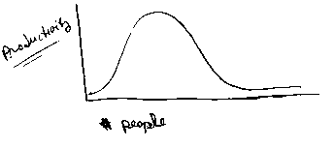
Productivity and People

Slide 8
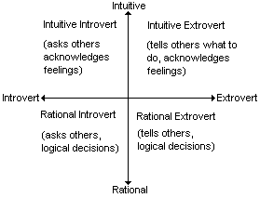
Matching People to Tasks (Myer-Briggs)

Slide 9
Software Team Organization
Democratic decentralized
rotating task coordinators
group consensus
Controlled decentralized
permanent leader
group problem solving
subgroup implementation of solutions
Controlled centralized
top level problem solving
internal coordination managed by team leader

Slide 10
Chief Programmer Team

Slide 11
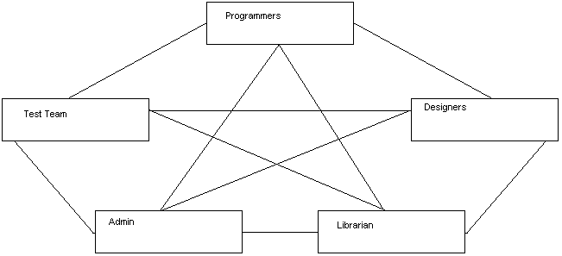
Democratic

Slide 12
Factors Affecting Team Organization
Difficulty of problem to be solved
Size of resulting program
Team lifetime
Degree to which problem can be modularized
Required quality and reliability of the system to be built
Rigidity of the delivery date
Degree of communication required for the project

Slide 13
Process
Framework activities populated with
Tasks milestones
Work products
Quality Assurance points

Slide 14
Framework Activities
Customer communication
Planning
Risk analysis
Engineering
Construction and release
Customer evaluation

Slide 15
Process Considerations - 1
Process model chosen must be appropriate for the:
customers
developers
characteristics of the product
project development environment
Project planning begins with melding the product and the process

Slide 16
Process Considerations - 2
Each function to be engineered must pass though the set of framework activities defined for a software organization
Work tasks may vary but the common process framework (CPF) is invariant (e.g. size does not matter)
Software engineer’s task is to estimate the resources required to move each function though the framework activities to produce each work product

Slide 17
Managing the Project
Start on the right foot
Maintain momentum
Track progress
Make smart decisions
Conduct a postmortem analysis

Slide 18
Critical Practices
Formal risk management
Empirical cost and schedule estimation
Metric-based project management
Earned value tracking
Defect tracking against quality targets
People-aware program management

Slide 19
Scheduling Principles - 1
Compartmentalization
the product and process must be decomposed into a manageable number of activities and tasks
Interdependency
tasks that can be completed in parallel must be separated from those that must completed serially
Time allocation
every task has start and completion dates that take the task interdependencies into account

Slide 20
Scheduling Principles - 2
Effort validation
project manager must ensure that on any given day there are enough staff members assigned to completed the tasks within the time estimated in the project plan
Defined Responsibilities
every scheduled task needs to be assigned to a specific team member

Slide 21
Scheduling Principles - 3
Defined outcomes
every task in the schedule needs to have a defined outcome (usually a work product or deliverable)
Defined milestones
a milestone is accomplished when one or more work products from an engineering task have passed quality review

Slide 22
Step 1 List the Deliverables
Documents.
Demonstration of function.
Demonstration of subsystem.
Demonstration of accuracy.
Demonstration of reliability, security, or speed.

Slide 23
Step 2 Define the Milestones
Completion of an activity or deliverable (must be measurable).
Activities must have definite a start and stop.
A milestone is point in time not a time period like an activity.

Slide 24
Step 3 Work Breakdown Structure
Create the work breakdown structure (task network)
Separate the project into phases composed of steps
Subdivide steps into activities as needed

Slide 25
Project Effort Distribution
Generally accepted guidelines are:
02-03 % planning
10-25 % requirements analysis
20-25 % design
15-20 % coding
30-40 % testing and debugging

Slide 26
Defining a Task Set
Consider project type.
Degree of rigor.
Review rigor adaptation criteria.
Determine task selector value.
Consider concept development tasks.

Slide 27
Software Project Types - 1
Concept development
initiated to explore new business concept or new application of technology
New application development
new product requested by customer
Application enhancement
major modifications to function, performance, or interfaces (observable to user)

Slide 28
Software Project Types - 2
Application maintenance
correcting, adapting, or extending existing software (not immediately obvious to user)
Reengineering
rebuilding all (or part) of a legacy system

Slide 29
Software Process Degree of Rigor - 1
Casual
all framework activities applied, only minimum task set required (umbrella activities minimized and documentation reduced)
Structured
all framework and umbrella activities applied (SQA, SCM, documentation, and measurement tasks are streamlined)

Slide 30
Software Process Degree of Rigor - 2
Strict
full process and umbrella activities applied (high quality products and robust documentation produced)
Quick reaction
emergency situation, process framework used, but only tasks essential to good quality are applied (back filling used to develop documentation and conduct additional reviews after product is delivered)

Slide 31
Rigor Adaptation Criteria
Size of project
Number of potential users
Mission criticality
Application longevity
Requirement stability
Ease of customer/developer communication
Maturity of applicable technology
Performance constraints
Embedded/non-embedded characteristics
Project staffing
Reengineering factors

Slide 32
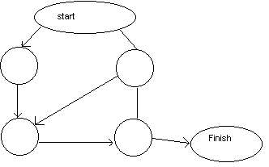
Activity Graph
Each activity has:
Precursor
Duration
Due date
End point (milestone or deliverable)

Slide 33
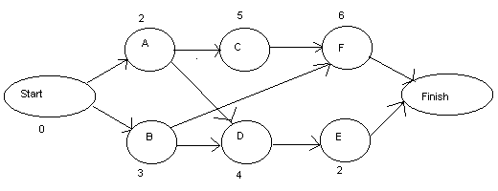
CPM Critical Path Method
http://groups.umd.umich.edu/cis/tinytools/cis375/f00/cpm/CPM(1).HTM

Slide 34
Activity
Precursor
Duration
EST
EFT
LST
LFT
Slack
Start
-
0
0
0
0
0
0
A
Start
2
0
2
0
2
0
B
Start
3
0
3
4
7
4
C
A
5
2
7
2
7
0
D
A,B
4
3
7
7
11
4
E
D
2
7
9
11
13
4
F
B,C
6
7
13
7
13
0
FINISH
E,F
0
13
13
13
13
0
EST = earliest start time, EFT = earliest finish time.
LST = latest start time, LFT = latest finish time.
Slack = (LST - EST) or (LFT - EFT).

Slide 35
CPM Equations
EST(START) always = 0, EFT(START) always = 0.
LST(START) always = 0, LFT(START) always = 0.
EFT(I) = EST(I) + DUR(I).
EST(I) = max(EFT of all predecessors).
LST(I) = LFT(I) - DUR(I).
LFT(I) = min(LST of all sucessors).
LFT(FINISH) = LST(FINISH) = EST(FINISH) = EFT(FINISH).
Critical path is all nodes with Slack = 0.

Slide 36
Program Evaluation and Review Technique
JAN
FEB
TASK
EARLIEST START
LATEST START
1
8
15
22
29
5
12
17
24
1
1/1
2/5
*
*
*
*
*
*
2
1/1
1/8
*
*
3
1/9
1/22
*
*
*
*
4
1/9
1/22
*
*
*
*
5
1/23
2/1
*
*
*
6
1/23
2/1
-
-
F
7
1/23
2/17
-
-
F
F
F
8
2/2
2/17
*
*
*
*
* = critical activity, - = non-critical, F = float or slack

Slide 37
Gantt Chart

Slide 38
Overlay Resources on Gantt Chart

Slide 39
Milestone Chart

Slide 40
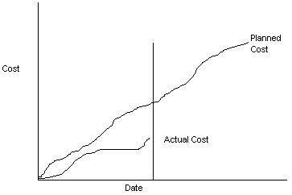
Line Graph

Slide 41
Earned Value Analysis
Earned value is a quantitative measure of percent of project completed so far.
The total hours to complete the entire project are estimated and each task is given an earned value based on its estimated percentage contribution to the total.
http://groups.umd.umich.edu/cis/course.des/cis525/js/f00/tejal/form.htm

Slide 42
Error Tracking
Allows comparison of current work to past projects and provides a quantitative indication of the quality of the work being conducted.
The more quantitative the approach to project tracking and control, the more likely problems can be anticipated and dealt with in a proactive manner.

