Slide 1
Software Engineering
CIS 375
Bruce R. Maxim
UM-Dearborn

Slide 2
What is CIS 375 about?
Project Management
Process Improvement
Object Oriented Analysis
Object Oriented Design
User Interface Design
Testing and Validation

Slide 3
Why is software engineering important?
To avoid costly errors caused by software:
Lost Voyager Spacecraft (one bad line of code caused failure)
3 Mile Island (poor user interface design)
Several people killed by a radiation machine (no means of catching operator errors)
Affordable Care Web Site (poor user interface and non-existent testing)

Slide 4
Software Crisis
Software failures receive a lot more publicity than software engineering success stories.
The software crisis predicted thirty years ago has never materialized and software engineering successes now outnumber the failures.
The problems that afflict software development are more likely to be associated with how to develop and support software properly, than with simply building software that functions correctly.

Slide 5
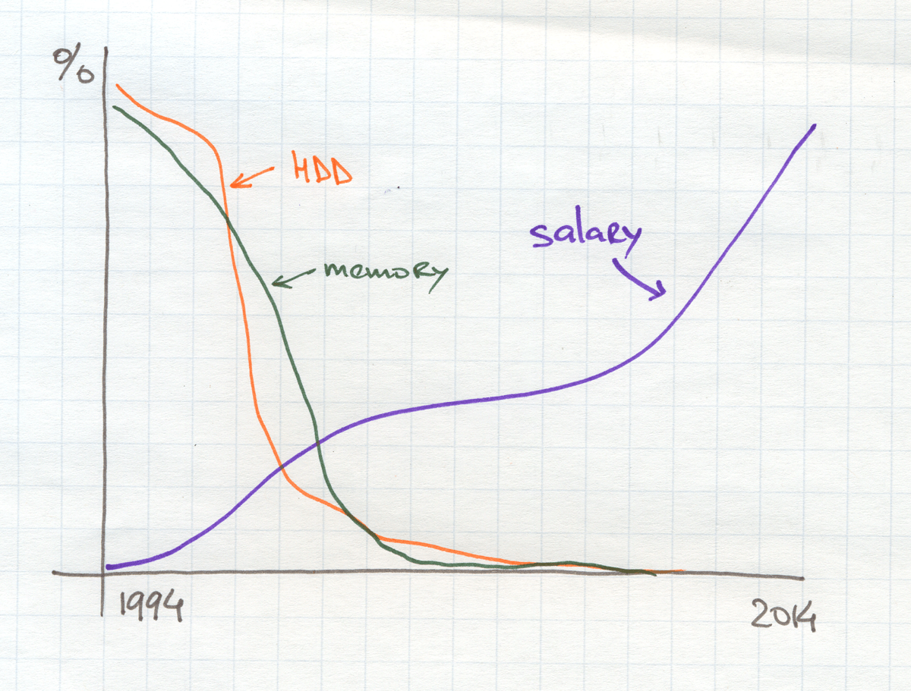
Historical Project Cost Allocation

Slide 6
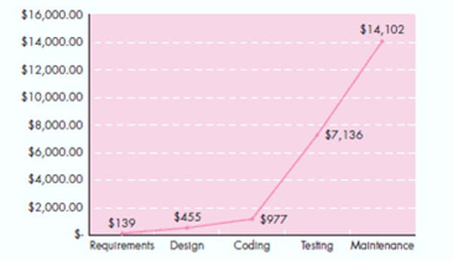
Early Error Detection
Saves Money

Slide 7
Software Characteristics
Software is both a product and a vehicle for developing a product.
Software is engineered not manufactured.
Software does not wear out, but it does deteriorate.
Most software is still custom-built.

Slide 8
Software Designer Characteristics
Studies have found that many designers tend to suffer from the “not invented here” syndrome
80% of most software errors can be discovered by peer review (proof reading) the code or document

Slide 9
Software Myths – Part 1
Software standards provide software engineers with all the guidance they need.
People with modern computers have all the software development tools they need
Adding people is a good way to catch up when a project is behind schedule.
Giving software projects to outside parties to develop solves software project management problems.

Slide 10
Software Myths – Part 2
A general statement of objectives from the customer is all that is needed to begin a software project.
Project requirements change continually and change is easy to accommodate in the software design.
Once a program is written, the software engineer's work is finished.

Slide 11
Software Myths – Part 3
There is no way to assess the quality of a piece of software until it is actually running on some machine. The only deliverable from a successful software project is the working program.
Software engineering is all about the creation of large and unnecessary documentation not shorter development times or reduced costs.

Slide 12
Software Engineering
A strategy for producing high quality software.
Software engineering encompasses a process, management techniques, technical methods, and the use of tools.

Slide 13
What is high quality software?
It must be useful (to the original customer).
It must be portable (work at all of the customer’s sites).
It must be maintainable.
It must be reliable.
It must have integrity (produces correct results, with a high degree of accuracy).

Slide 14
What is high quality software?
It must be efficient.
It must have consistency of function (it does what the user would, reasonably expect it to do).
It must be accessible (to the user).
It must have good human engineering (easy to learn and easy to use).

Slide 15
Software Engineering Phases
Definition phase
  focuses on what (information engineering, software project planning, requirements analysis).
Development phase
  focuses on how (software design, code generation, software testing).
Support phase
  focuses on change (corrective maintenance, adaptive maintenance, perfective maintenance, preventative maintenance).

Slide 16
Software Life Cycle Phases
Requirements, analysis, and design phase.
System design phase.
Program design phase.
Program implementation phase.
Unit testing phase.
Integration testing phase.
System testing phase.
System delivery.
Maintenance.

Slide 17
Umbrella Activities
Part 1
Software project tracking and control (allows team to assess progress and take corrective action to maintain schedule)
Risk management (assess risks that may affect project outcomes or quality)
Software quality assurance (activities required to maintain software quality)
Formal technical reviews (assess engineering work products to uncover and remove errors before they propagate to next activity)

Slide 18
Umbrella Activities
Part 2
Measurement (define and collect process, project, and product measures to assist team in delivering software meeting customer needs)
Software configuration management (manage effects of change)
Reusability management (defines criteria for work product reuse and establish mechanisms to achieve component reuse)
Work product preparation and production (activities to create models, documents, logs, forms, lists, etc.)

Slide 19
Waterfall Model

Slide 20
Tower Game - Resources
The mission of each team is to build a tower as high as possible using only what is placed in front of them.
Each team can have 4 members.
Material for each group:
Two A4-size sheets of construction paper per team.
One pair of scissors per team.
Two 20-inch strips of clear tape per team.
No other materials may be used.

Slide 21
Tower Game - Rules
The team engineering the tallest tower wins a prize.
The tower must be freestanding and remain freestanding for at least 60 seconds.
The tower cannot be taped to anything for support.
You must build to your planned design
If you change your design you must start over by revising your plan and get it approved.
No testing will be allowed until you have shown your work and have a tower built to ready to test - for 60 seconds free standing
NOTE – You will have no more than 20-minutes if that.

Slide 22
Why doesn’t this approach work?
Was it difficult to get the group to agree on what steps to take?
Customers are not capable of describing their needs completely or precisely.
Customers and developers like change the specifications as development proceeds

Slide 23
Prototyping Model
Quick
plan
communication
Modeling
Quick design
Deployment
delivery &
feedback
Construction
of prototype

Slide 24
Prototyping in Practice
concept definition
implementation of a skeletal system
user evaluation and concept refinement
implementation of refined requirements
user evaluation and concept refinement
implementation of refined requirements
This continues until times runs out or desired product quality and functionality is acheived

Slide 25
Airplane Prototype
Concept definition: Your team has 8 minutes to build an airplane capable of landing on a table
Implement skeletal system: Your team designs its first plane and documents the design steps
User evaluation: Test the plane’s ability to fly and land on the table

Slide 26
Refined Airplane Prototype
Evaluate the test results: What would you change about the design document or air plane
Implement skeletal system: Your team has 6 minutes to make one or more modifications to the first plane and documents the modified design steps
User evaluation: Test each plane modification on the plane’s ability to fly and land on the table

Slide 27
Throw Away Prototype
Evaluate the test results: What would you change about the design document or air plane
Implement skeletal system: Your team has 6 minutes to create a different plane and document the modified design steps
User evaluation: Test the new plane’s ability to fly and land on the table

Slide 28
Lessons Learned
Was it helpful to record your design on paper before starting construction?
Did you use text or drawings?
How did you represent the procedural nature of the design (e.g. cuts vs folds)?
How were the test results integrated into the new design?
Would adding more or different types of materials change your design?
How would you test this?
Did you expect the first prototype to land properly?

Slide 29
Spiral Model – Compromise?

Slide 30
Comparing Process Models
Part 1
Overall flow and level of interdependencies among tasks
Degree to which work tasks are defined within each framework activity
Degree to which work products are identified and required
Manner in which quality assurance activities are applied
Manner in which project tracking and control activities are applied

Slide 31
Comparing Process Models – Part 2
Overall degree of detail and rigor of process description
Degree to which stakeholders are involved in the project
Level of autonomy given to project team
Degree to which team organization and roles are prescribed

